Slide 1
Covid-19 update
10 March 2022

Slide 2
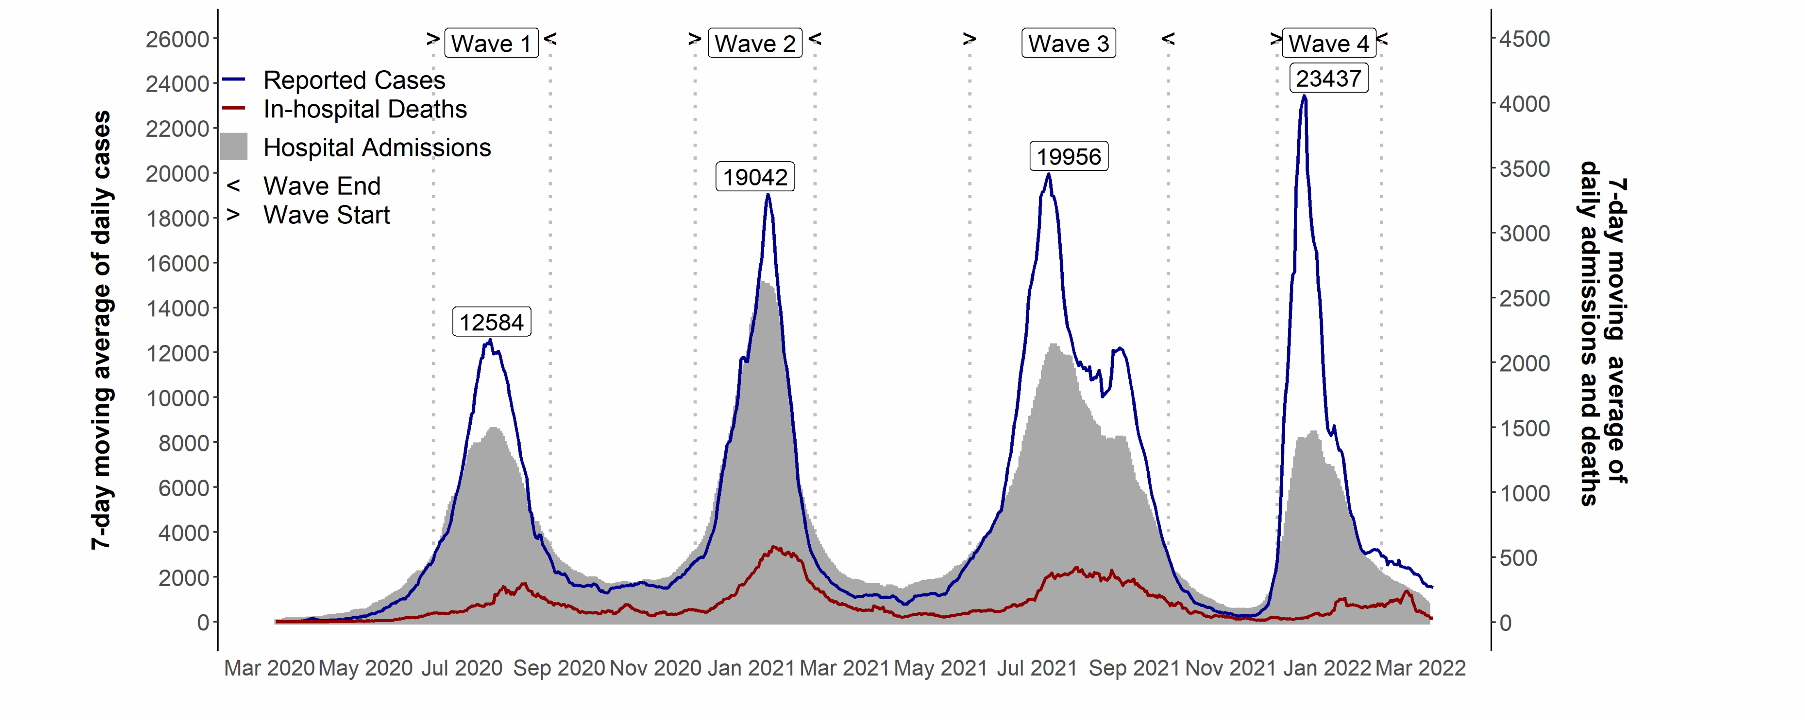
Covid-19 in South Africa
Covid-19 in South Africa
up to – 9 March 2022
  Source of hospital admissions data: Lucille Blumberg, Richard Welch and Waasila Jassat – DATCOV, NICD

Slide 3
Covid-19 in South Africa
Covid-19 in South Africa
up to - 9 March 2022
Before lockdown
Level 5
Level 4
Level 3
Level 2
Level 1
L3 adjusted
Level 3 readjusted
Level 2
Level 1
Level 3
Level 4
Level 3
Level 2
Level 1
  Source of hospital admissions data: Lucille Blumberg, Richard Welch and Waasila Jassat – DATCOV, NICD
Notes:
Level 5 – 26 March 2020
Level 4 – 1 May 2020
Level 3 – 1 June 2020
Level 2 – 16 Aug 2020
Level 1 – 20 Sept 2020
Level 3 adjusted – 29 Dec 2020
Level 3 readjusted – 6 Feb 2021
Level 1 – 4 March 2021
Level 2 – 30 May 2021
Level 3 – 16 June 2021
Level 4 – 30 June 2021
Level 3 – 26 July 2021
Level 2 – 13 September 2021
Level 1 – 1 Oct 2021

Slide 4
SARS-Cov-2 cases in 1st, 2nd & 3rd and 4th waves: South Africa
up to - 9 March 2022
23437 cases
19956 cases
19042 cases
Waves aligned at a threshold of 5 cases per 100,000 population.
12584 cases
Data source: Department of Health; Analysis: Marothi LETSOALO; Ande MCHUNU

Slide 5
Will there be a 5th wave in South Africa?
3 Feb
8 May
Note: New variant and other factors may change epidemic trajectory. These estimations are based on several assumptions and not on mathematical modelling

Slide 6

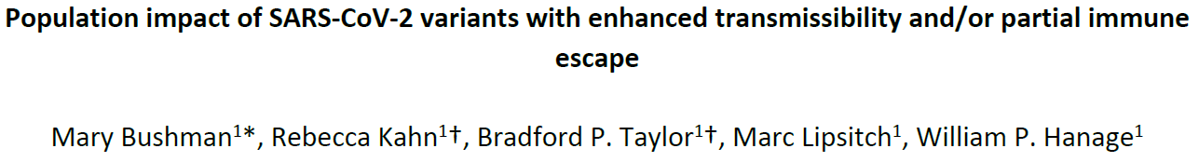
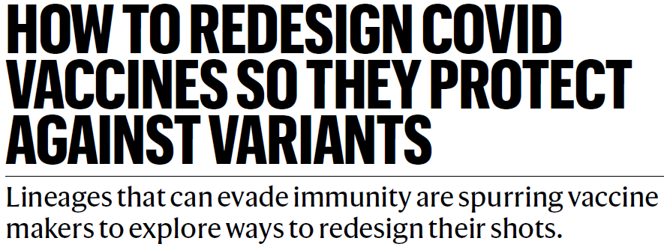

Predicting the impact of (& preparing for) future immune escape variants on the pandemic
Population impact of SARS-CoV-2 variants with enhanced transmissibility and/or partial immune
Moderate immune escape poses a low risk unless there is ↑ transmissibility

Slide 7
Average daily tests and proportion of positive tests
up to - 9 March 2022
Cumulative number tests 4 Mar 2020 – 09 March 2022 = 23314522
  Data source: Department of Health

Slide 8
Estimated effective reproduction rate (R) of Covid-19 in South Africa
up to - 4 March 2022
  Source: Our World in Data; data explorer; Johns Hopkins University COVID-19 Dashboard

Slide 9
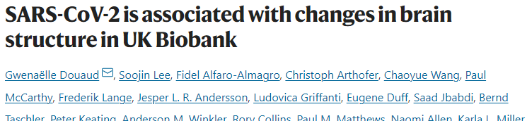

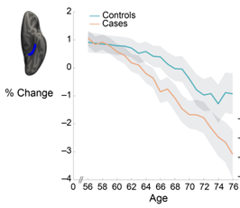
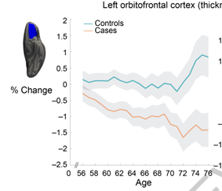
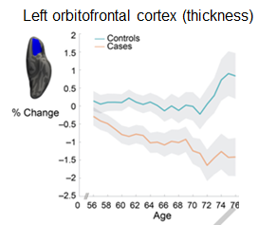
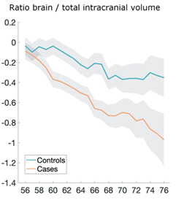
Left parahippocampal gyrus (contrast)
Left orbitofrontal cortex (thickness)
785 UK Biobank participants imaged twice 141 days apart (401 Covid+ between two scans)
Covid+ participants → larger cognitive decline between two timepoints
Effects of SARS-CoV-2 infection:
Smaller brain size
↓ in grey matter thickness
Effect marked in olfactory region
Notes:
Douaud, G., Lee, S., Alfaro-Almagro, F. et al. SARS-CoV-2 is associated with changes in brain structure in UK Biobank. Nature (2022). https://doi.org/10.1038/s41586-022-04569-5

Slide 10
Proportion of individuals vaccinated as % of adult population
  Source: Department of Health. https://sacoronavirus.co.za/latest-vaccine-statistics/

Slide 11
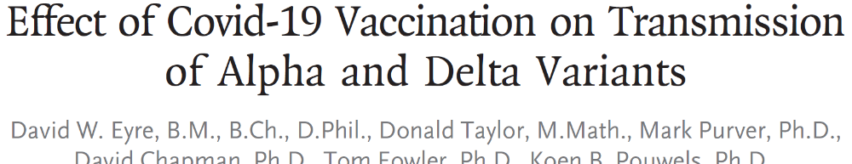

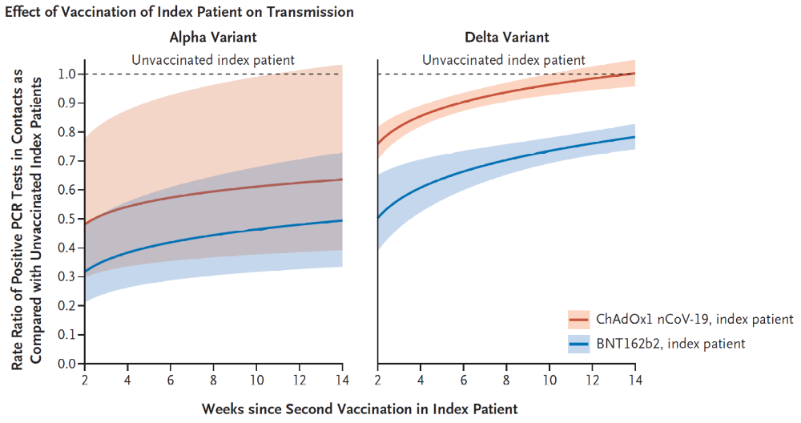
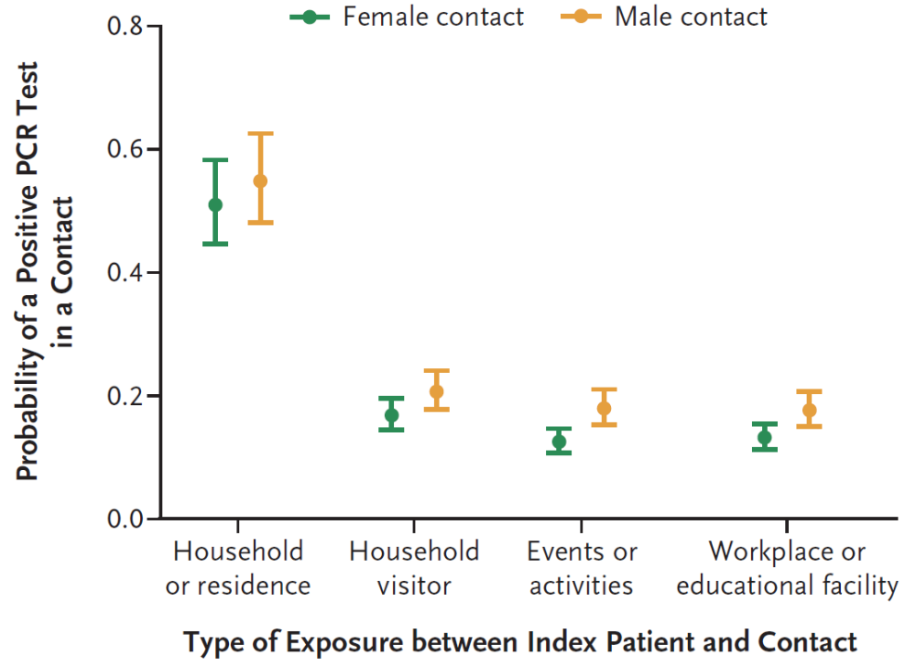
Vaccination reduced transmission SARS-CoV-2 to contacts (in two variants)
146,243 contacts of 108,498 index patients tested (37% +)
Pfizer (X2) or AstraZeneca (X2) → reduced infection by 68% and 52% in contacts when compared to infections in contacts of unvaccinated
Vaccine → lower viral load –
↓ infectiousness
Residence contacts – high risk

Slide 12
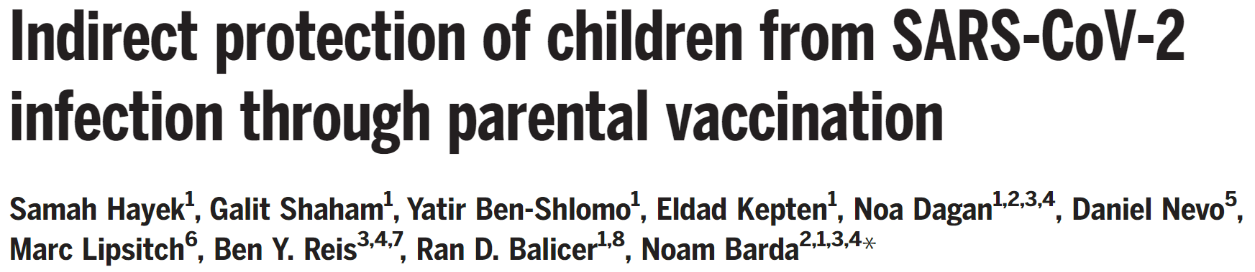

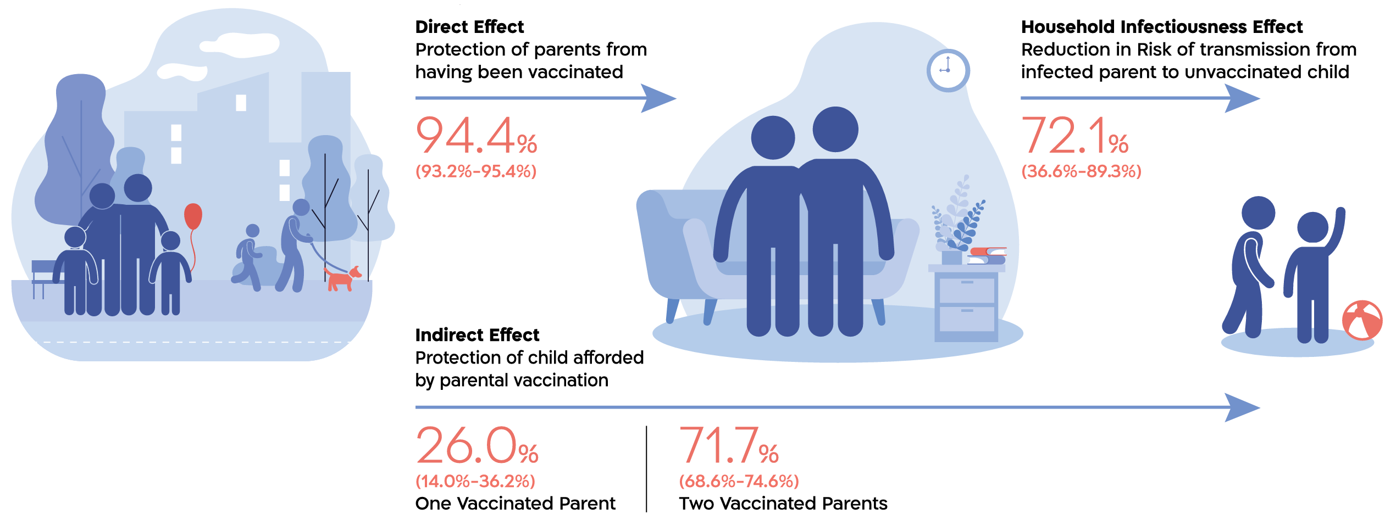
Two-parent homes with at least one vaccine-ineligible child
Children with two parents vaccinated - 72% lower risk of getting infected

Slide 13
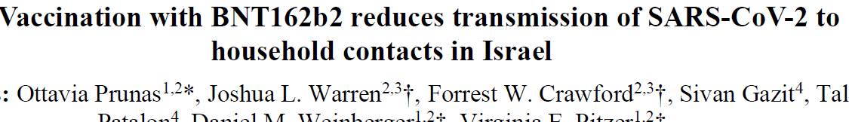

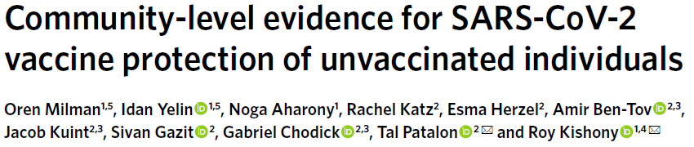

↓ infections in unvaccinated in communities with high mRNA vaccination coverage
Transmission in 253,564 individuals in 65,624 households in Israel –
in unvaccinated: 79% ↓ infection in those exposed to vaccinated vs unvaccinated infected household contacts
Each 20% ↑ in vaccination → positive tests ↓ ~50% in unvaccinated people

Slide 14
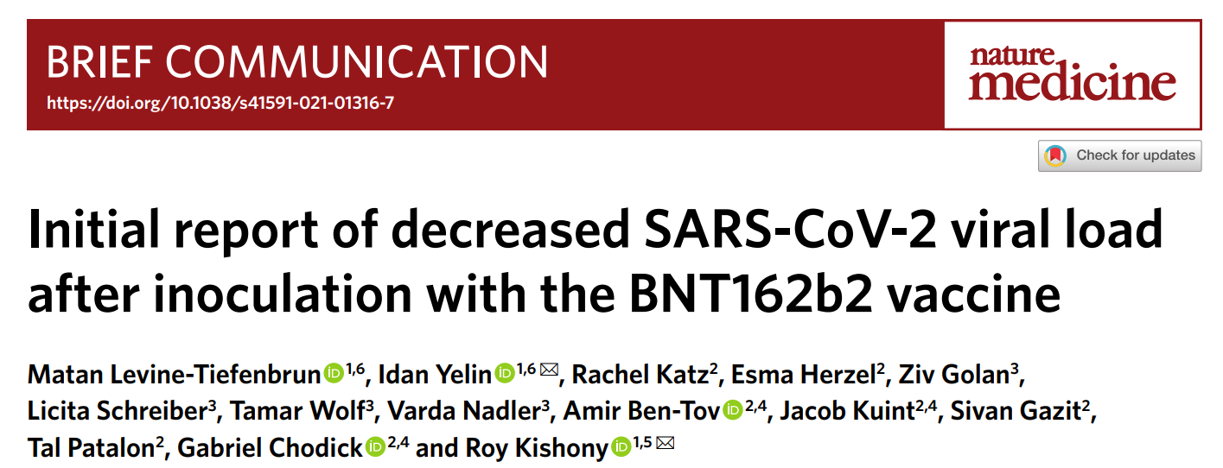
Covid-19 vaccines reduce infectiousness by
↓ virus levels which ↓spread of the virus
Reducing infectiousness:
Pfizer: Significant drop in viral load from about 2-4 weeks after 1st dose
AstraZeneca: lower viral load in vaccinated compared to unvaccinated
Sources: Mallapaty S. Can COVID vaccines stop transmission? Scientists race to find answers. Nature. 2021 Feb 19;10;
Levine-Tiefenbrun, M., Yelin, I., Katz, R. et al. Initial report of decreased SARS-CoV-2 viral load after inoculation with the BNT162b2 vaccine. Nat Med 27, 790–792 (2021).

Slide 15


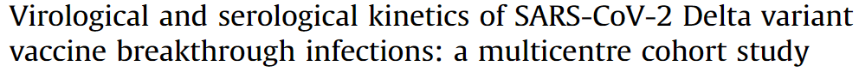
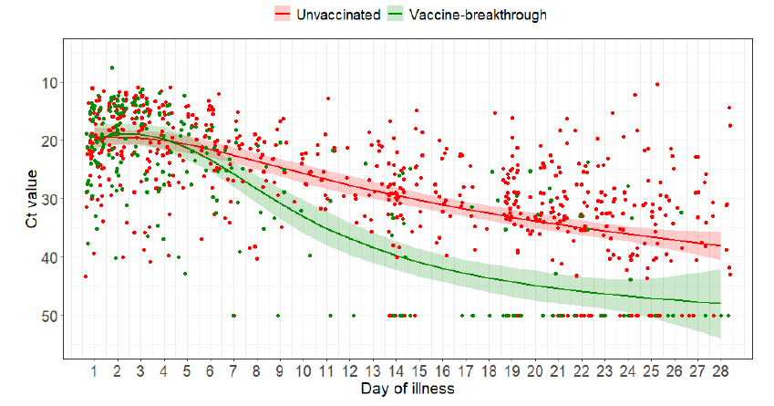
Vaccines – Community benefit by more rapidly declining viral load in vaccinated vs unvaccinated
Chia PY, Ong SW, Chiew CJ, Ang LW, Chavatte JM, Mak TM, Cui L, Kalimuddin S, Chia WN, Tan CW, Chai LY.
218 individuals in Singapore:
(88 vaccinated, 130 unvaccinated)
Delta - viral loads ↓ faster in vaccinated
Omicron has a higher viral load than Delta (↓ Ct) – do vaccines Omicron ↓ VL?

Slide 16
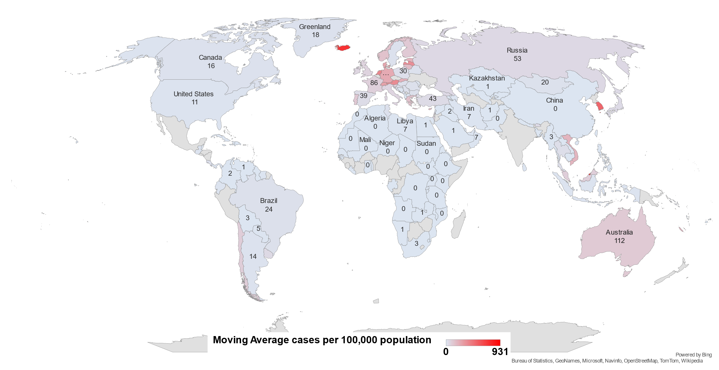
Global Covid-19 epidemic
7-day moving average cases per 100,000 population
up to - 9 March 2022
  Source: Our World in Data
Notes:
Needs the date of this analysis. Make sure it is no later than a day or two behind the date on which we send It out.

Slide 17
Covid-19 in Africa
Omicron variant drives 4th wave
up to - 9 March 2022
* 450 million cumulative global case and 6 million deaths
  Data Source: Our World in Data; NICD

Slide 18

Expected & actual all-cause deaths during Covid-19
Before lockdown
Excess deaths: 1007
Covid-19 deaths : 2
L5
Excess deaths: -4,276
Covid-19 deaths: 121
L4
Excess deaths:
-2,794
Covid-19 deaths: 525
L3
Excess deaths:
33,295
Covid-19 deaths:
11,008
L2
Excess deaths: 5,578
Covid-19 deaths: 4,363
L1
Excess deaths:
27,677
Covid-19 deaths:
10,581
L3
Excess deaths: 59,966
Covid-19 deaths: 17,430
L2
Excess deaths:6,728
Covid-19 deaths: 1343
L2
Excess deaths: 6,050
Covid-19 deaths: 3,002
L3 (readjusted)
Excess deaths: 12,544
Covid-19 deaths: 5,990
L3
Excess deaths: 7,852
Covid-19 deaths: 2,072
L1
Excess deaths: 4,287
Covid-19 deaths: 1,410
L1
Excess deaths:22,484
Covid-19 deaths: 6,455
L4: Excess deaths: 34,671
Covid-19 deaths: 9,710
L3
Excess deaths: 39,527
Covid-19 deaths: 15,263
Source: Bradshaw D, et al
Notes:
Level 5 – 26 March 2020
Level 4 – 1 May 2020
Level 3 – 1 June 2020
Level 2 – 16 Aug 2020
Level 1 – 20 Sept 2020
Level 3 adjusted – 29 Dec 2020
Level 3 readjusted – 6 Feb 2021
Level 1 – 4 March 2021
Level 2 – 30 May 2021
Level 3 – 16 June 2021
Level 4 – 30 June 2021
Level 3 – 26 July 2021
Level 2 – 13 September 2021
Level 1 – 1 Oct 2021

Slide 19
Weekly excess all cause deaths & reported Covid-19 deaths
Before lockdown
Excess deaths: 1007
Covid-19 deaths : 2
L5
Excess deaths: -4,276
Covid-19 deaths: 121
L4
Excess deaths:
-2,794
Covid-19 deaths: 525
L3
Excess deaths:
33,295
Covid-19 deaths:
11,008
L2
Excess deaths: 5,578
Covid-19 deaths: 4,363
L1
Excess deaths:
27,677
Covid-19 deaths:
10,581
L3
Excess deaths: 59,966
Covid-19 deaths: 17,430
L2
Excess deaths:6,728
Covid-19 deaths: 1343
L3 (readjusted)
Excess deaths: 12,544
Covid-19 deaths: 5,990
L3
Excess deaths: 7,852
Covid-19 deaths: 2,072
L4: Excess deaths: 34,671
Covid-19 deaths: 9,710
L1
Excess deaths:22,484
Covid-19 deaths: 6,455
L3
Excess deaths: 39,527
Covid-19 deaths: 15,263
L2
Excess deaths: 6,050
Covid-19 deaths: 3,002
L1
Excess deaths: 4,287
Covid-19 deaths: 1,410
Source: Bradshaw D, et al
Notes:
No update this week
Level 5 – 26 March 2020
Level 4 – 1 May 2020
Level 3 – 1 June 2020
Level 2 – 16 Aug 2020
Level 1 – 20 Sept 2020
Level 3 adjusted – 29 Dec 2020
Level 3 readjusted – 6 Feb 2021
Level 1 – 4 March 2021
Level 2 – 30 May 2021
Level 3 – 16 June 2021
Level 4 – 30 June 2021
Level 3 – 26 July 2021

Slide 20
Provincial SARS-CoV-2 cases in the 4 waves

Slide 21
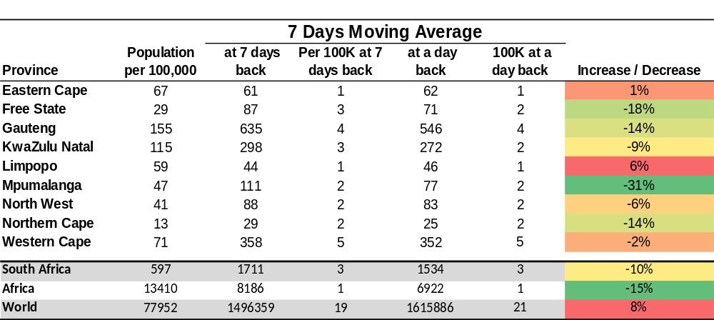
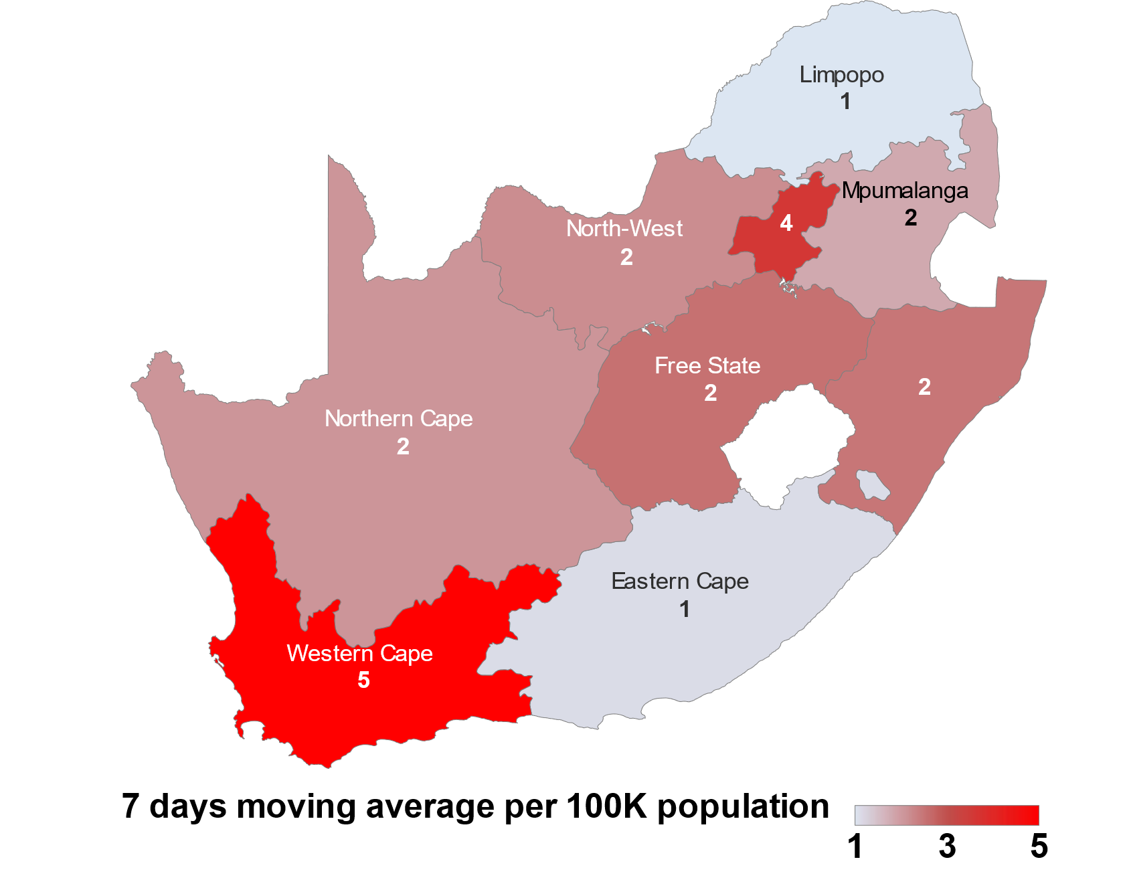
Daily new cases over last 7 days/100,000
up to - 9 March 2022
  Data source: Department of Health

Slide 22
Confirmed SARS-Cov-2 cases by province
  Data source: Department of Health; Analysis

Slide 23
SARS-Cov-2 cases in 1st, 2nd & 3rd and 4th waves: Gauteng
  Data source: Department of Health; Analysis: Marothi Letsoalo; Ande Mchunu
Notes:
No update this week
Level 5 – 26 March 2020
Level 4 – 1 May 2020
Level 3 – 1 June 2020
Level 2 – 16 Aug 2020
Level 1 – 20 Sept 2020
Level 3 adjusted – 29 Dec 2020
Level 3 readjusted – 6 Feb 2021
Level 1 – 4 March 2021
Level 2 – 30 May 2021
Level 3 – 16 June 2021
Level 4 – 30 June 2021
Level 3 – 26 July 2021

Slide 24
SARS-Cov-2 cases in 1st, 2nd & 3rd and 4th waves: Limpopo
  Data source: Department of Health; Analysis: Marothi Letsoalo; Ande Mchunu
Notes:
No update this week
Level 5 – 26 March 2020
Level 4 – 1 May 2020
Level 3 – 1 June 2020
Level 2 – 16 Aug 2020
Level 1 – 20 Sept 2020
Level 3 adjusted – 29 Dec 2020
Level 3 readjusted – 6 Feb 2021
Level 1 – 4 March 2021
Level 2 – 30 May 2021
Level 3 – 16 June 2021
Level 4 – 30 June 2021
Level 3 – 26 July 2021

Slide 25
SARS-Cov-2 cases in 1st, 2nd & 3rd and 4th waves: North West
1369 cases
1300 cases
768 cases
  Data source: Department of Health; Analysis: Marothi Letsoalo; Ande Mchunu
Notes:
No update this week
Level 5 – 26 March 2020
Level 4 – 1 May 2020
Level 3 – 1 June 2020
Level 2 – 16 Aug 2020
Level 1 – 20 Sept 2020
Level 3 adjusted – 29 Dec 2020
Level 3 readjusted – 6 Feb 2021
Level 1 – 4 March 2021
Level 2 – 30 May 2021
Level 3 – 16 June 2021
Level 4 – 30 June 2021
Level 3 – 26 July 2021

Slide 26
SARS-Cov-2 cases in 1st, 2nd & 3rd and 4th waves: Mpumalanga
  Data source: Department of Health; Analysis: Marothi Letsoalo; Ande Mchunu
Notes:
No update this week
Level 5 – 26 March 2020
Level 4 – 1 May 2020
Level 3 – 1 June 2020
Level 2 – 16 Aug 2020
Level 1 – 20 Sept 2020
Level 3 adjusted – 29 Dec 2020
Level 3 readjusted – 6 Feb 2021
Level 1 – 4 March 2021
Level 2 – 30 May 2021
Level 3 – 16 June 2021
Level 4 – 30 June 2021
Level 3 – 26 July 2021

Slide 27
SARS-Cov-2 cases in 1st, 2nd & 3rd and 4th waves: Northern Cape
  Data source: Department of Health; Analysis: Marothi Letsoalo; Ande Mchunu
Notes:
No update this week
Level 5 – 26 March 2020
Level 4 – 1 May 2020
Level 3 – 1 June 2020
Level 2 – 16 Aug 2020
Level 1 – 20 Sept 2020
Level 3 adjusted – 29 Dec 2020
Level 3 readjusted – 6 Feb 2021
Level 1 – 4 March 2021
Level 2 – 30 May 2021
Level 3 – 16 June 2021
Level 4 – 30 June 2021
Level 3 – 26 July 2021

Slide 28
SARS-Cov-2 cases in 1st, 2nd & 3rd and 4th waves: Free State
  Data source: Department of Health; Analysis: Marothi Letsoalo; Ande Mchunu
Notes:
No update this week
Level 5 – 26 March 2020
Level 4 – 1 May 2020
Level 3 – 1 June 2020
Level 2 – 16 Aug 2020
Level 1 – 20 Sept 2020
Level 3 adjusted – 29 Dec 2020
Level 3 readjusted – 6 Feb 2021
Level 1 – 4 March 2021
Level 2 – 30 May 2021
Level 3 – 16 June 2021
Level 4 – 30 June 2021
Level 3 – 26 July 2021

Slide 29
SARS-Cov-2 cases in 1st, 2nd & 3rd and 4th waves: KwaZulu Natal
  Data source: Department of Health; Analysis: Marothi Letsoalo; Ande Mchunu
Notes:
No update this week
Level 5 – 26 March 2020
Level 4 – 1 May 2020
Level 3 – 1 June 2020
Level 2 – 16 Aug 2020
Level 1 – 20 Sept 2020
Level 3 adjusted – 29 Dec 2020
Level 3 readjusted – 6 Feb 2021
Level 1 – 4 March 2021
Level 2 – 30 May 2021
Level 3 – 16 June 2021
Level 4 – 30 June 2021
Level 3 – 26 July 2021

Slide 30
SARS-Cov-2 cases in 1st, 2nd & 3rd and 4th waves: Western Cape
3629 cases
3256 cases
  Data source: Department of Health; Analysis: Marothi Letsoalo; Ande Mchunu
Notes:
No update this week
Level 5 – 26 March 2020
Level 4 – 1 May 2020
Level 3 – 1 June 2020
Level 2 – 16 Aug 2020
Level 1 – 20 Sept 2020
Level 3 adjusted – 29 Dec 2020
Level 3 readjusted – 6 Feb 2021
Level 1 – 4 March 2021
Level 2 – 30 May 2021
Level 3 – 16 June 2021
Level 4 – 30 June 2021
Level 3 – 26 July 2021

Slide 31
SARS-Cov-2 cases in 1st, 2nd & 3rd and 4th waves: Eastern Cape
  Data source: Department of Health; Analysis: Marothi Letsoalo; Ande Mchunu
Notes:
No update this week
Level 5 – 26 March 2020
Level 4 – 1 May 2020
Level 3 – 1 June 2020
Level 2 – 16 Aug 2020
Level 1 – 20 Sept 2020
Level 3 adjusted – 29 Dec 2020
Level 3 readjusted – 6 Feb 2021
Level 1 – 4 March 2021
Level 2 – 30 May 2021
Level 3 – 16 June 2021
Level 4 – 30 June 2021
Level 3 – 26 July 2021

