Slide 1
COVID-19 UPDATES
08 May 2022

Slide 2
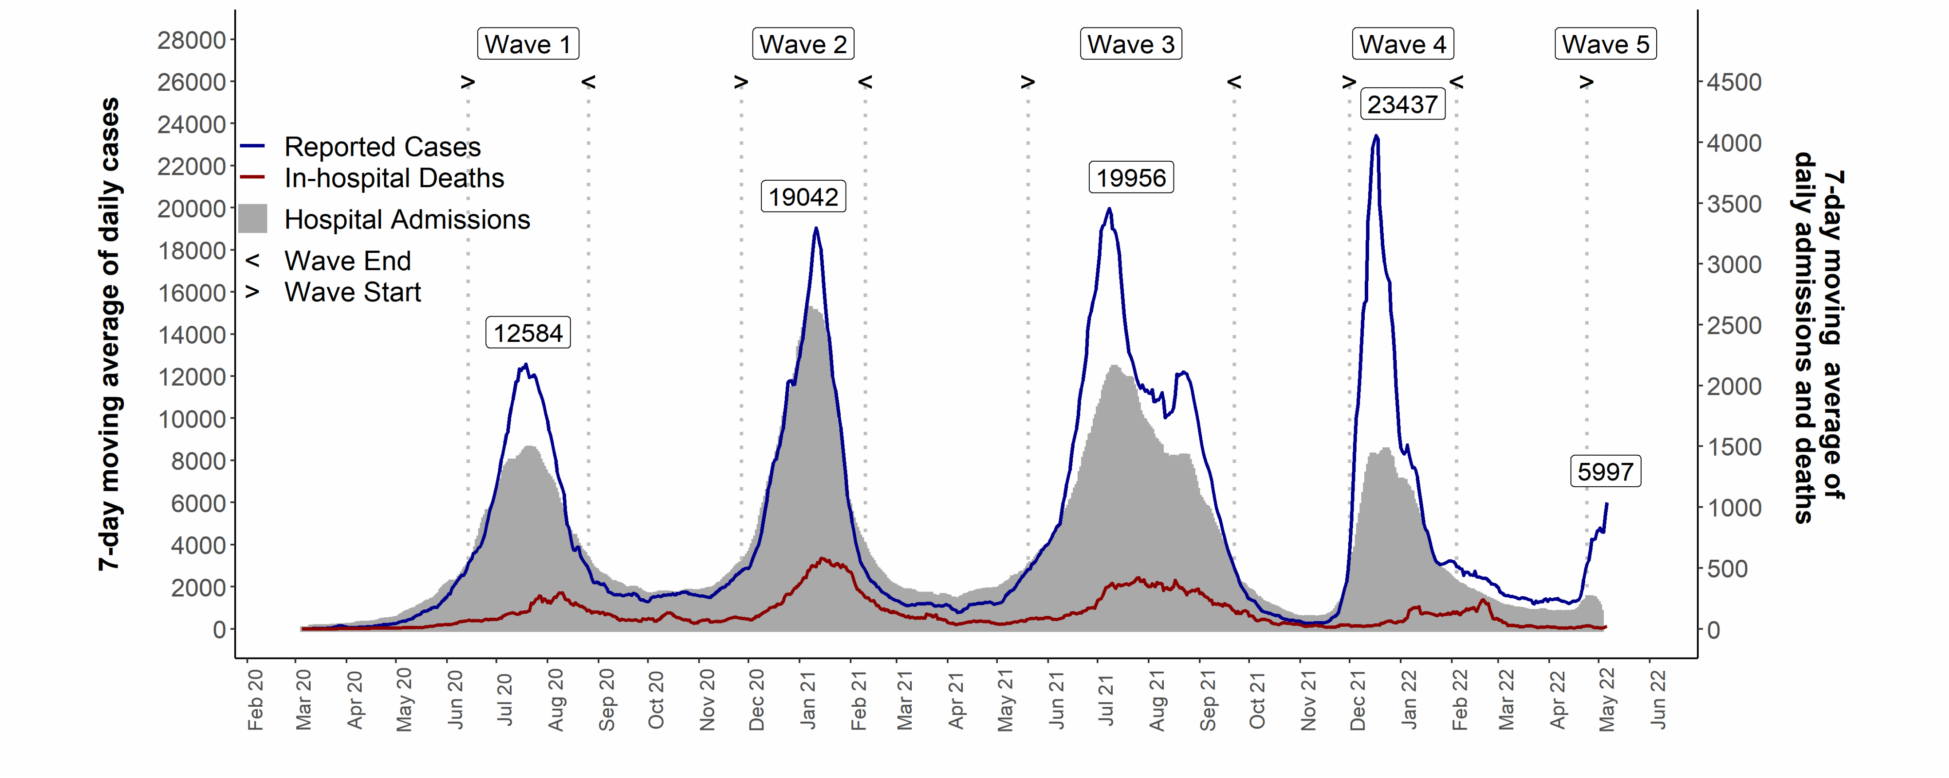
Covid-19 in South Africa
Covid-19 in South Africa
up to - 06 May 2022
  Source of hospital admissions data: Lucille Blumberg, Richard Welch and Waasila Jassat – DATCOV, NICD

Slide 3
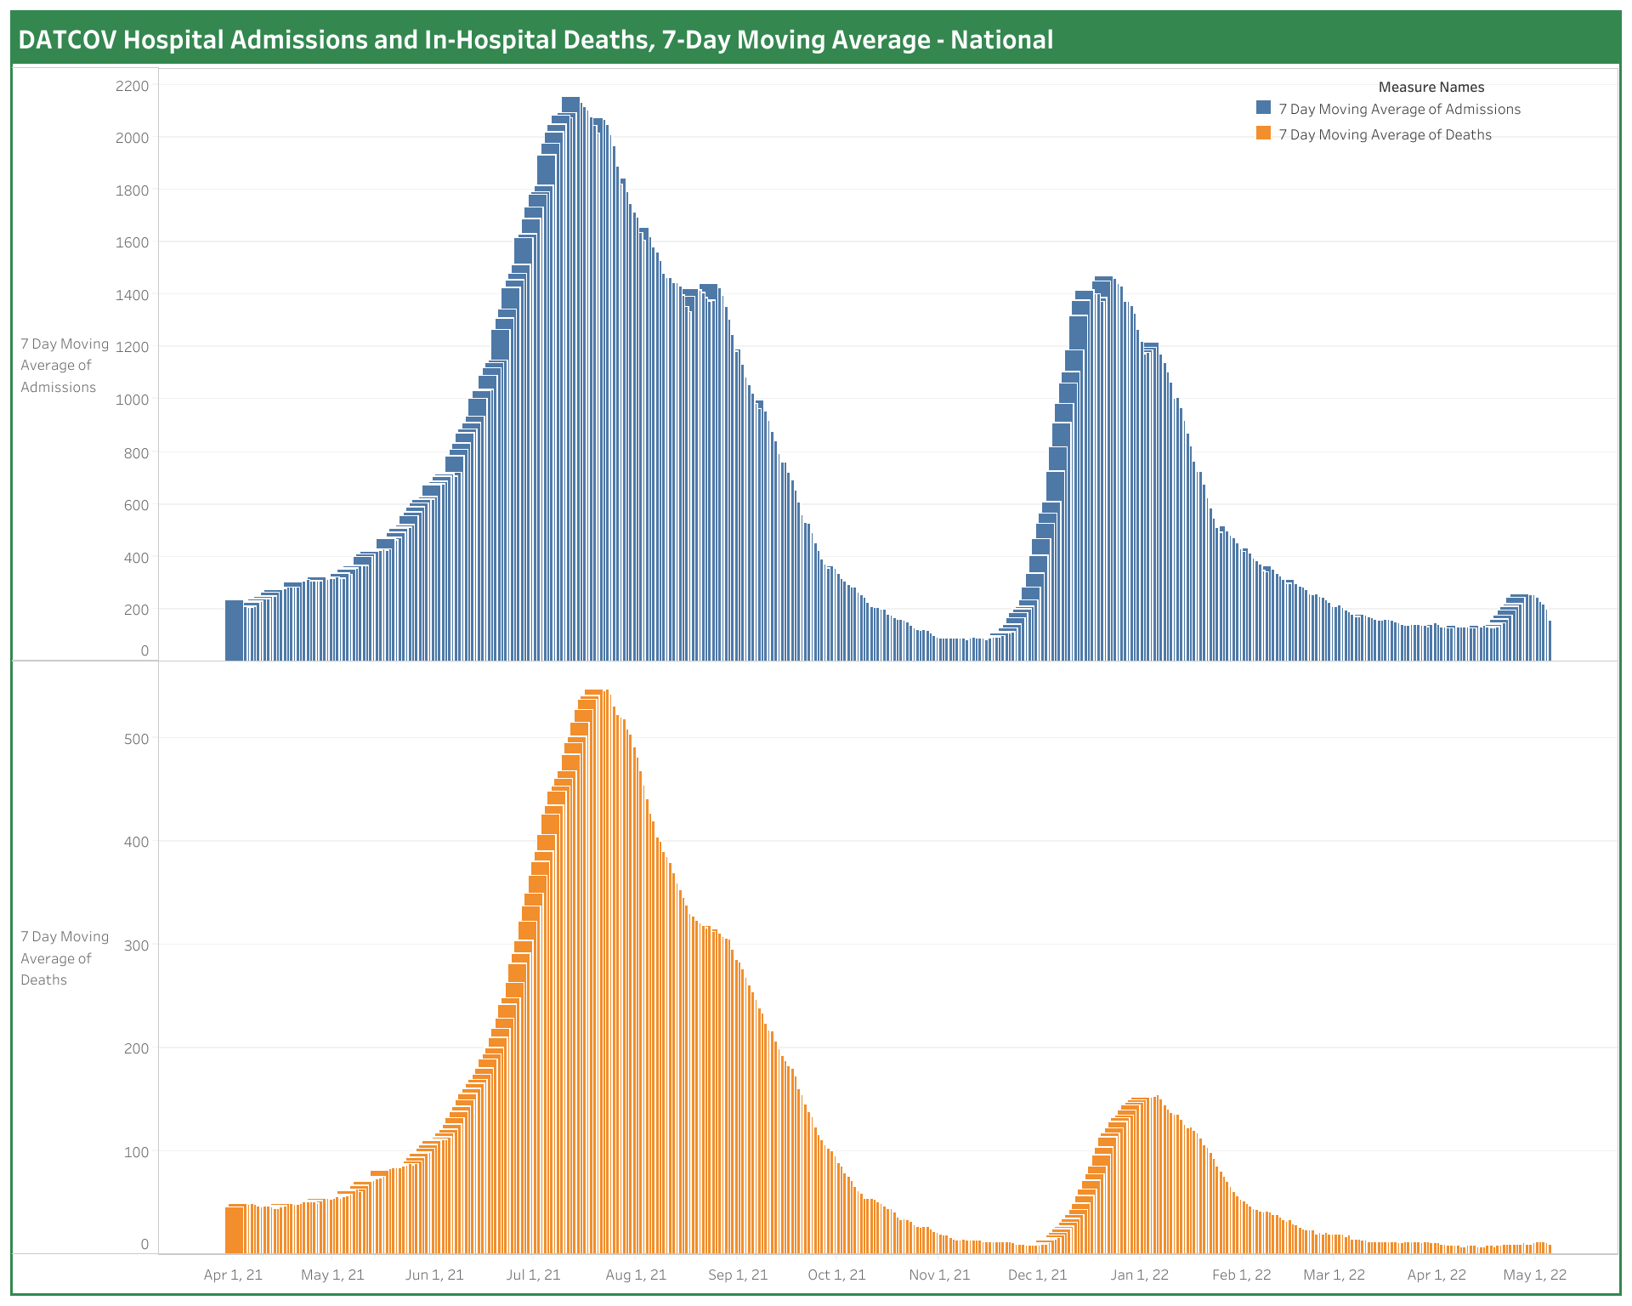
South Africa:
National hospital admissions & in-hospital deaths
Data up to - 03 May 2022
  Analysis: National Surveillance Centre Team (NDoH AMD); Diagram from Amanda Brewer, NDoH
Notes:
Level 5 – 26 March 2020
Level 4 – 1 May 2020
Level 3 – 1 June 2020
Level 2 – 16 Aug 2020
Level 1 – 20 Sept 2020
Level 3 adjusted – 29 Dec 2020
Level 3 readjusted – 6 Feb 2021
Level 1 – 4 March 2021
Level 2 – 30 May 2021
Level 3 – 16 June 2021
Level 4 – 30 June 2021
Level 3 – 26 July 2021
Level 2 – 13 September 2021
Level 1 – 1 Oct 2021

Slide 4
SARS-Cov-2 cases in 1st, 2nd & 3rd and 4th waves: South Africa
up to - 06 May 2022
Waves aligned at a threshold of 5 cases per 100,000 population.
Data source: Department of Health; Analysis: Marothi LETSOALO; Ande MCHUNU

Slide 5
Will there be a 5th wave in South Africa?
3 Feb
8 May
Note: New variant and other factors may change epidemic trajectory. These estimations are based on several assumptions and not on mathematical modelling

Slide 6

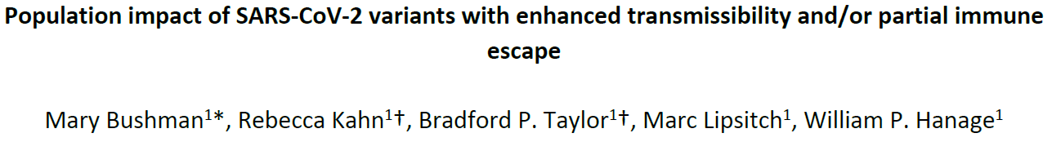
What will Pi look like? - Predicting the impact of future immune escape variants on the pandemic
Population impact of SARS-CoV-2 variants with enhanced transmissibility and/or partial immune
Characteristics of future variants:
More transmissible – faster doubling time
Immune escape – causes infection in those with natural & vaccine immunity
Moderate immune escape poses a low risk unless there is ↑ transmissibility
Severity due to viral virulence & existing immunity – past infection & vaccination

Slide 7
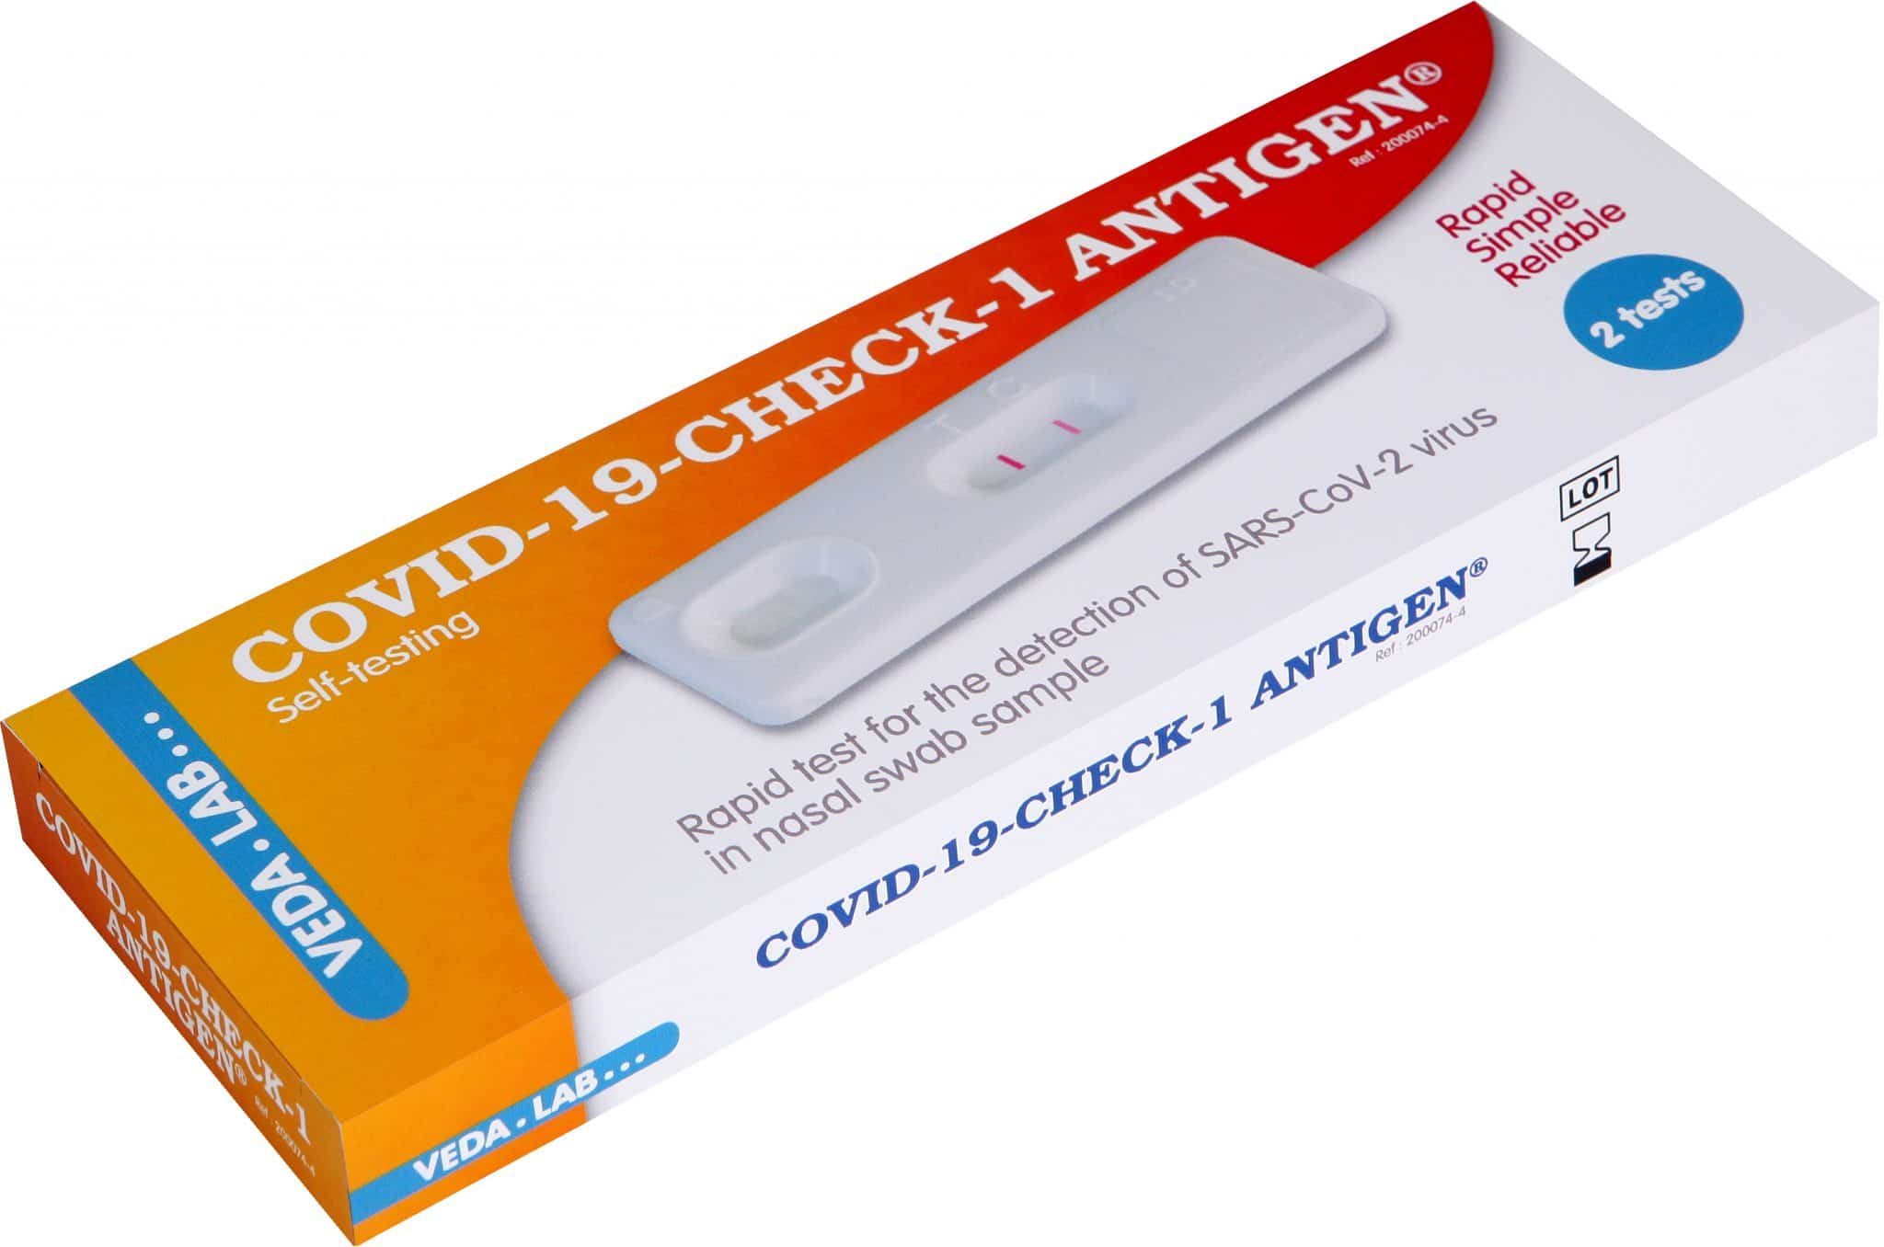
What Covid-19 measures to maintain?
Testing: increased access to testing, including home rapid
antigen tests (isolation of Covid+ to continue), for ongoing
surveillance through diagnostic & phylogenetic sequencing
Restrictions on indoor mass gatherings (e.g., Ballito Rage)
Indoor mask requirement – shops, malls, public transport, offices etc.
Vaccine requirement to enter public indoor spaces, e.g., shops & malls
Prepare for next wave: may need to increase restrictions again

Slide 8
Estimated effective reproduction rate (R) of Covid-19 in South Africa
up to - 01 May 2022
  Source: Our World in Data; data explorer; Johns Hopkins University COVID-19 Dashboard

Slide 9
Average daily tests and proportion of positive tests
up to – 06 May 2022
Cumulative number tests 4 Mar 2020 – 06 May 2022 = 24626847
  Data source: Department of Health

Slide 10
Proportion of individuals vaccinated as % of adult population
  Source: Department of Health. https://sacoronavirus.co.za/latest-vaccine-statistics/

Slide 11

Expected & actual all-cause deaths during Covid-19
Before lockdown
Excess deaths: 1007
Covid-19 deaths : 2
L5
Excess deaths: -4,276
Covid-19 deaths: 121
L4
Excess deaths:
-2,794
Covid-19 deaths: 525
L3
Excess deaths:
33,295
Covid-19 deaths:
11,008
L2
Excess deaths: 5,578
Covid-19 deaths: 4,363
L1
Excess deaths:
27,677
Covid-19 deaths:
10,581
L3
Excess deaths: 59,966
Covid-19 deaths: 17,430
L2
Excess deaths:6,728
Covid-19 deaths: 1343
L2
Excess deaths: 6,050
Covid-19 deaths: 3,002
L3 (readjusted)
Excess deaths: 12,544
Covid-19 deaths: 5,990
L3
Excess deaths: 7,852
Covid-19 deaths: 2,072
L1
Excess deaths: 4,287
Covid-19 deaths: 1,410
L1
Excess deaths:22,484
Covid-19 deaths: 6,455
L4: Excess deaths: 34,671
Covid-19 deaths: 9,710
L3
Excess deaths: 39,527
Covid-19 deaths: 15,263
Source: Bradshaw D, et al
Notes:
Level 5 – 26 March 2020
Level 4 – 1 May 2020
Level 3 – 1 June 2020
Level 2 – 16 Aug 2020
Level 1 – 20 Sept 2020
Level 3 adjusted – 29 Dec 2020
Level 3 readjusted – 6 Feb 2021
Level 1 – 4 March 2021
Level 2 – 30 May 2021
Level 3 – 16 June 2021
Level 4 – 30 June 2021
Level 3 – 26 July 2021
Level 2 – 13 September 2021
Level 1 – 1 Oct 2021

Slide 12
Weekly excess all cause deaths & reported Covid-19 deaths
Before lockdown
Excess deaths: 1007
Covid-19 deaths : 2
L5
Excess deaths: -4,276
Covid-19 deaths: 121
L4
Excess deaths:
-2,794
Covid-19 deaths: 525
L3
Excess deaths:
33,295
Covid-19 deaths:
11,008
L2
Excess deaths: 5,578
Covid-19 deaths: 4,363
L1
Excess deaths:
27,677
Covid-19 deaths:
10,581
L3
Excess deaths: 59,966
Covid-19 deaths: 17,430
L2
Excess deaths:6,728
Covid-19 deaths: 1343
L3 (readjusted)
Excess deaths: 12,544
Covid-19 deaths: 5,990
L3
Excess deaths: 7,852
Covid-19 deaths: 2,072
L4: Excess deaths: 34,671
Covid-19 deaths: 9,710
L1
Excess deaths:22,484
Covid-19 deaths: 6,455
L3
Excess deaths: 39,527
Covid-19 deaths: 15,263
L2
Excess deaths: 6,050
Covid-19 deaths: 3,002
L1
Excess deaths: 4,287
Covid-19 deaths: 1,410
Source: Bradshaw D, et al

Slide 13
Global epidemiology:
Reported cases by country, region and the world

Slide 14
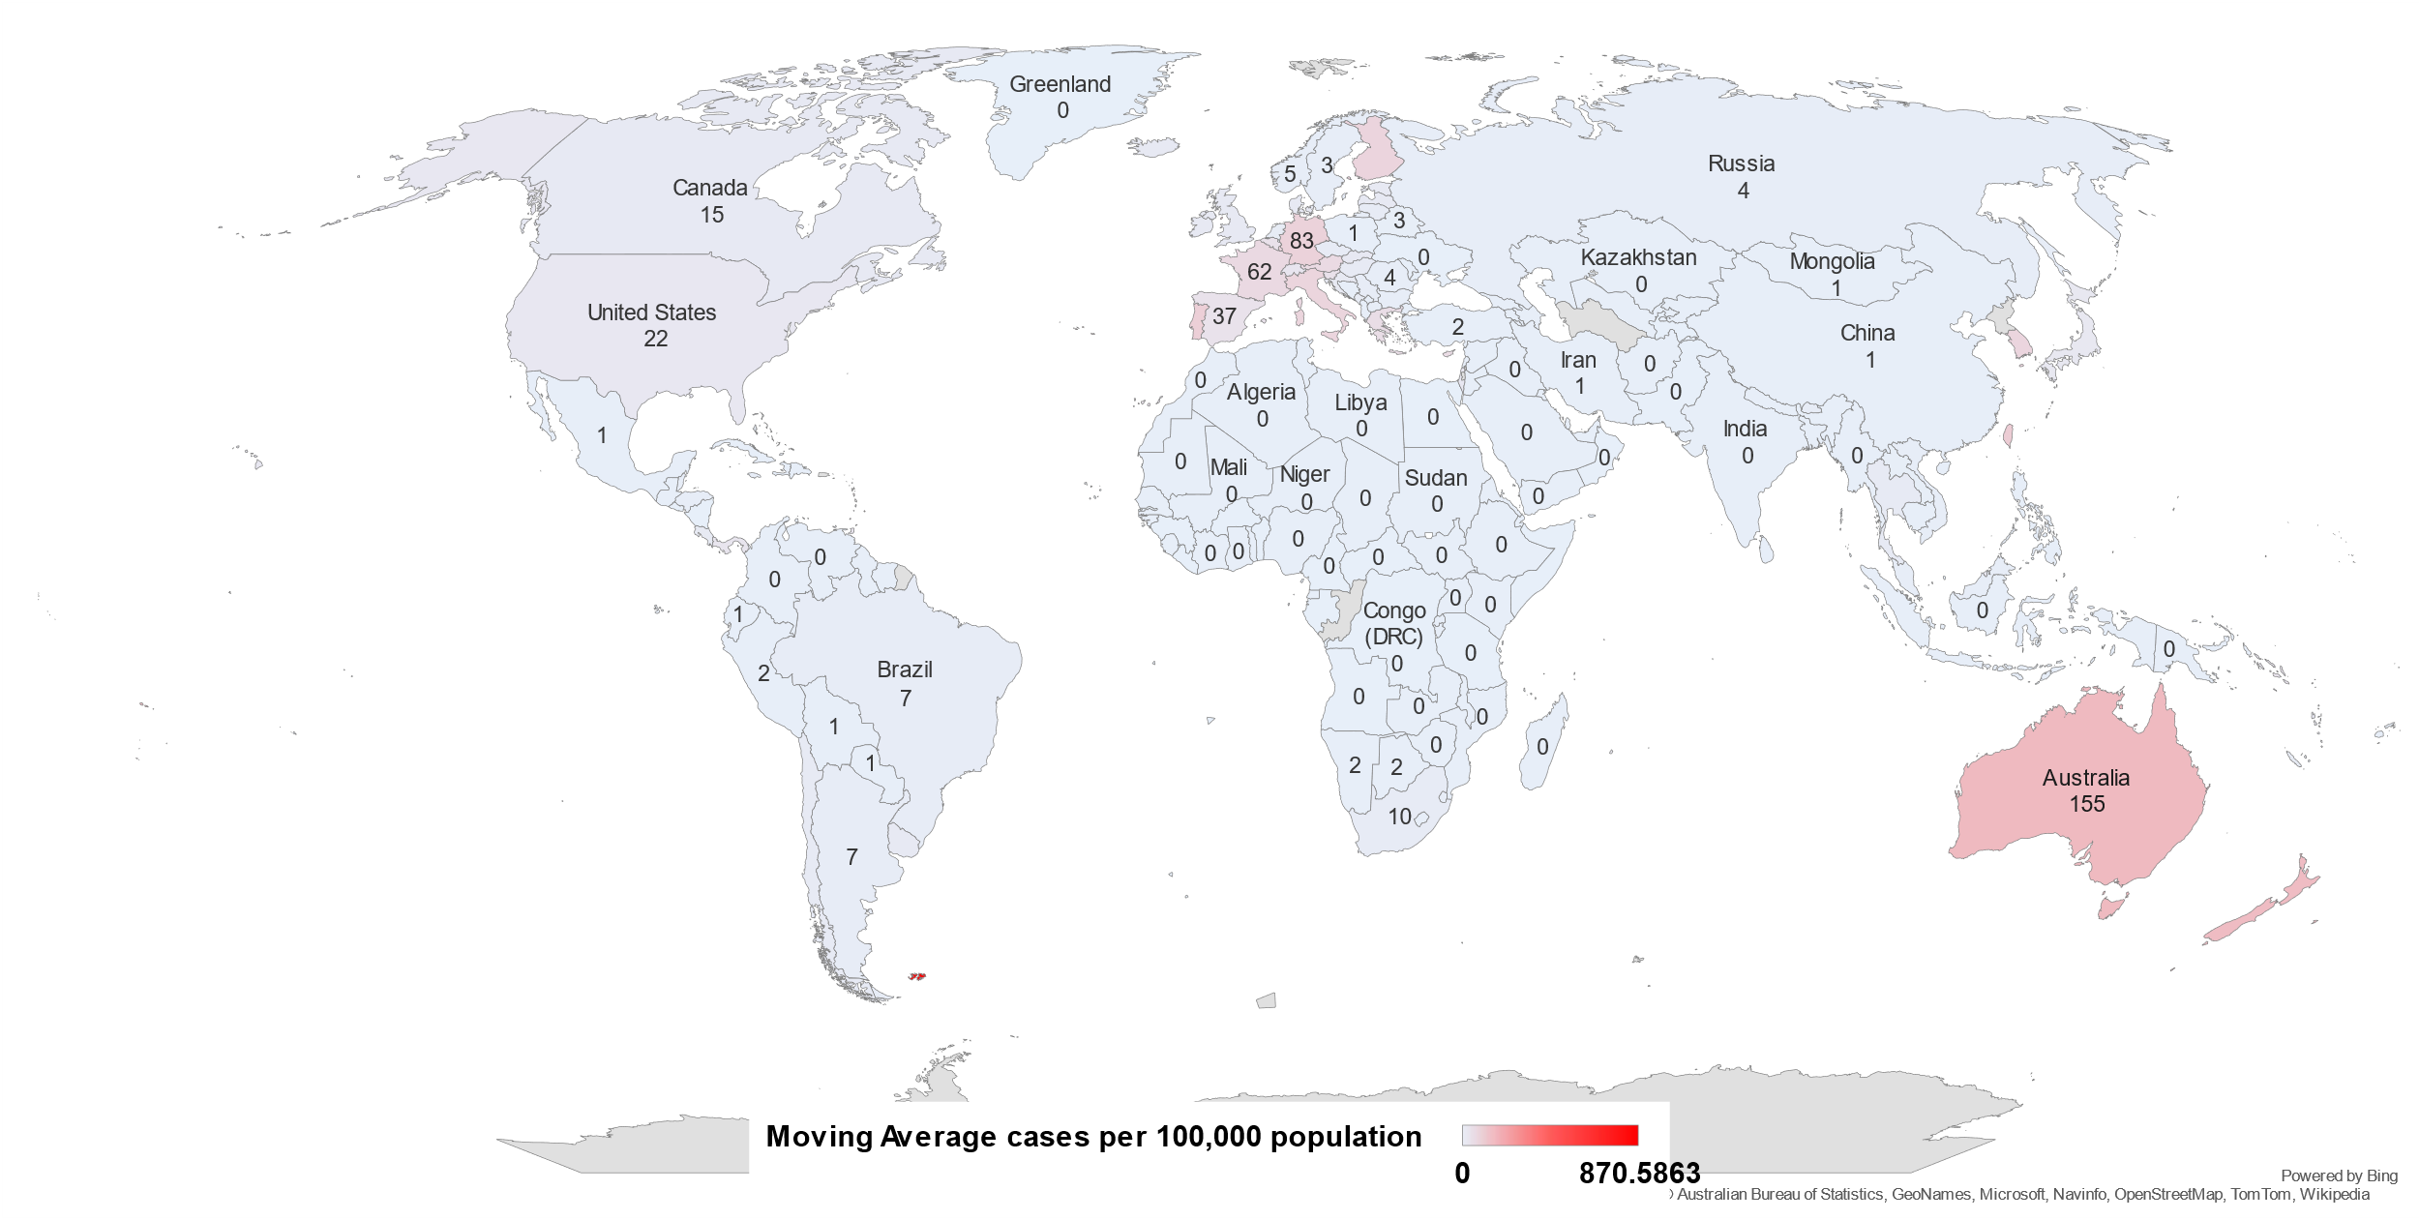
Global Covid-19 epidemic
7-day moving average cases per 100,000 population
up to - 06 May 2022
  Source: Our World in Data

Slide 15
Global SARS-CoV-2 cases: Trends
up to - 06 May 2022
  Data Source: Our World in Data; NICD

Slide 16
Cases stratified by continents showing the waves
up to - 06 May 2022
  Data Source: Our World in Data; NICD

Slide 17
Covid-19 cases stratified by country income level
up to - 06 May 2022
  Data Source: Our World in Data; NICD

Slide 18
South Africa:
Trends in reported provincial
SARS-CoV-2 cases

Slide 19
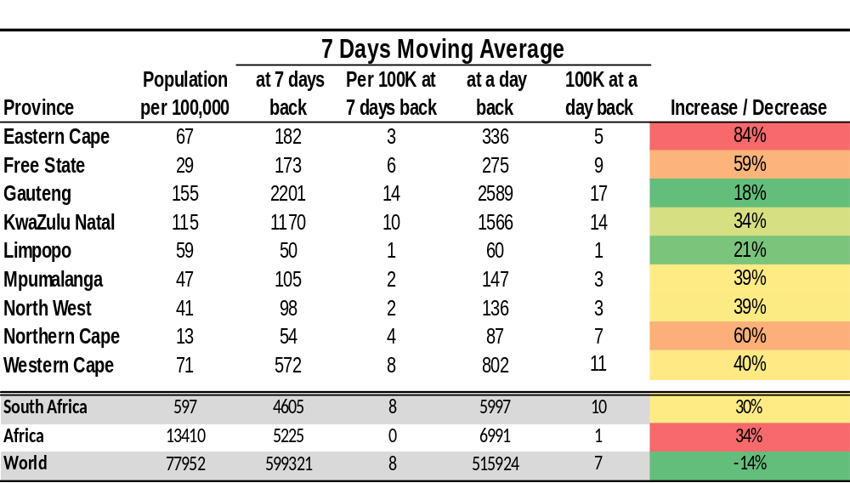
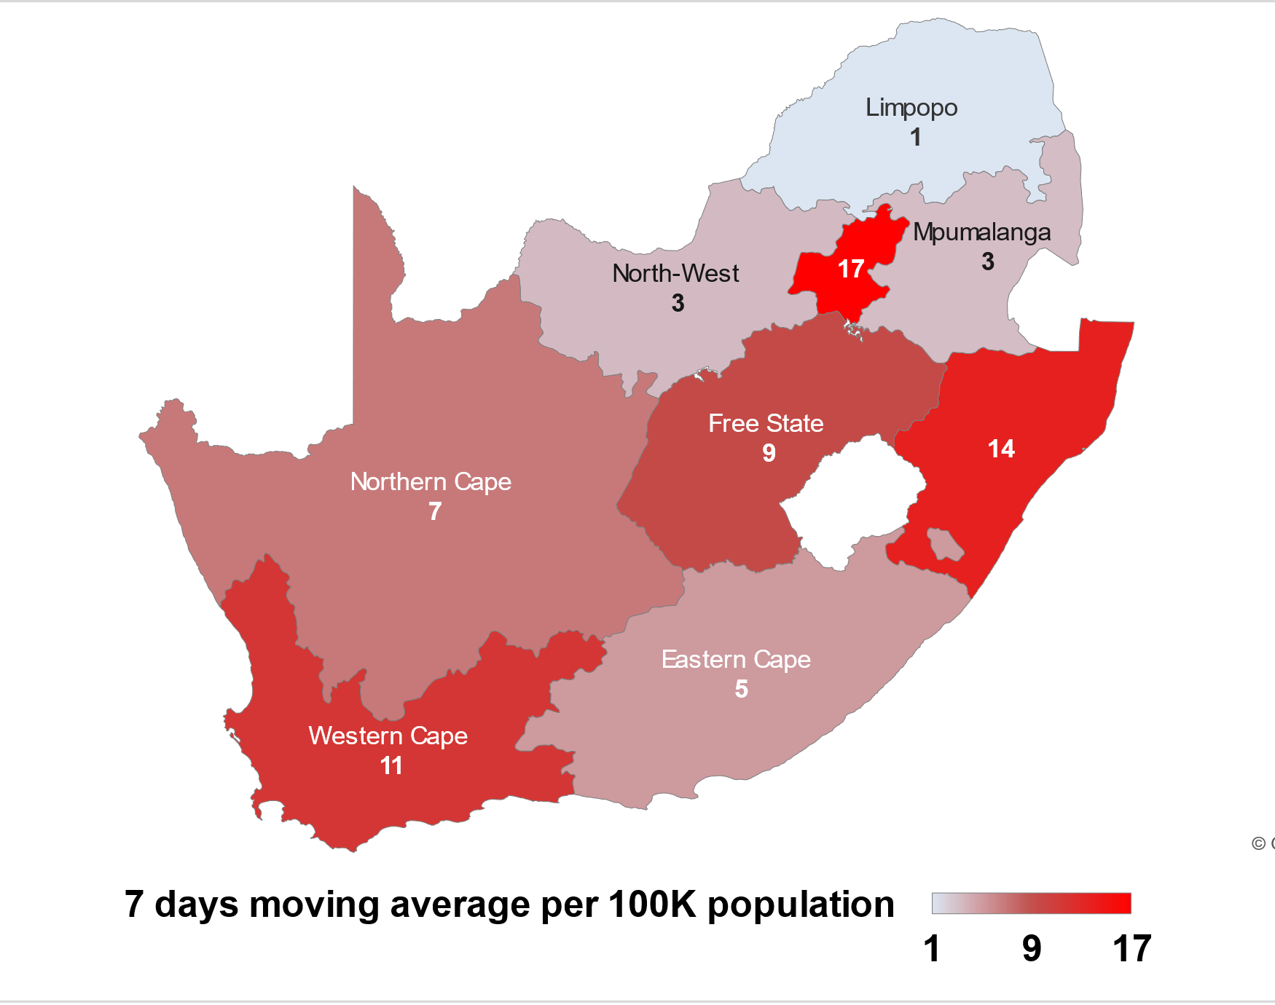
Daily new cases over last 7 days per 100,000 pop
up to - 06 May 2022
  Data source: Department of Health

Slide 20
Confirmed SARS-Cov-2 cases by province
  Data source: Department of Health; Analysis

Slide 21
Confirmed SARS-Cov-2 cases by province
7-day moving average cases per 100,000 population
up to - 06 May 2022
  Data source: Department of Health; Analysis

Slide 22
SARS-CoV-2 in Gauteng province
7-day moving average of new cases, hospital admissions and in-hospital Covid-19 deaths
up to - 06 May 2022
  Source of hospital admissions data: Lucille Blumberg, Richard Welch and Waasila Jassat – DATCOV, NICD

Slide 23
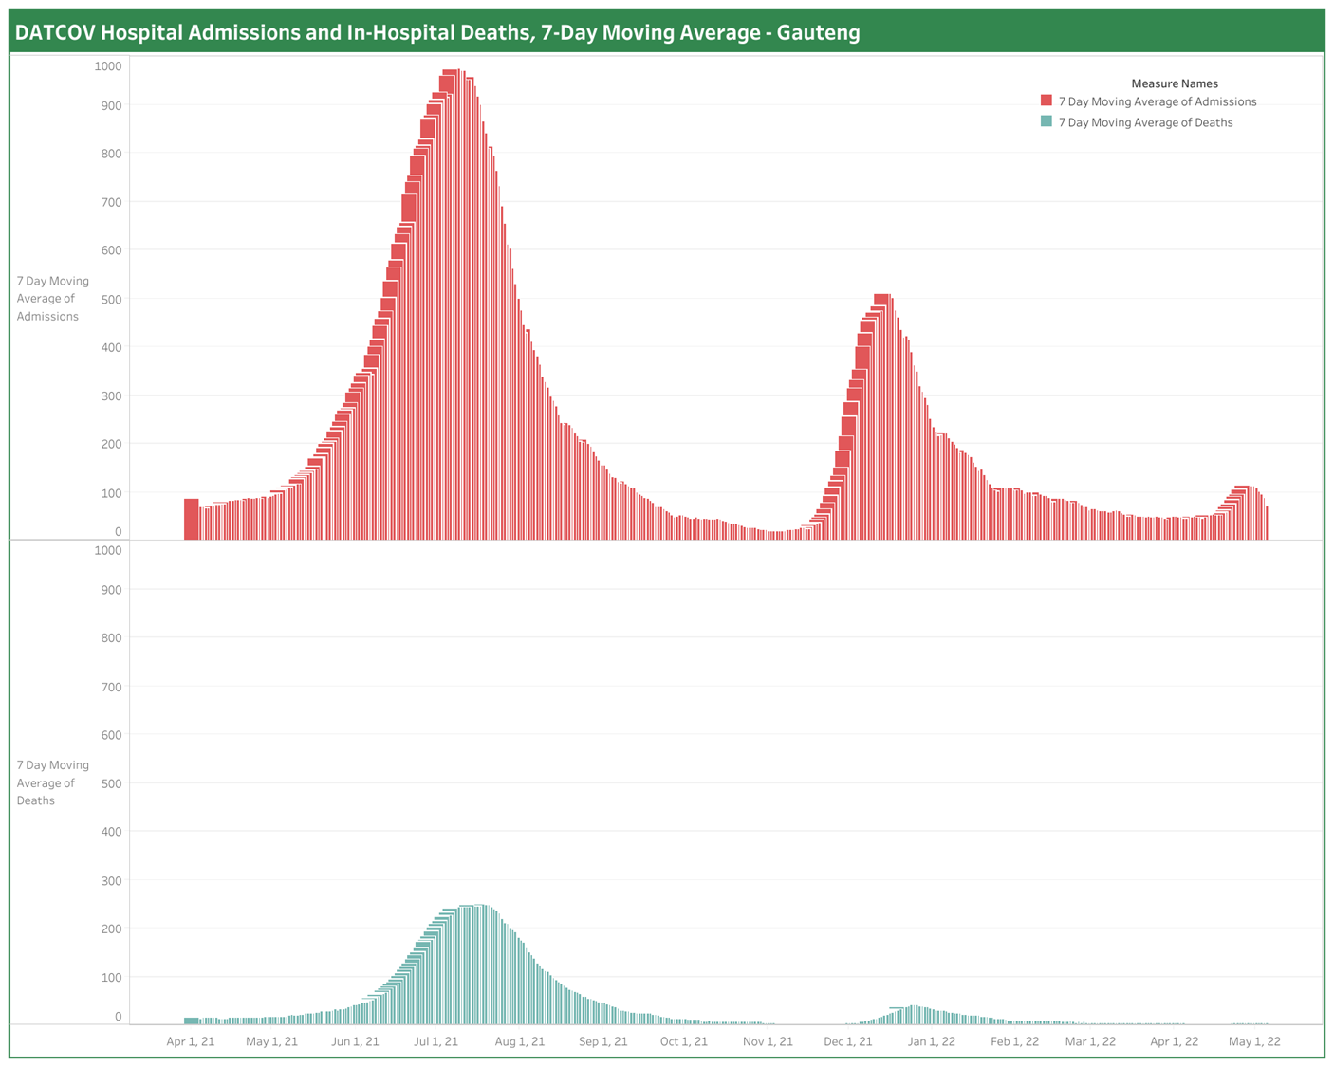
Gauteng Hospital Admissions & In-Hospital Deaths
up to - 03 May 2022
  Analysis: National Surveillance Centre Team (NDoH AMD)
Notes:
Level 5 – 26 March 2020
Level 4 – 1 May 2020
Level 3 – 1 June 2020
Level 2 – 16 Aug 2020
Level 1 – 20 Sept 2020
Level 3 adjusted – 29 Dec 2020
Level 3 readjusted – 6 Feb 2021
Level 1 – 4 March 2021
Level 2 – 30 May 2021
Level 3 – 16 June 2021
Level 4 – 30 June 2021
Level 3 – 26 July 2021
Level 2 – 13 September 2021
Level 1 – 1 Oct 2021

Slide 24
SARS-CoV-2 cases in 1st, 2nd, 3rd, 4th and 5th waves: Gauteng
Waves aligned at a threshold of 5 cases per 100,000 population.
  Data source: Department of Health; Analysis: Marothi Letsoalo; Ande Mchunu

Slide 25
SARS-CoV-2 cases in KwaZulu-Natal
7-day moving average of new cases, hospital admissions and in-hospital Covid-19 deaths
up to - 06 May 2022
  Source of hospital admissions data: Lucille Blumberg, Richard Welch and Waasila Jassat – DATCOV, NICD

Slide 26
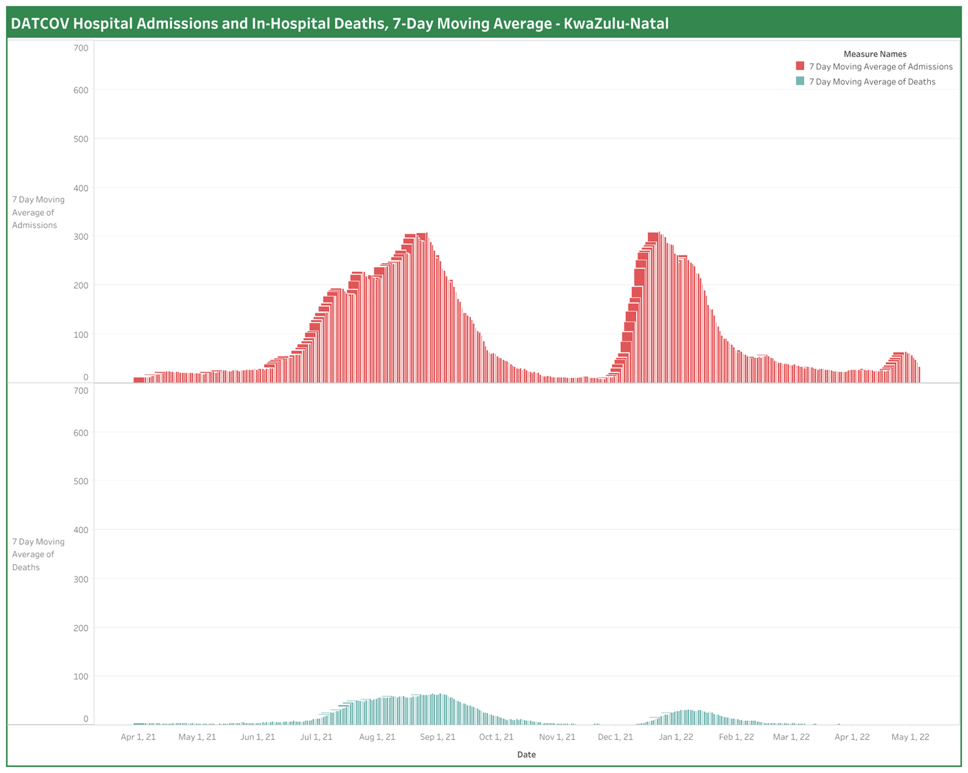
KwaZulu-Natal Hospital admissions & in-hospital deaths
up to - 03 May 2022
  Analysis: National Surveillance Centre Team (NDoH AMD)
Notes:
Level 5 – 26 March 2020
Level 4 – 1 May 2020
Level 3 – 1 June 2020
Level 2 – 16 Aug 2020
Level 1 – 20 Sept 2020
Level 3 adjusted – 29 Dec 2020
Level 3 readjusted – 6 Feb 2021
Level 1 – 4 March 2021
Level 2 – 30 May 2021
Level 3 – 16 June 2021
Level 4 – 30 June 2021
Level 3 – 26 July 2021
Level 2 – 13 September 2021
Level 1 – 1 Oct 2021

Slide 27
SARS-CoV-2 cases in 1st, 2nd, 3rd, 4th and 5th waves: KwaZulu Natal
Waves aligned at a threshold of 5 cases per 100,000 population.
  Data source: Department of Health; Analysis: Marothi Letsoalo; Ande Mchunu

Slide 28
SARS-CoV-2 cases in Western Cape
7-day moving average of new cases, hospital admissions and in-hospital Covid-19 deaths
up to - 06 May 2022
  Source of hospital admissions data: Lucille Blumberg, Richard Welch and Waasila Jassat – DATCOV, NICD

Slide 29
SARS-CoV-2 cases in 1st, 2nd, 3rd, 4th and 5th waves: Western Cape
3629 cases
3256 cases
Waves aligned at a threshold of 5 cases per 100,000 population.
  Data source: Department of Health; Analysis: Marothi Letsoalo; Ande Mchunu

Slide 30
SARS-CoV-2 cases in Eastern Cape
7-day moving average of new cases, hospital admissions and in-hospital Covid-19 deaths
up to - 06 May 2022
  Source of hospital admissions data: Lucille Blumberg, Richard Welch and Waasila Jassat – DATCOV, NICD

Slide 31
SARS-CoV-2 cases in 1st, 2nd, 3rd, 4th and 5th waves: Eastern Cape
Waves aligned at a threshold of 5 cases per 100,000 population.
  Data source: Department of Health; Analysis: Marothi Letsoalo; Ande Mchunu

Slide 32
SARS-CoV-2 cases in Free State province
7-day moving average of new cases, hospital admissions and in-hospital Covid-19 deaths
up to - 06 May 2022
  Source of hospital admissions data: Lucille Blumberg, Richard Welch and Waasila Jassat – DATCOV, NICD

Slide 33
SARS-CoV-2 cases in 1st, 2nd, 3rd, 4th and 5th waves: Free State
Waves aligned at a threshold of 5 cases per 100,000 population.
  Data source: Department of Health; Analysis: Marothi Letsoalo; Ande Mchunu

Slide 34
SARS-CoV-2 cases in Northern Cape
7-day moving average of new cases, hospital admissions and in-hospital Covid-19 deaths
up to - 06 May 2022
  Source of hospital admissions data: Lucille Blumberg, Richard Welch and Waasila Jassat – DATCOV, NICD

Slide 35
SARS-CoV-2 cases in 1st, 2nd, 3rd, 4th and 5th waves: Northern Cape
Waves aligned at a threshold of 5 cases per 100,000 population.
  Data source: Department of Health; Analysis: Marothi Letsoalo; Ande Mchunu

Slide 36
SARS-CoV-2 cases in Limpopo province
7-day moving average of new cases, hospital admissions and in-hospital Covid-19 deaths
up to - 06 May 2022
  Source of hospital admissions data: Lucille Blumberg, Richard Welch and Waasila Jassat – DATCOV, NICD

Slide 37
SARS-CoV-2 cases in 1st, 2nd, 3rd, 4th and 5th waves: Limpopo
Waves aligned at a threshold of 5 cases per 100,000 population.
  Data source: Department of Health; Analysis: Marothi Letsoalo; Ande Mchunu

Slide 38
SARS-CoV-2 cases in North West province
7-day moving average of new cases, hospital admissions and in-hospital Covid-19 deaths
up to - 06 May 2022
  Source of hospital admissions data: Lucille Blumberg, Richard Welch and Waasila Jassat – DATCOV, NICD

Slide 39
SARS-CoV-2 cases in 1st, 2nd, 3rd, 4th and 5th waves: North West
1369 cases
1300 cases
768 cases
Waves aligned at a threshold of 5 cases per 100,000 population.
  Data source: Department of Health; Analysis: Marothi Letsoalo; Ande Mchunu

Slide 40
SARS-CoV-2 cases in Mpumalanga
7-day moving average of new cases, hospital admissions and in-hospital Covid-19 deaths
up to - 06 May 2022
  Source of hospital admissions data: Lucille Blumberg, Richard Welch and Waasila Jassat – DATCOV, NICD

Slide 41
SARS-CoV-2 cases in 1st, 2nd, 3rd, 4th and 5th waves: Mpumalanga
Waves aligned at a threshold of 5 cases per 100,000 population.
  Data source: Department of Health; Analysis: Marothi Letsoalo; Ande Mchunu

