Slide 1

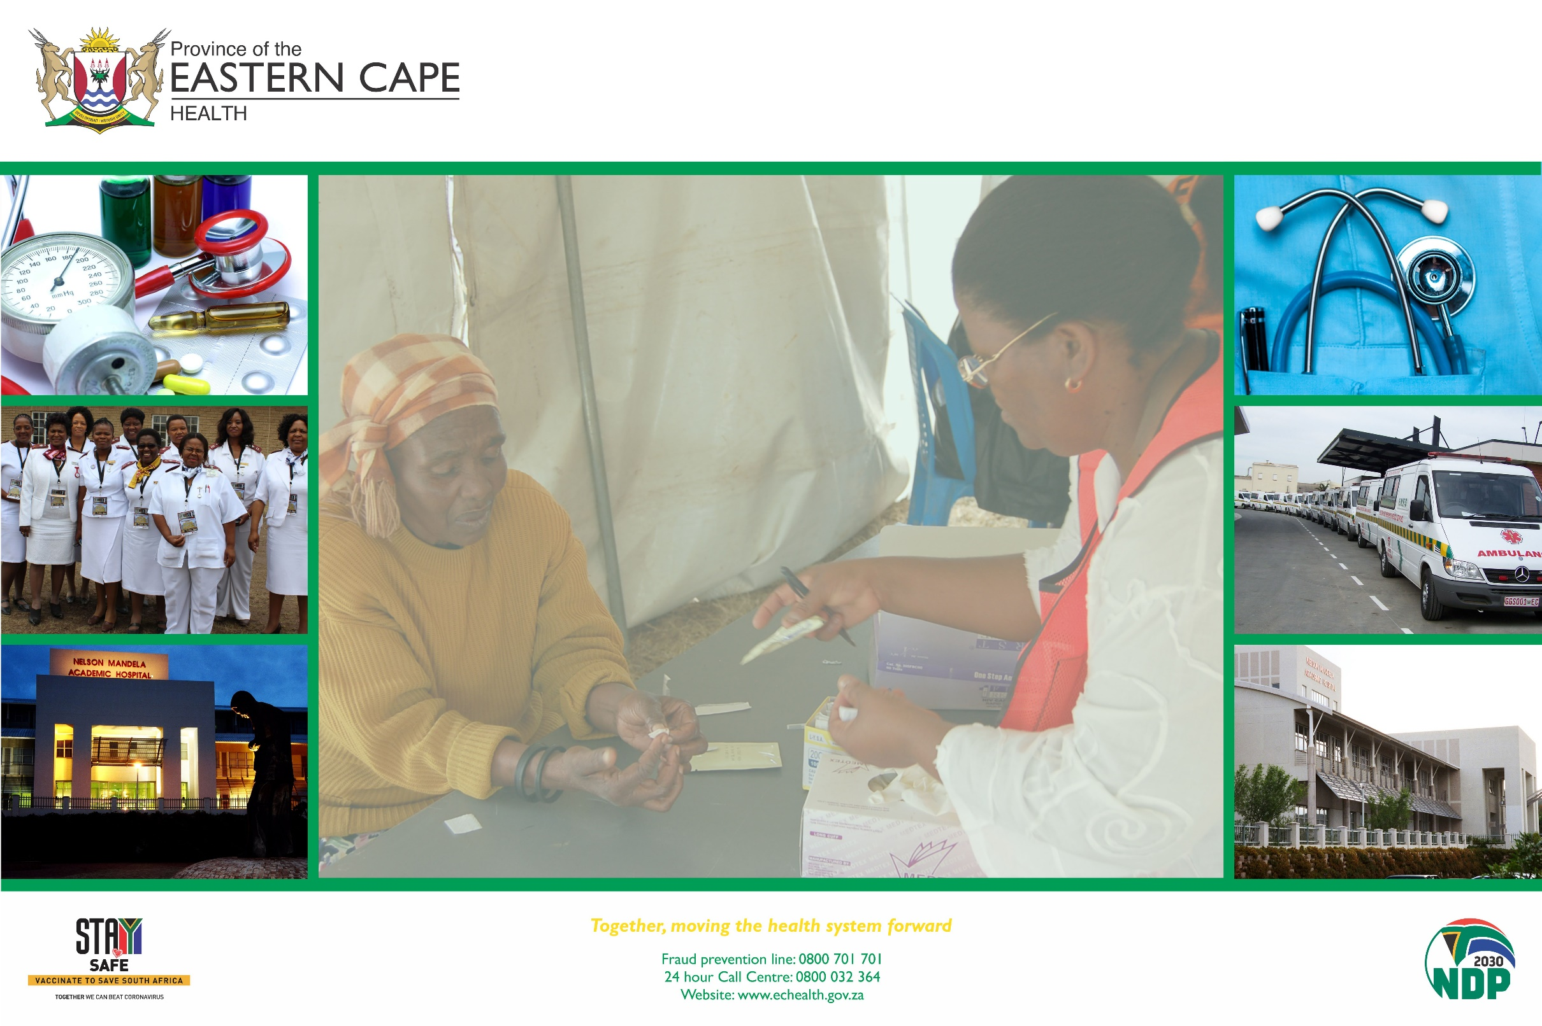
NMBHD
NEXT STEPS FOR STRENGTHENING PEP IMPLEMENTATION

Slide 2
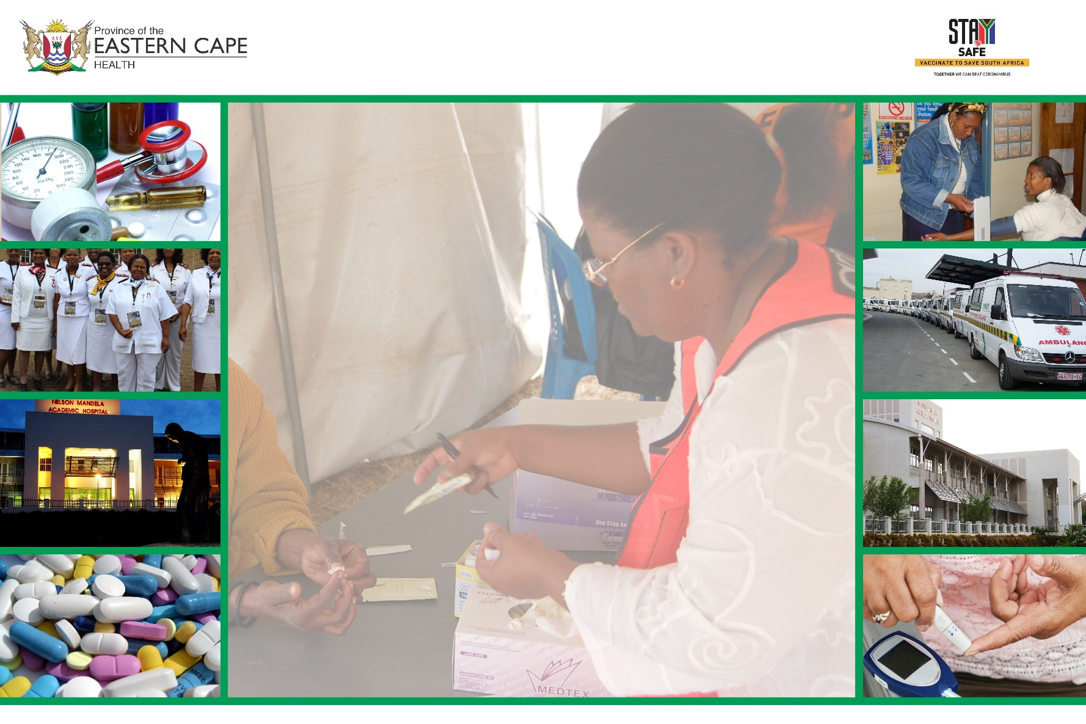
Presentation Outline
Information sharing
Commencement of PEP Services
ACSM
Facility & District Plans

Slide 3
DESCRIBE THE PROCESS FOR DEVELOPING THE DISTRICT PLAN TO SUPPORT PHC FACILITIES IN THE DISTRICT TO STRENGTHEN PEP IMPLEMENTATION
Activity | Responsible person | Time frame
Provide feedback to all stakeholders Internal & External (e.g., DAC, DMT, Partners, Governance Structures, Other Governmental Departments, etc) | Dr Mayekiso (Drs and Pharmacisits) Ms N. vd Bergh | By end July 2023
Avail Clinical Stationery, Job Aides, guidelines and IEC material to all stakeholders | Ms. N. vd Bergh | In progress
Training (HCW, non-clinical staff) Incorporate into the existing training plan (outstanding 32 facilities) | RTC (Ms. Perils) | 12 July and ongoing following the district training plan

Slide 4
WHAT ARE THE TIME FRAMES FOR THE STRENGTHENING / COMMENCEMENT OF PEP SERVICES IN THE DISTRICT
Activity | Responsible Person | Time frame
PEP services are already provided in facilities, to strengthen as follows: Utilization of clinical forms and PHC comprehensive tick register to optimize reporting into the WebDHIS Provision of the stat dose of PEP whilst preparing to conduct e.g., HTS (NEW addition in guidelines – slide / page 15) Ensure proper referral pathways to the secondary level of care where necessary (e.g., referral to TCCs in the event of sexual offenses). Ensure availability of PEP drugs | All (23) facilities (incl. hospitals), and programs that attended the training on 10th July (refer to the attendance register). Sub – district Pharmacist | By 01st Aug 23
Conduct facility readiness assessments and implementation (availability of all necessary commodities, clinical stationery, PEP meds, guidelines, etc.) | Sub- district Coordinators, Supervisors and Program coordinators Sub District Pharmacists | By 2nd Aug 23 and ongoing

Slide 5
HOW WILL HP, WBPHCOTS, ISHP AND SUPPORTING PARTNERS GENERATE DEMAND & SOCIAL MOBILISATION TO RAISE AWARENESS ABOUT PEP SERVICES
Activity | Responsible Person | Time frame
ACSM activities Different Community awareness campaigns and distribution of IEC materials Health week campaign (NMU) | Ms Sohuma & Team WBPHCOTs; ISHP District Supporting Partners Nelson Mandela University | 14th July and ongoing, targeting health calendar days 4 – 8 Aug 2023

Slide 6
Describe the process & time frame for developing the district plan to support PHC facilities in the district to strengthen PEP implementation.
Activity | Responsible Person | Time frame
Compilation of Facility Implementation Plans | OMs Cluster Supervisors | 27 July 23
Consolidation and Submission of the District Implementation Plan | Ms. N. vd Bergh | 10 Aug 23

