Slide 1
Post Exposure Prophylaxis (PEP) Workshop
Overview
7 February 2023
PEP Workshop
Notes:
Thatho

Slide 2
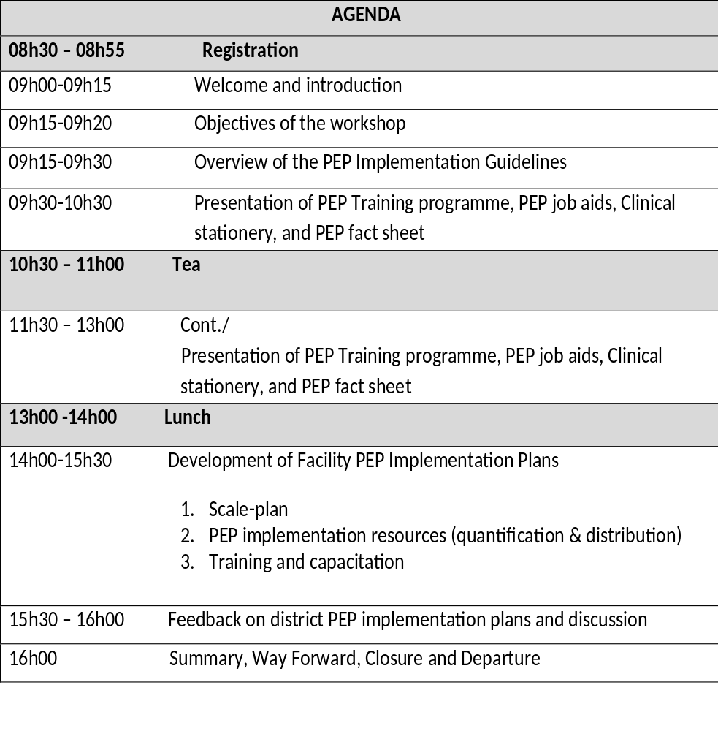
AGENDA

Slide 3
Workshop Objectives
Provide guidance on providing PEP services at the facility
Improve quality of PEP services if already provided in the facility
Facilitate access to PEP services for eligible persons visiting the facility
Integrate PEP with all PHC services (including HIV prevention, treatment and related sexual and reproductive health services offered at the facility)
Develop action plans for strengthening PEP implementation
Update on progress with oral PrEP in Mphumalanga

Slide 4
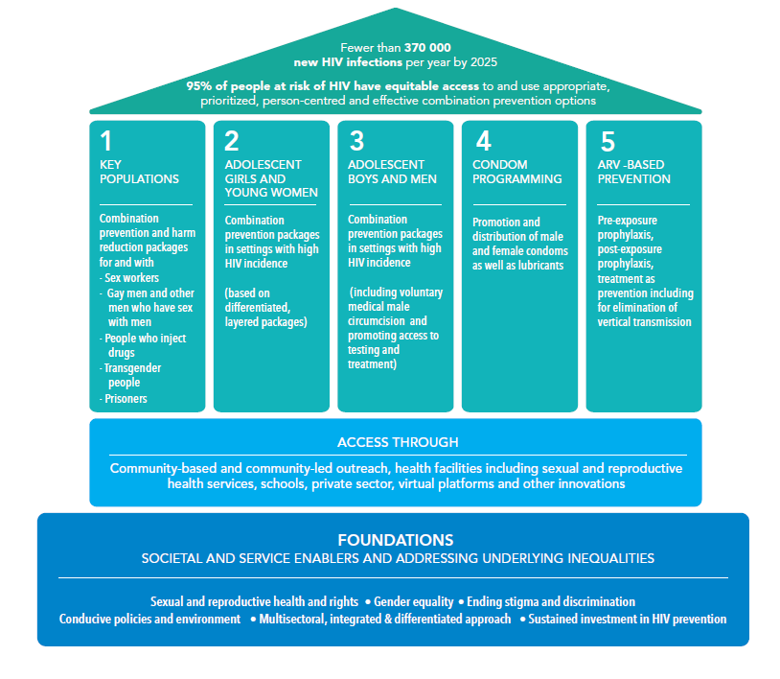
Comprehensive and integrated HIV prevention approach
* HIV Prevention 2025 Roadmap
Notes:
The five-pillar approach has been refined in the 2025 Road Map to reflect the emphasis
in the Global AIDS Strategy (2021–2026) and the demands of an evolving epidemic.
Highlighted now are people-centred approaches, addressing persistent inequalities in
access to and use of services and promoting integration and complementarity between
service delivery platforms.
Pillar 5 on antiretroviral-based prevention speaks to high impact
prevention tools that are relevant to all populations. Pillar 5 emphasizes the vital
complementarity between HIV prevention and HIV treatment and care services.
Post-exposure prophylaxis has been under-utilized in HIV prevention response. It has
been a critical component of the clinical management of sexual assault survivors and in reducing
occupational risk, but remains largely unavailable outside clinical settings. There is
urgent need to address demand and supply-side barriers to the use of post-exposure
prophylaxis and increase access to the non-health sector for key and priority populations.

Slide 5
Integration of HIV prevention services
PEP stat dose
Screening and management (STIs, Pregnancy, HBV, HCV, Tetanus, GBV)
Psycho-social support
HIV counselling, combination prevention and treatment
28-day PEP medication
HIV test
PEP primary package
Emergency contraception
Counselling and support
Additional services

Slide 6

Policy and Guideline Overview

Slide 7
Policy and Guideline Overview
Comprises of 8 sections, namely:
Exposures that pose a risk of HIV or HBV transmission
Package of care for the management of the exposed individual
Post-exposure prophylaxis for the prevention of HIV in adults and adolescents
Post-exposure prophylaxis for the prevention of HIV in children
Post-exposure prophylaxis for the prevention of Hepatitis B
Post-exposure prophylaxis for the prevention of Hepatitis C, STIs, pregnancy, and tetanus
Tetanus prevention
Monitoring and evaluation

Slide 8
PEP Monitoring & Evaluation
PEP data elements currently reported on DHIS:
Sexual Assault cases seen at PHC facility
New sexual assault case HIV neg offered ARV PEP
PEP indicator on DHIS
Sexual assault prophylaxis rate
New PEP Data Elements (Proposed on NIDS) (as @ April 2023)
Person exposed to HIV who tested HIV negative and was issued with Post Exposure Prophylaxis (PEP) (NEW)
Sexual Assault cases seen at PHC facility (Current)
New sexual assault case HIV neg offered ARV PEP (Current)

Slide 9
Summary of Facilities Reporting on PEP (DHIS): Period 2016-2022
Phased Implementation
 | Clinic | CHC | CDC | Hospital | Mobile | Satellite | Correctional | Private | Other | TOTAL
EC | 139 | 25 |  | 69 |  | 1 | 2 | 1 |  | 237
FS | 102 | 6 |  | 27 | 11 |  |  |  |  | 146
GP | 116 | 24 | 3 | 19 | 2 |  | 1 | 1 | 1 | 167
KZN | 305 | 17 |  | 46 | 9 |  | 7 |  | 7 | 391
LP | 185 | 15 |  | 36 | 1 |  |  |  |  | 237
MP | 65 | 31 |  | 28 | 2 | 1 |  |  |  | 127
NC | 29 | 15 |  | 14 |  | 4 |  |  |  | 62
NW | 80 | 28 |  | 17 | 2 |  |  |  |  | 127
WC | 1 | 1 |  | 37 |  |  |  |  | 1 | 40
TOTAL | 1022 | 162 | 3 | 293 | 27 | 6 | 10 | 2 | 9 | 1534

Slide 10
Oral PrEP and PEP PHC Implementation and Reporting (DHIS):
Period 2016 -2022
Phased Implementation
Province | PHC Facility Implementation Targets PrEP | PHC Facilities Implementing PrEP | PHC PrEP Facility Coverage | PHC Facilities Implementing PEP | PHC PEP Facility Coverage
EC | 776 | 635 | 83% | 164 | 21%
FS | 219 | 219 | 97% | 108 | 49%
GP | 372 | 363 | 98% | 143 | 38%
KZN | 619 | 613 | 98% | 322 | 52%
LP | 482 | 130 | 27% | 200 | 41%
MP | 295 | 285 | 98% | 96 | 33%
NC | 162 | 60 | 38% | 44 | 27%
NW | 314 | 216 | 70% | 108 | 34%
WC | 266 | 86 | 37% | 2 | 1%
SA | 3 505 | 2 607 | 75% | 1187 | 34%
 | ≤25% |  | 26%-50% |  | 51%-75% |  | >75%

Slide 11
PEP implementation progress Persons Offered PEP
FY21/22 & 22/23
Province | Target 21/22 | Progress to target | % Actual achieved | Annual Target 22/23 | Q1 & 2 target | Progress to Q1& Q2 target | % Actual achieved | FY23/24 targets
EC | 13 067 | 3 991 | 31% | 5 281 | 2 640 | 1740 | 65% | 5 809
FS | 1 128 | 1 443 | 125% | 1 740 | 870 | 760 | 87% | 1 914
GP | 5 447 | 5 879 | 108% | 5 197 | 2 598 | 2092 | 80% | 5 716
KZN | 4 772 | 4 755 | 99% | 4 772 | 2 386 | 2480 | 103% | 5 197
LP | 3 500 | 2 845 | 81% | 2 669 | 1 320 | 1291 | 97% | 3 335
MP | 4 200 | 1 978 | 47% | 2 556 | 1 278 | 914 | 71% | 2 811
NC | 509 | 557 | 109% | 495 | 244 | 185 | 75% | 544
NW | 1 924 | 1 547 | 79% | 1 761 | 884 | 667 | 75% | 1 937
WC | 3 004 | 3 217 | 107% | 5 548 | 2 774 | 1430 | 51% | 3 362
SA | 37 551 | 26 212 | 70% | 30 019 | 15 004 | 11 599 | 77% | 30 625
Reason for deviations: Some clients/survivors reporting after 72 hours, some already HIV positive, refusal of PEP

Slide 12
Post Exposure Prophylaxis (PEP) Targets
PEP targets are developed nationally
PEP targets for each new financial year are derived by reviewing PEP data reported on DHIS for the last 2 financial years
  An average of the 2 years PEP data taken is used to determine the PEP targets
Challenges faced with using above methodology:
  Reliance on data reported which is not always accurately reported
  Focus remains with PEP provided to persons experiencing sexual assault (as this is the only data reported on the DHIS)
Recommendation : targets should be based on the HIV negative population having access to PEP
  Focus on all public PHC facilities offering PEP as an emergency HIV prevention intervention
  Measurement : No. of public PHC facilities reporting PEP initiation (In addition to hospitals and Thuthuzela Centres)
h

Slide 13
Challenges with PEP Implementation
PEP focus on only on sexual assault and occupational exposure
Majority of the public primary health care facilities are not offering PEP to all persons exposed
Guidance on who and how PEP is implemented is not always very explicit to frontline health care workers at PHC facilities
Capacitation of all frontline health care workers to implement PEP is required
PEP data elements for reporting on PEP is limited
PEP implementation target setting not efficient and requires a revision

Slide 14
In conclusion this workshop aims to support the provinces to:
  Review current PEP service delivery in provinces;
  Identify challenges and bottlenecks affecting implementation on the ground
  Share & review PEP training resources, clinical tools and job aides that are drawn from the current PEP clinical guidelines
    Provide guidance on identifying eligible clients for PEP initiation and clinical management and follow-up
    Provide guidance on transition from PEP to PrEP for eligible clients
  Develop action plans for strengthening PEP implementation

Slide 15
Thank you

