Slide 1

Not Just a Full Blood Count
Presented by Dr D.B. Tzitzivacos

Slide 2

The full blood count (FBC) stands as the cornerstone of haematological evaluation and is arguably the most frequently employed investigation across various medical conditions.
It provides a fundamental basis for clinical decision-making, delineating potential diagnostic pathways and guiding further investigative protocols.
The FBC not only represents a conglomeration of quantitative and qualitative data but also serves as a logical framework from which clinicians can explore the complexity of physiological and pathological states.

Slide 3

In conceptualising the FBC, it is useful to visualise the solution space it inhabits.
This space comprises an array of potential solutions, wherein each parameter can be viewed as a node on a decision tree. These trees serve as algorithms that clinicians utilise to navigate through the symptoms and signs presented by patients, effectively isolating the underlying conditions requiring attention.
The interconnections among various components of the FBC foster a comprehensive understanding of haematopoietic function and systemic health.

Slide 4
Investigating the Parameters of the Full Blood Count
The analysis of a FBC encompasses multiple parameters—quantitative measures such as cell counts, along with qualitative assessments concerning morphology and functional activation.
These parameters often exhibit overlap, thus providing synergistic insights into the functional state of blood components that collectively strive towards both common and distinct physiological goals.

Slide 5
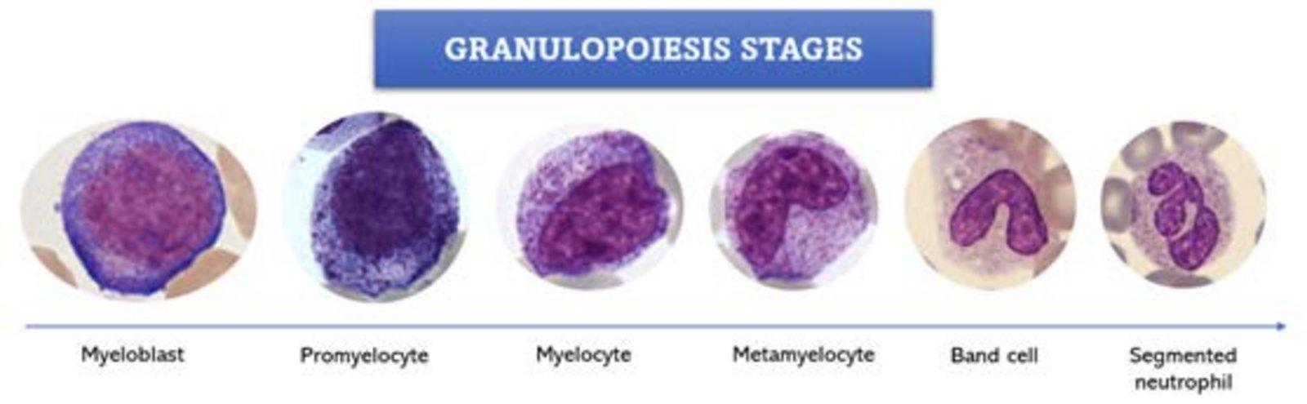
Erythroid and Myeloid Lineages
A detailed examination of the cellular components reveals significant functional interplay between erythroid and myeloid lineages.
For instance, the evaluation of granulocyte maturation offers essential insights into the immune system’s capacity to combat foreign pathogens.
The maturity of these cells can be characterised by a ‘right shift’ in maturation patterns, evidenced by increased granulation and lobulation, indicative of heightened reactivity.

Slide 6
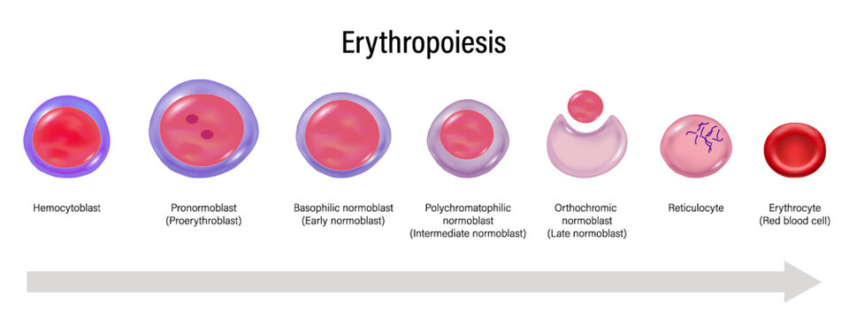
Erythroid and Myeloid Lineages contd.
Conversely, red cell maturation is crucial for assessing the marrow's responsiveness to oxygen demands.
Indicators such as reticulocytosis and an elevated red cell distribution width (RDW) provide practical information on the bone marrow’s ability to produce erythrocytes, particularly in response to states of haemolysis or other underlying pathologies.
The presence of normoblasts, or young red blood cells, highlights the marrow's adaptive mechanisms in maintaining haemoglobin levels.

Slide 7
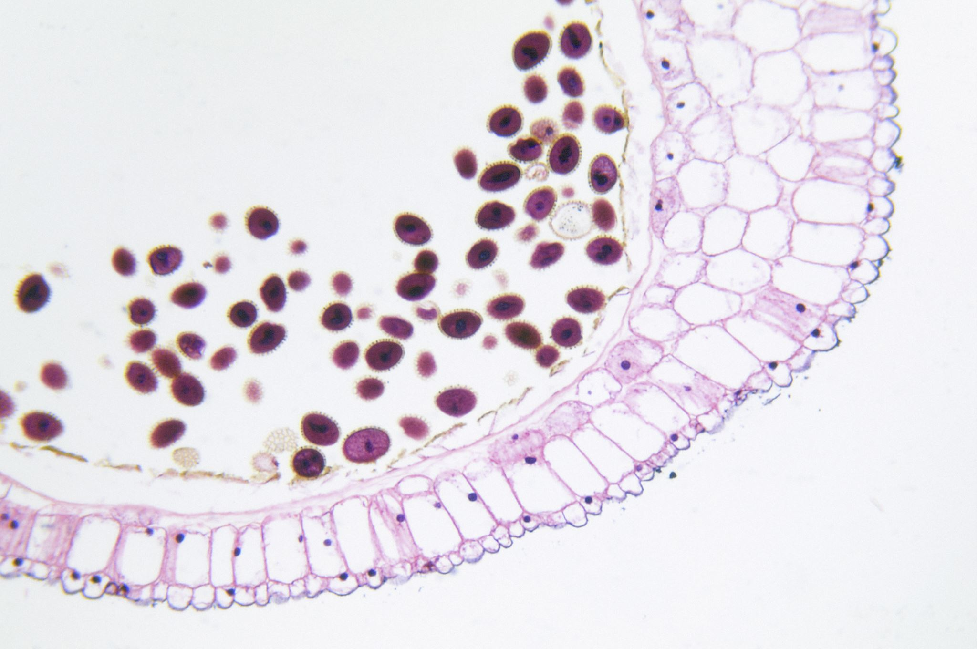
Platelet Evaluation
The assessment of platelets adds another layer of complexity to the clinical picture. An increased megakaryocyte activity within the bone marrow is indicative of heightened platelet production, evident in thrombocytosis.
Thrombocytosis may arise from essential or reactive processes, necessitating a nuanced interpretation to distinguish between benign and potentially malignant aetiologies. In some cases, thrombocythemia may be reflected as a decrease in platelet size and number, often linked to idiopathic autoimmune phenomena.

Slide 8

Thrombopoietin (TPO) plays a pivotal role in the regulatory mechanisms governing platelet production. Understanding the nuances of TPO's function is essential not only for diagnostic purposes but also for therapeutic interventions aimed at normalising platelet counts.

Slide 9
Conclusion
The FBC is not merely a collection of data points; it is an intricate compilation of information that facilitates a deeper understanding of a patient's physiological state.
Through meticulous analysis of the parameters encompassing erythroid, myeloid, and platelet lineages, clinicians can leverage the FBC as a vital tool in clinical reasoning.
Its role in healthcare extends far beyond the mere quantification of blood components, forming a critical component of the diagnostic algorithm that guides clinical practice. Consequently, the FBC remains an indispensable element in the ongoing quest to decipher the complexities of human health and disease

Slide 10

The Role of AI in the Future of Full Blood Count and Blood Results Interpretation

Slide 11

The interpretation of FBC and other blood results has traditionally relied on the expertise of healthcare professionals, who examine clinical details alongside numerical data to derive meaningful insights.
As artificial intelligence (AI) continues to evolve and integrate into healthcare systems, its application in interpreting blood results presents both opportunities and challenges that merit thorough analysis

Slide 12
AI’s Analytical Capabilities
AI algorithms, particularly those based on machine learning and deep learning, possess the ability to analyse vast datasets with speeds and accuracies surpassing human capabilities.

Slide 13
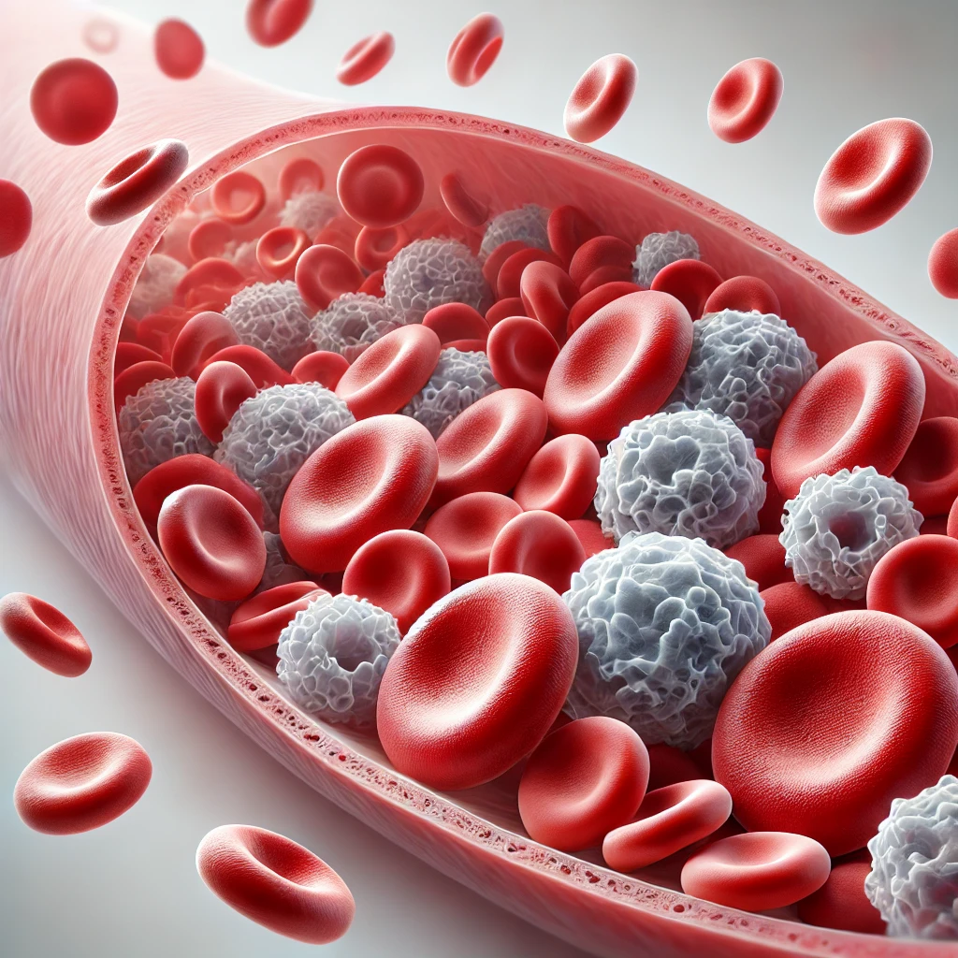
- White blood cell count
- Haemoglobin levels
- Platelet counts
This allows for the identification of abnormalities that may indicate underlying health conditions.
This capability can enhance diagnostic accuracy by facilitating earlier detection of diseases, such as anaemia or leukaemia, which are often diagnosed through blood analysis.
In the context of FBC interpretation, AI can swiftly assess various parameters, including:

Slide 14

Integration into Clinical Practice
The integration of AI in laboratory settings is likely to streamline the workflow of pathologists and clinicians.
With AI systems capable of pre-filtering results for anomalies, healthcare providers can focus on cases that require immediate attention, thereby optimising time and resources.

Slide 15

AI Patterns
For instance, AI can flag concerning patterns in blood results that warrant further investigation or immediate intervention, potentially improving patient outcomes through timely treatment.
Moreover, the use of AI can standardise interpretation processes, reducing variability that may stem from individual clinician experience. Standardised assessments could minimise the risk of human error and improve inter-rater reliability when interpreting complex or borderline cases.

Slide 16

Challenges and Ethical Considerations
The implementation of AI in blood result interpretation is not without challenges.
One of the foremost concerns is the "black box" nature of many AI systems, where the decision-making process is not transparent to users.
Clinicians may be hesitant to rely on AI-generated interpretations without understanding the rationale behind them, which poses a challenge to clinical acceptance and trust.

Slide 17
Challenges and Ethical Considerations contd.
Moreover, ethical considerations surrounding data privacy and the consent framework for the use of patient data remain paramount. Ensuring the confidentiality and security of sensitive health information while harnessing the power of AI will require robust regulatory frameworks and governance structures.

Slide 18
Future Directions
Looking ahead, it is crucial to explore hybrid models where AI and human expertise complement each other. Clinical judgement, informed by AI's analytical power, can lead to more holistic patient care. Continuous training of AI algorithms with diverse populations and conditions will enhance the robustness of AI systems, ensuring that they are equipped to interpret a wide array of clinical scenarios effectively.
It is equally important to engage healthcare professionals in the development and deployment of AI tools, as their insights will be invaluable in addressing clinical nuances that algorithms may not inherently grasp. Ongoing education and training in AI literacy for clinicians will also be essential to facilitate smoother integration into clinical workflows.

Slide 19

Conclusion
In conclusion, AI holds significant potential to revolutionise the interpretation of FBC and other blood results. By enhancing accuracy, efficiency, and standardisation, AI can play a pivotal role in improving patient outcomes.
However, careful consideration of the associated challenges and ethical implications is crucial in ensuring that AI serves as a supportive tool that augments, rather than undermines, the invaluable role of human expertise in healthcare.

Slide 20

As we move forward, collaboration between technologists and healthcare professionals will be vital in realising the full potential of AI in clinical laboratory settings.

