Slide 1

ANTENATAL SCREENING: A LAB PERSPECTIVE
Ronald Dalmacio
Chemical pathology

Slide 2

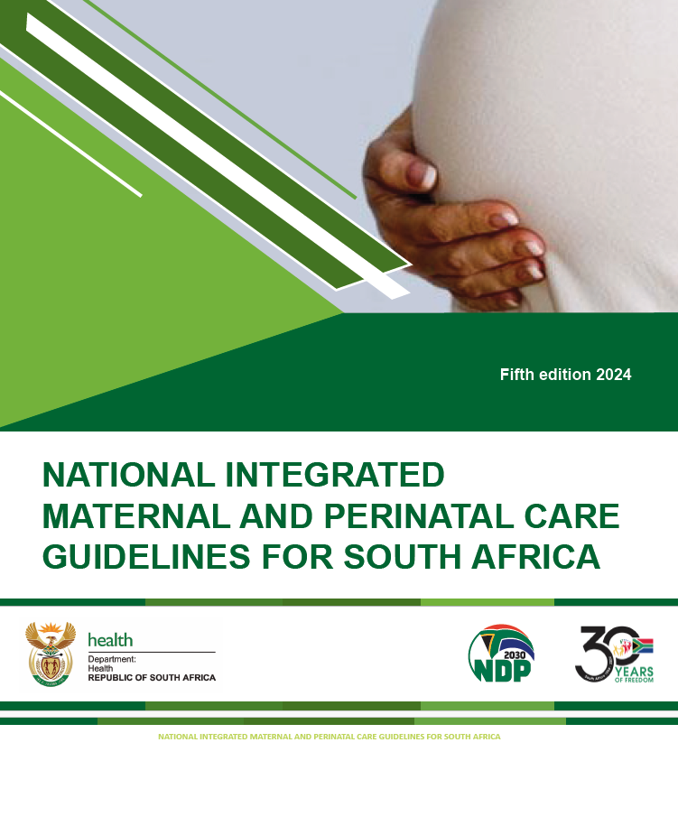
OUTLINE
Basics of antenatal visits
Prenatal screening
  fetal chromosomal/structural anomalies
  Pre eclampsia

Slide 3
FIRST ANTENATAL VISIT
History
  Pregnancy: Current, previous (Complications, outcomes)
  Co-morbidities: incl. familial/genetic disorders
  Allergies
  Medication/drugs/substances
  Family/social/violence exposure

Slide 4
FIRST ANTENATAL VISIT: cont.
Physical examination
  General: weight, height, heart rate, blood pressure, oedema, lymph nodes, colour of mucous membranes
    Nutritional status:
      Mid-upper arm circumference (MUAC)
        >=33: Obesity, <23: Malnutrition/chronic wasting
      BMI??
  Systemic: Teeth/gums, breasts, thyroid, heart, lungs, dental

Slide 5
FIRST ANTENATAL VISIT: cont.
Estimation of gestational age
  Last menstrual period (LMP)
  Symphysus-fundal height
  Palpation
  Ultrasound

Slide 6
FIRST ANTENATAL VISIT: cont.
Routine screening
  HIV
  HBV
  TB screening
  Syphilis serology
  Rhesus (D)
  Haemaglobin
  Urine dipstick: protein, glucose, nitrates, leukocytes (At each visit)
  Mental health screen

Slide 7
FIRST ANTENATAL VISIT: cont.
Consider
  ABO blood group
  Congenital disorder screening: Down’s syndrome ***
  Rubella
  Blood glucose screening
  Cervical smear??
  Urine culture
  Group B
  Pre-eclampsia ***

Slide 8
Follow-up visits
Basic antenatal care plus (BANC+) 8 visits (incl. first visit)
  First: <14weeks. F/U: 20, 26, 30, 34, 36, 38, 40
  Still pregnant 1 week after 40 week visit:
    antenatal clinical for possible induction

Slide 9
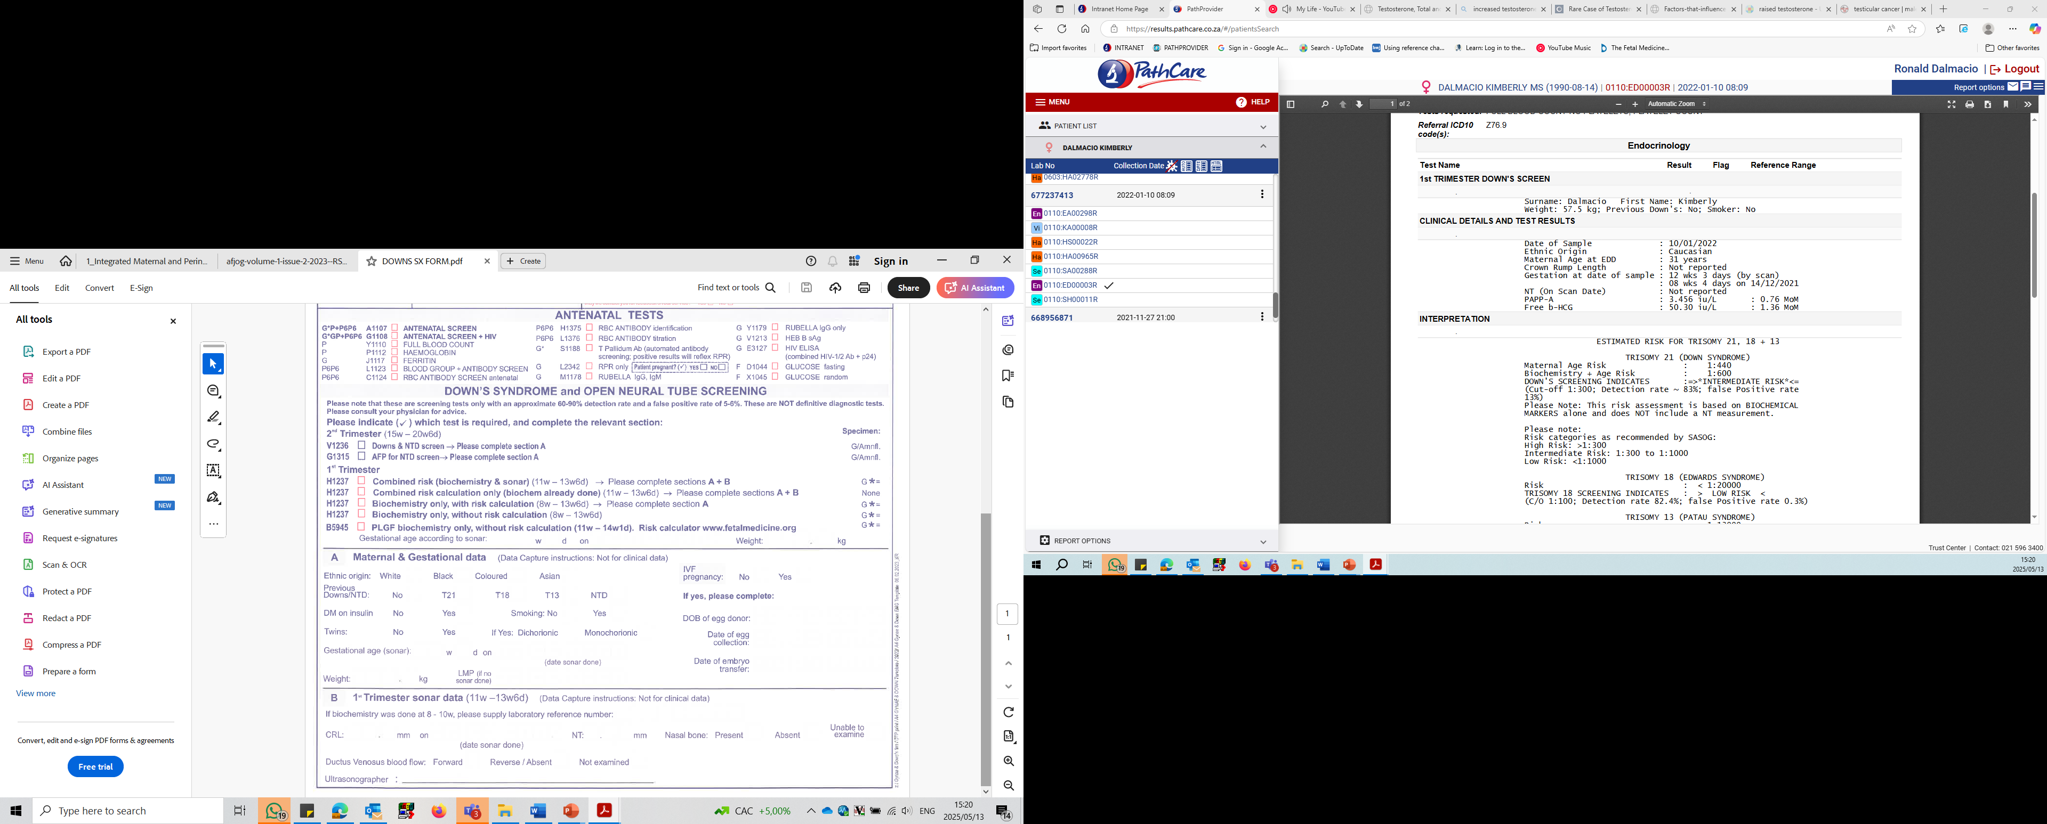

Slide 10
ANTENATAL SCREEN (A1107):
Excl. HIV and Rubella IgM
RBC antibody, Group, Hepatitis, platelet, COOMBS, Rh, Rubella IgG, Syphillis
ANTENATAL SCREEN + HIV (G1108):
Excl. Rubella IgM

Slide 11
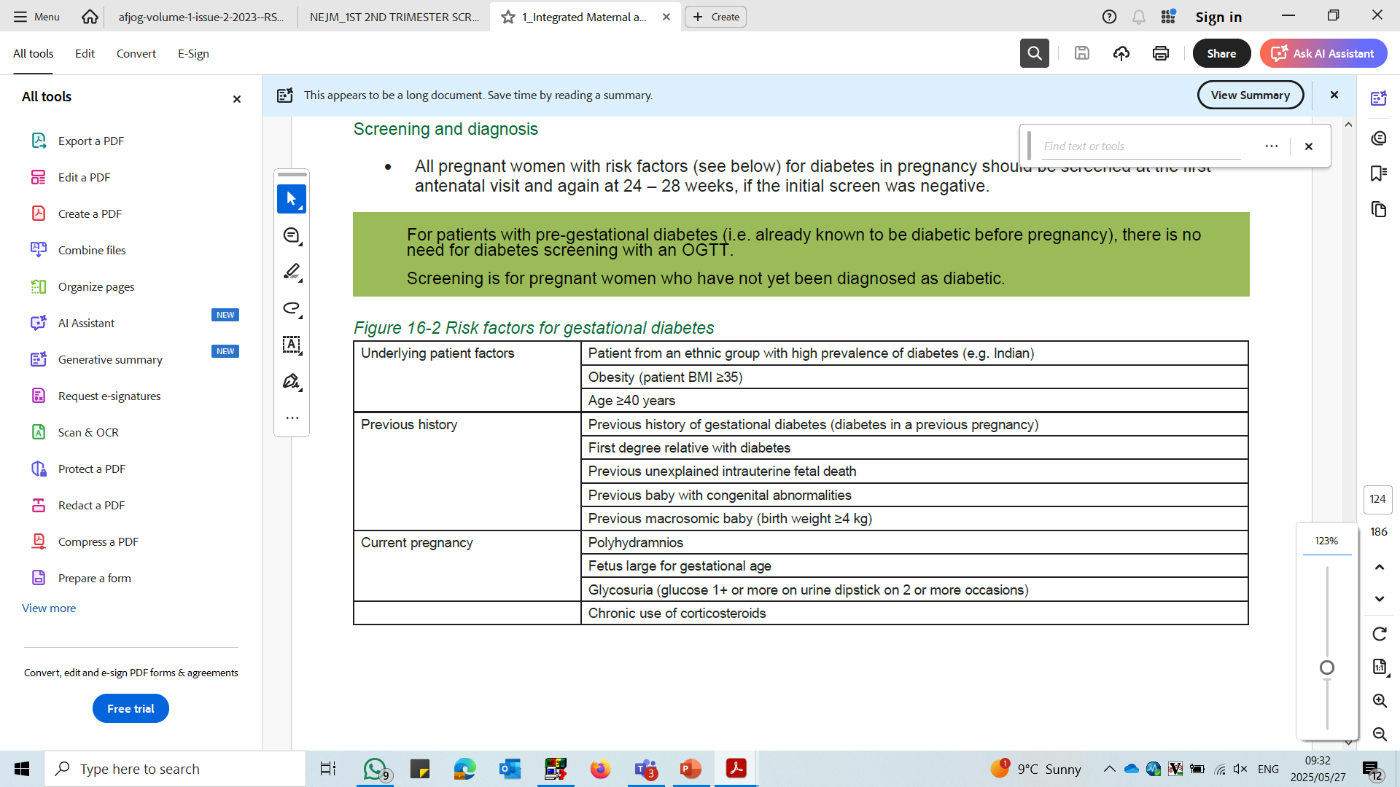
Gestational diabetes:
Diabetes occurring during pregnancy and resolves 6 weeks post partum
Screen:
  Risk factors present
  24 – 28 weeks
  Fasting glucose: ≥5.6mmol/L (NICE), ≥5.1mmol/L (WHO,2015)
  2hr OGTT: ≥7.8mmol/L (NICE), ≥8.5mmol/L (WHO,2015)
Notes:
WHO guideline used at PC:
After a 75g oral glucose load, the diagnosis of gestational
DM is made at 24 - 28 w gestation when any one of these
plasma glucose values is met or exceeded:
Fasting: 5.1 mmol/L
1h: 10.0 mmol/L
2h: 8.5 mmol/L
Ref: Diabetes Care 2017;40 (suppl 1)S11-S24

Slide 12
FIVE DANGER SIGNS OF PREGNANCY
severe headache
abdominal pain (not discomfort)
drainage of liquor from the vagina
vaginal bleeding irrespective of amount
reduced fetal movements
If any of these danger signs appear report immediately to clinic or hospital

Slide 13
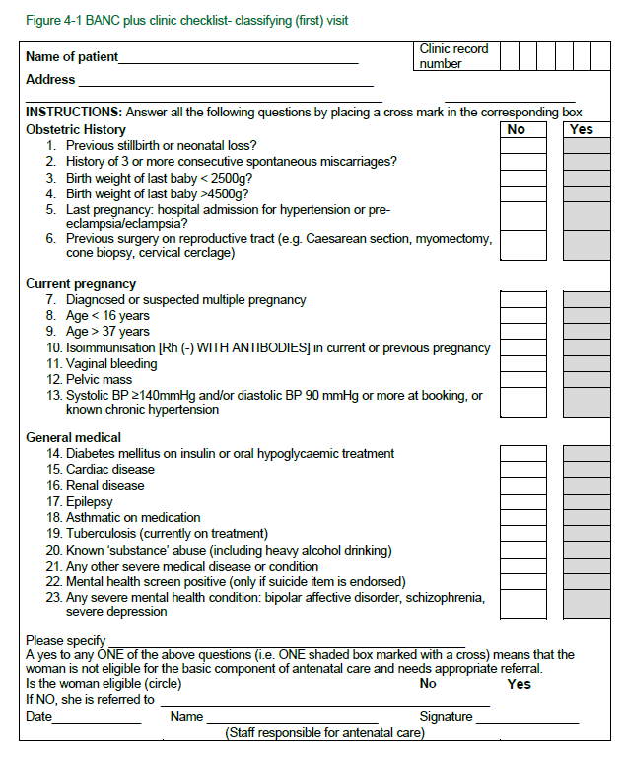
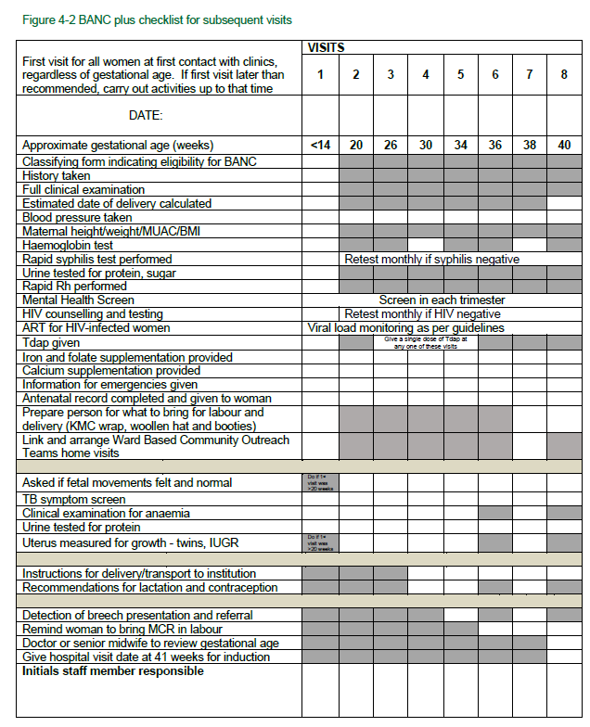

Slide 14
PRENATAL SCREENING FOR FETAL DEFECTS: CHROMOSOMAL / STRUCTURAL

Slide 15
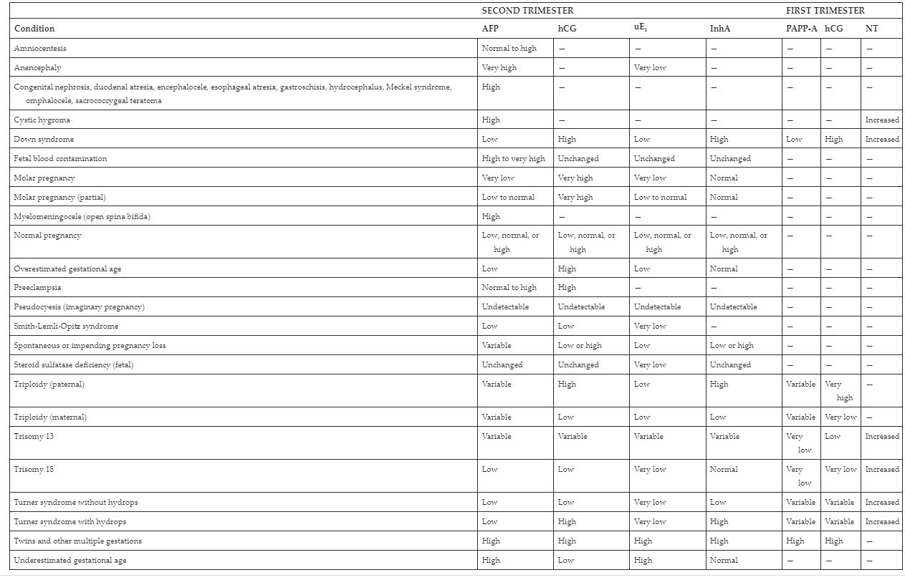
MATERNAL SERUM SCREENING PATTERNS AND ASSOCIATED CONDITIONS

Slide 16
HISTORY
1970: Maternal serum screening for neural tubal defects (NTD)
  Second trimester
1977: United Kingdom. Collaborative multicentre study to develop reporting convention, i.e. Multiple of the median (MoM).
  Developed to account for large result discrepancy between centres
1984: Association between elevated AFP and Down syndrome (T21) was identified
1988: Triple test implemented: unconjugated oestradiol (uE3), human chorionic gonadotrophin (hCG), AFP
1990: Fourth analyte introduced to T21 screening: Inhibin A

Slide 17
Notes:
Detection rate (DS):
Quad 81%
Triple 69%

Slide 18
PHYSICIAN REQUIRED INFORMATION
Specimen collection date
Identify specimen as 1st vs 2nd trimester
Date of LMP or gestational age (U/S)
Relevant pregnancy history
Fetus number
Maternal race
Maternal diabetes requiring insulin

Slide 19
CONSTITUENT BIOCHEMISTRY
1ST TRIMESTER
  PAPPA
  hCG
2ND TRIMESTER
  AFP
  hCG
  uE3
  Inhibin A

Slide 20
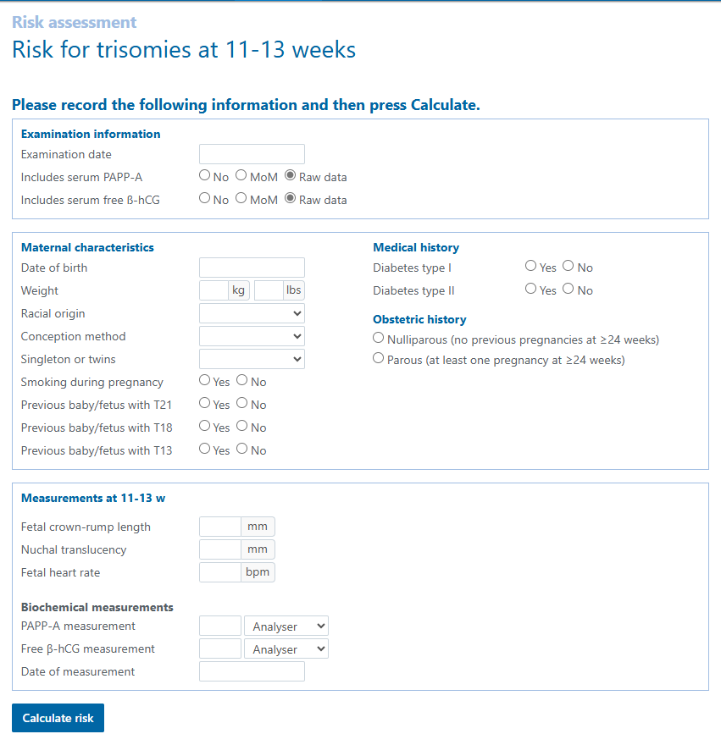
Notes:
Brahms Kryptor

Slide 21
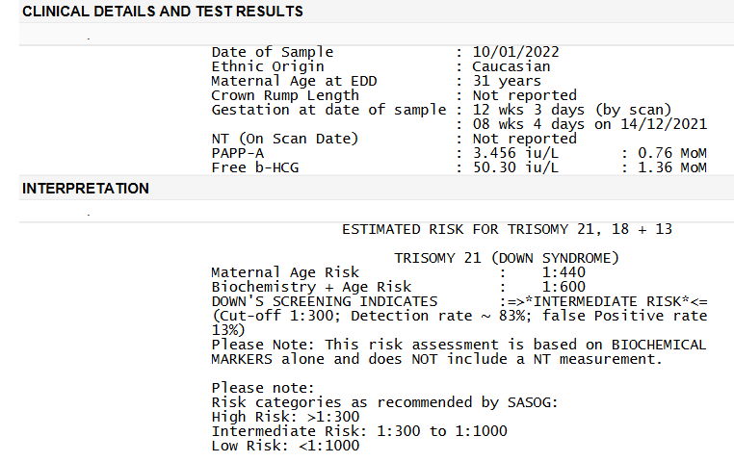

Slide 22
Multiple of the median (MoM)
Developed in UK 1977 collaborative study
Normalising statistic
Calculating MoM
  “In house” laboratory data used
    Considers current laboratory performance, and population
  Develop median values for each gestational week (or day)
  Recalculate values every 3 months
    Caucasian, black, coloured, asian)
  Calculations:
    “Individual test”/Median=MoM
Notes:
3 monthly data generation
200pts/ethnic group
Changes confirmed with ALPHA

Slide 23
GUIDELINES:
Screening for Chromosomal and Structural Fetal Anomalies: Guidelines for South African Private Practice. African Journal of Obstetrics and Gynaecology | Volume 1 | Issue 2 | 2023
Summary:
  Offer appropriate screening to all patients:
    1st vs 2nd, Trisomy vs NTD etc.
  If refused:
    Document + offer Basic U/S
  If accepted:
    Discuss screening options: Biochemistry, combination screen (Biochem + FMF U/S), NIPT
    High risk biochem (>1:300): FMF U/S or NIPT
    NIPT: Pre-/post- test genetic counselling
    Discuss invasive testing options: CVS or amniocentesis
    Multiple pregnancy: FMF U/S (Biochemistry if multiple pregnancy risk calculation is an option)
Notes:
1:200-1:300
NIPT 99% accuracy

Slide 24
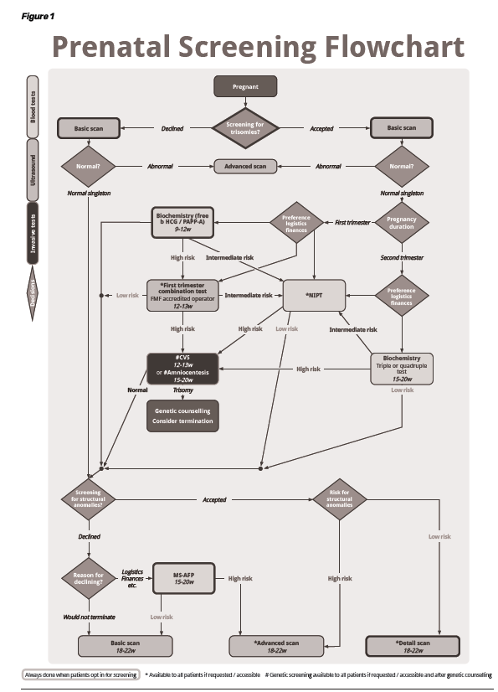
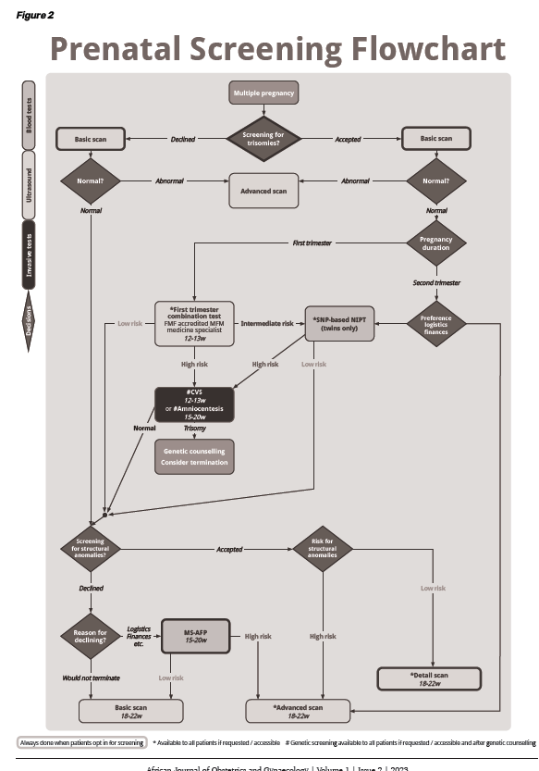

Slide 25

NON INVASIVE PRENATAL TESTING (NIPT)

Slide 26
NIPT
Cell free DNA (cfDNA)
  Circulating free DNA
  Short degraded DNA fragments released in plasma
Screening test
Screens:
  Trisomy 21 (Downs)/18 (Edward)/13 (Patau)
  Sex chromosomes:
    Turner Sx (monosomy X)
    Triple X Sx (XXX)
    Jacobs Sx (XYY)
    Klinefelters Sx (XXY)
Notes:
99% accuracy

Slide 27
NIPT
From 10 weeks: Requires sufficient fetal circulating cfDNA
Peripheral blood draw from mother (Minimal invasive)
  No miscarriage risk compared to amniocentesis
High detection rate
Low false positive and low false negative

Slide 28
NIPT
Singelton pregnancies
Twins
Donor pregnancies
In vitro fertilization
Surrogacy

Slide 29
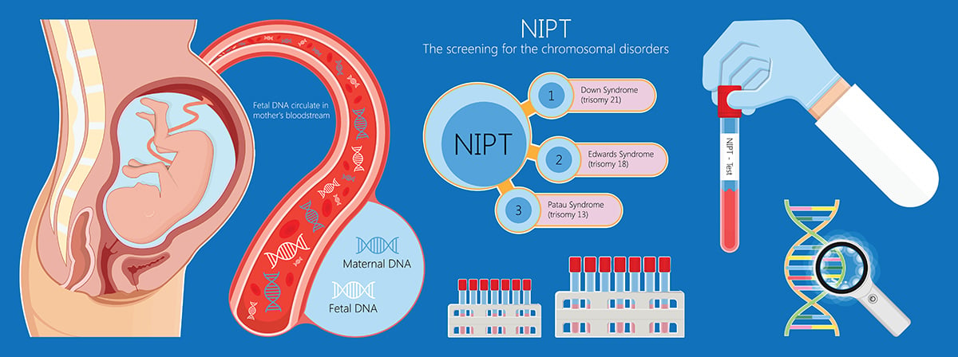

Slide 30
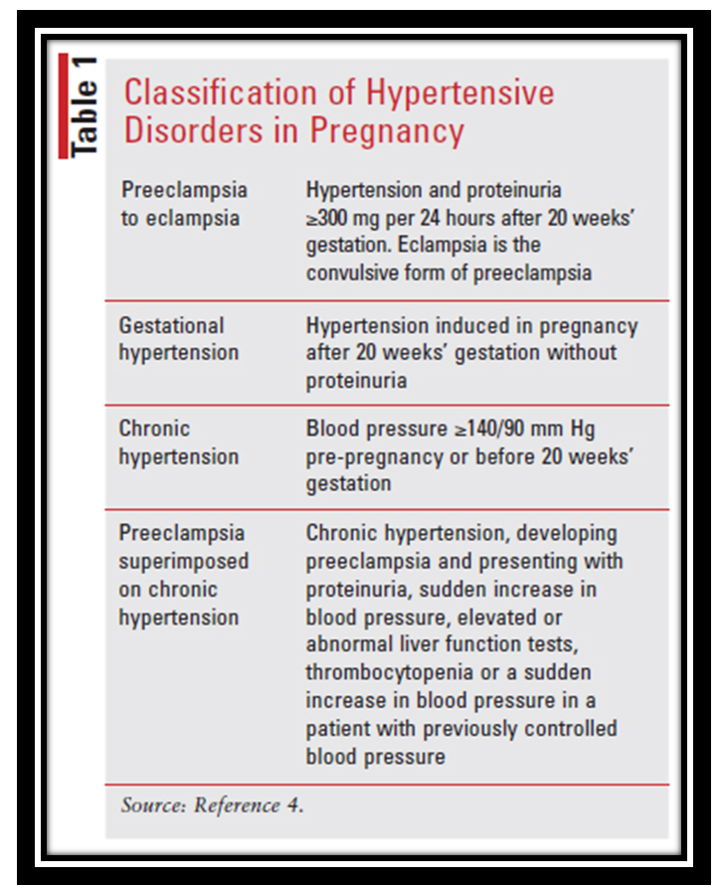
PRE ECLAMPSIA SCREENING

Slide 31
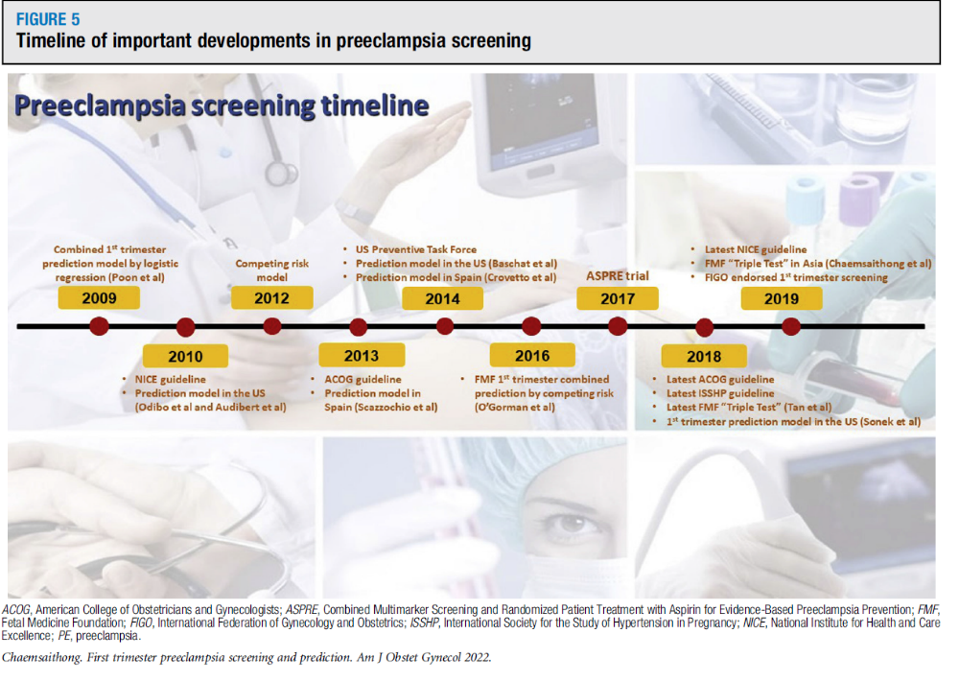

Slide 32
Pre-eclampsia is a multisystem disorder of pregnancy characterized by:
  New onset Hypertension
  after 20 weeks gestation
  significant proteinuria or end organ dysfunction
Affects 2 to 8% of women
  Associated with high risk of complications to mother and baby (morbidity and mortality)
Studies have demonstrated the beneficial use of aspirin early on in pregnancy
Some prediction models during first trimester to detect and treat- NICE/ ACOG
  Results have been suboptimal
  NICE- 41% and 34% detection rate FPR (10%) for pre-term and term PE
  ACOG- 5 % and 2% FPR (0.2%)
FMF validated a first trimester prediction model (TRIPLE TEST)
  maternal factors
  measurements of mean arterial pressure (MAP)
  uterine artery pulsatility index
  serum placental growth factor (PlGF)
FMF detection rates
  90%: Early PE
  75%: Preterm PE
  FPR of 10% for pre-term and Term PE

Slide 33
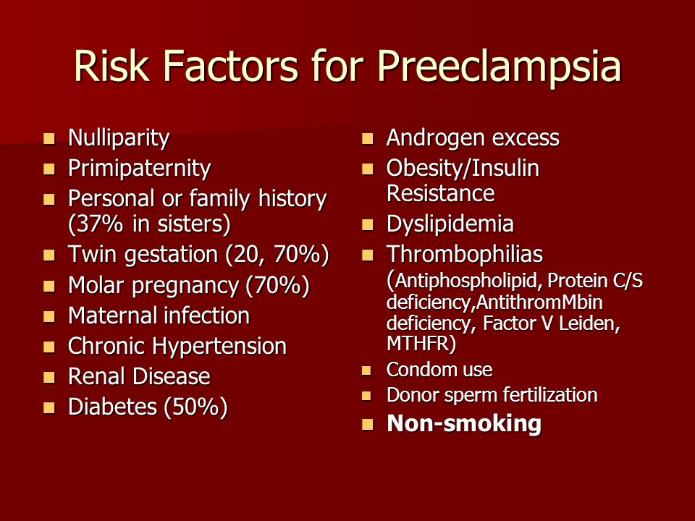

Slide 34
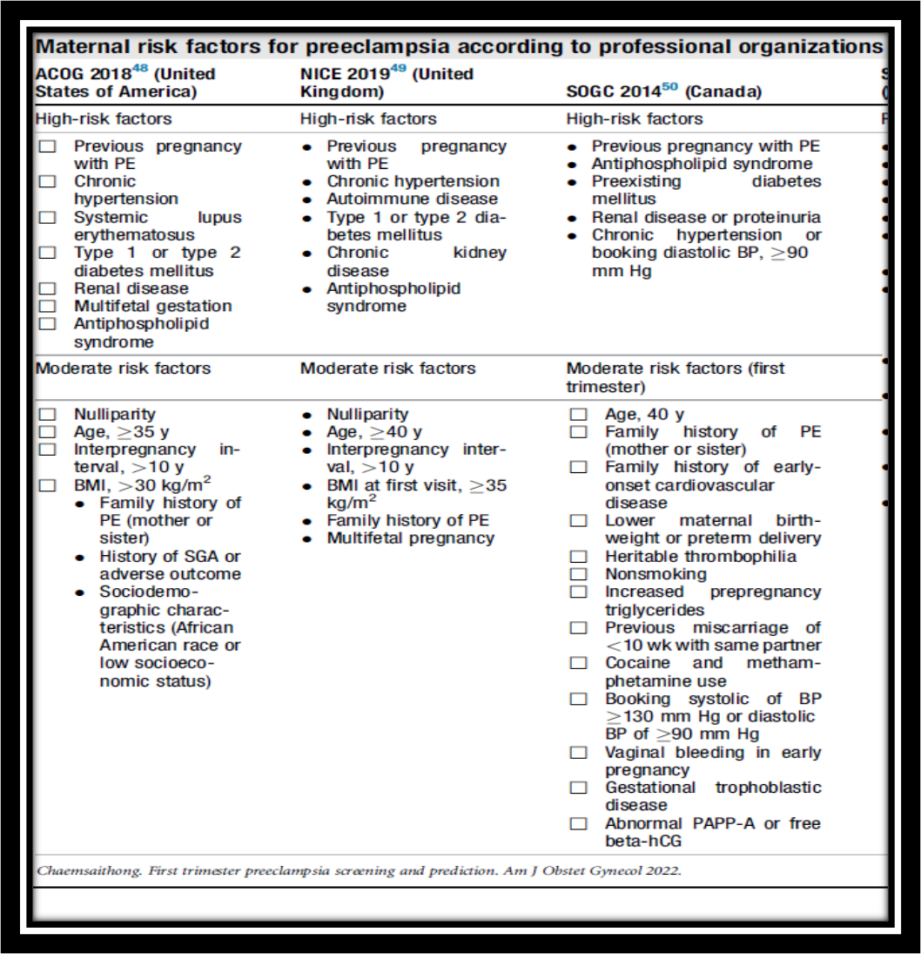

Slide 35
MEASURES TO PREVENT PRE-ECLAMPSIA
National integrated manual and perinatal care guidelines for South Africa, 5th edition, 2024
Calcium supplementation:
  1g calcium, divided dose
    E.g. Calcium carbonate 500 bd
High risk pre-eclampsia
  Aspirin 150mg at night
    From 6 weeks to 36 weeks gestation (preferably start before 16 weeks)

Slide 36
ASPRE trial: Aspirin for evidence-based Preeclampsia prevention
To test whether aspirin (150mg) can reduce the incidence of preterm pre-eclampsia in women at high risk identified using the FMF algorithm
Randomly assigned participants to take either 150 mg of aspirin or a placebo daily from 11 to 36 weeks of gestation
Aspirin
  reduced the incidence of preterm pre-eclampsia by 62%
  Reduced the incidence of early pre-eclampsia by 89% (34 – 37 weeks)
Aspirin no significant affect on term PE

Slide 37
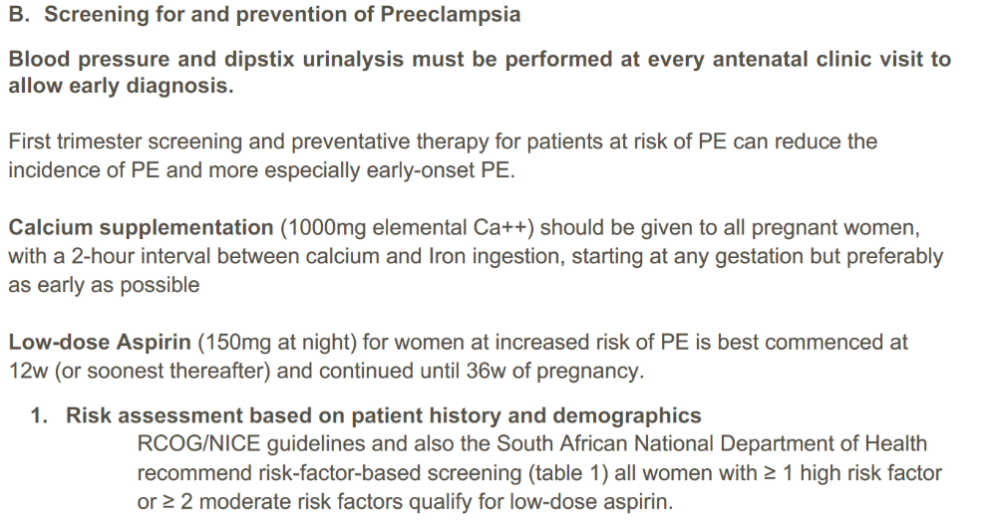
SASOG guidelines

Slide 38
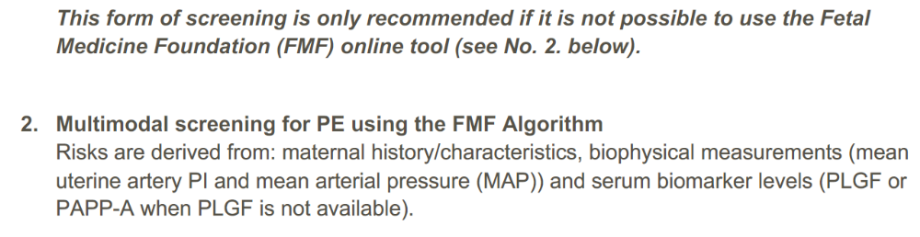
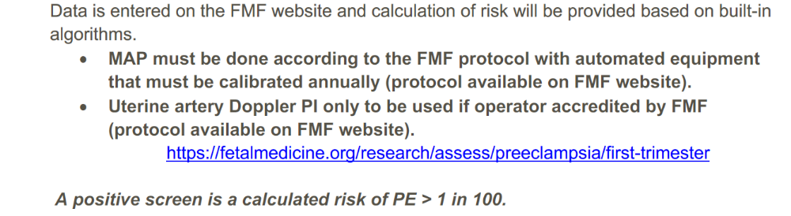

Slide 39
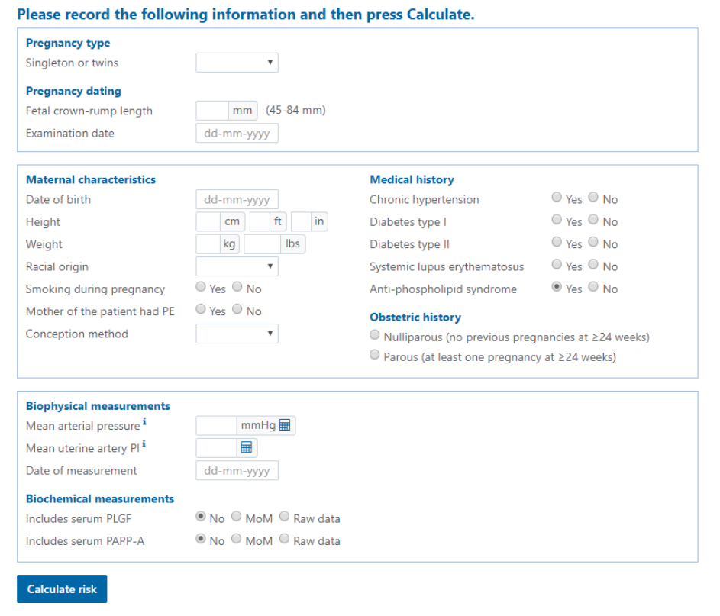

Slide 41
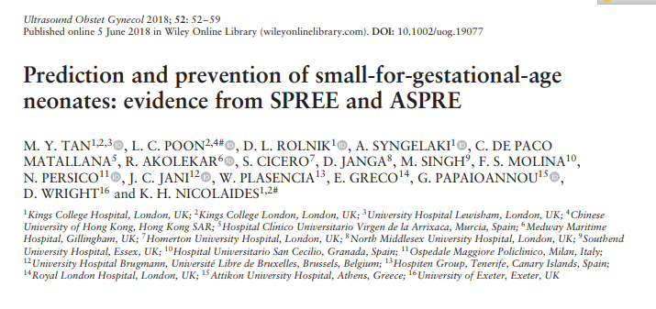

Slide 42
2 multicentre studies
  SPREE (Screening ProgRamme for prE-Eclampsia)
  ASPRE (Aspirin for evidence-based pre-eclampsia prevention)
First trimester screening data
  maternal factors
  measurements of mean arterial pressure (MAP)
  uterine artery pulsatility index (UAPI)
  serum placental growth factor (PlGF)
Identifies a high proportion of cases of preterm SGA which can be prevented by prophylactic aspirin
Notes:
SPREE: PE screening is superior to NICE guidelines
ASPRE: Aspirin is effective in PE

Slide 43
THANK YOU!!
Ronald.Dalmacio@pathcare.net
041 391 5700
0792275589

Slide 44
