Slide 1



The Value Care Team
From PPO Serve
Lungi Kasapato and Brian Ruff

Slide 2

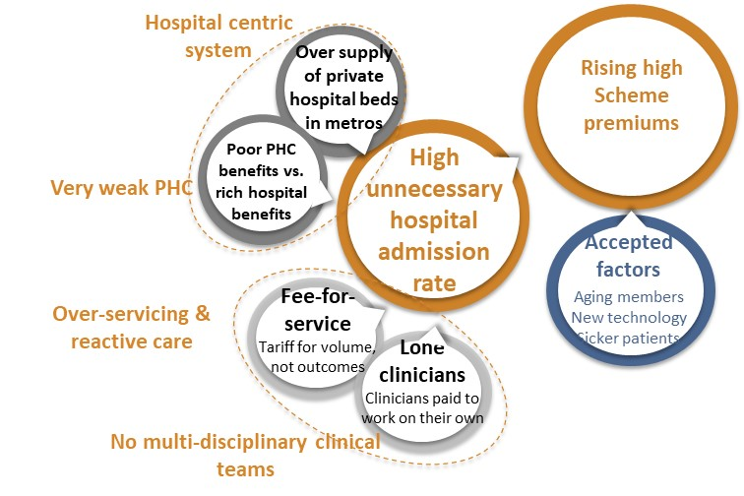
Problem Statement:
SA Private Healthcare sector is poorly organised, very costly with sub-optimal outcomes
Low volume, high-cost model - poor value

Slide 3

Solution: Population Medicine
Teamwork, Value-based Models
Solution: Healthcare is a team sport
“the only way to make quality healthcare affordable is to organise clinicians to actively work together in teams”
3

Slide 4







PPO Serve:
Health management company - 2015
Dr Brian Ruff & Riedwaan Jabaar
Alberton GP consortium PHC programme 2016 – 2018
The Birthing Team 2017 - 2021
GP Care Cell (HIV)- 2018 - 2022
GEMS TVCT pilot 2019 => GEMS Population Medicine Programme 2023 open ended
GP Care Cell
A project of:
In partnership with:
Funded by:

Slide 5

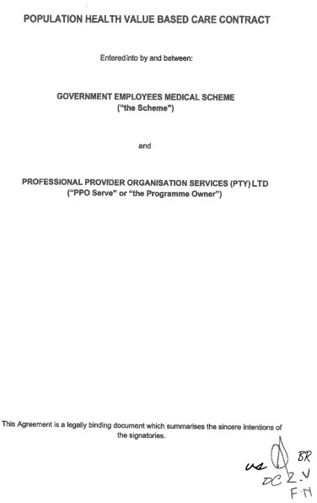




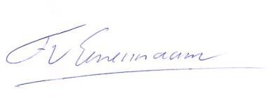
Value-Based Care
Value = best Outcomes (matter to patient) / lowest cost(through patient’s journey)
PPO Serve - The Value Care Team
In recognition of the nomination for the Value-Based Health Care Prize 2023 and their contribution to the implementation of Value-Based Health Care
Prof. dr. Fred van Eenennaam, VBHC Center Europe
A special thank you to the honorary chairman and the international jury:
Prof. Michael Porter, PhD
Dr. César Velasco Muñoz, MD, PhD Dr. Jens Deerberg-Wittram, MD
Prof. Robert S. Kaplan, PhD Prof. Federico Lega, PhD
Prof. Alice Andrews, PhD Prof. Leonard H. Friedman, PhD, MPH Dr. Christina Åkerman, MD, PhD, MBA
https://iris.who.int/bitstream/handle/10665/373212/9789240078499-eng.pdf https://vbhcprize.com/nominees-vbhc-prize-2023/

Slide 6

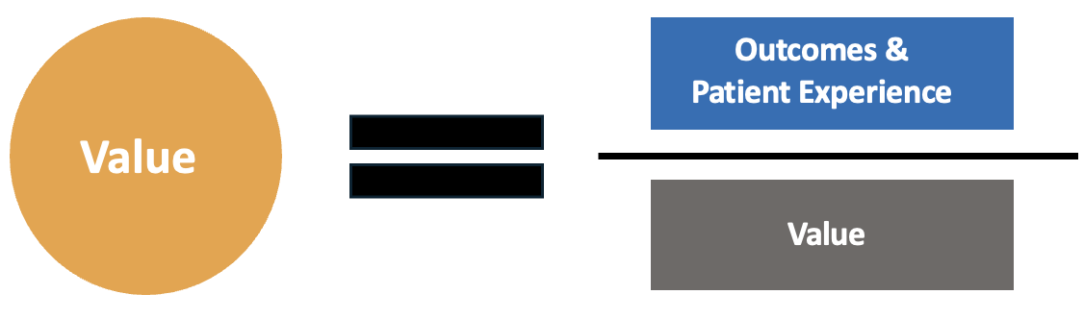

What is value-based care?
Value-Based Health Care is a framework for restructuring health care systems around the globe with the overarching goal of value for patients.
Cost
A framework for restructuring healthcare – focus is on
achieving the best outcomes at the lowest cost.
Notes:
In 2006, Michael Porter published the book Redefining Health Care: Creating Value-Based Competition on Results

Slide 7

GEMS Population Medicine Programme - delivered by PPO Serve

Slide 8
TVCT Vision
Restore balance to private healthcare by strengthening PHC vs. specialist / hospital care
GP led primary care multidisciplinary teams – system building blocks
TVCT teams take clinical accountability - for their shared population
    fair risk adjusted monthly global fee replaces ‘fee for service’ (volume incentive)
    plus
    ‘value based care’ fee - significant % linked to health outcomes (value incentive)
    Care Coordination: patient access healthcare: right time, right level of care
    TVCT – convergence towards Universal Health Coverage

Slide 9



The Value Care Team: Introduction
Value-based care model
TVCT strengthens PHC:
Core: GP - centered PHC role
Multidisciplinary teams – leverage medical skills
Value - Based Care Contract:
  replaces Fee for Service
  rewards improved patient care outcomes
Unlimited out-of-hospital (OH) risk benefits - comprehensive PHC benefits counterpoint unlimited hospital benefits
Social and environmental – NB causes of hospital bed days

Slide 10
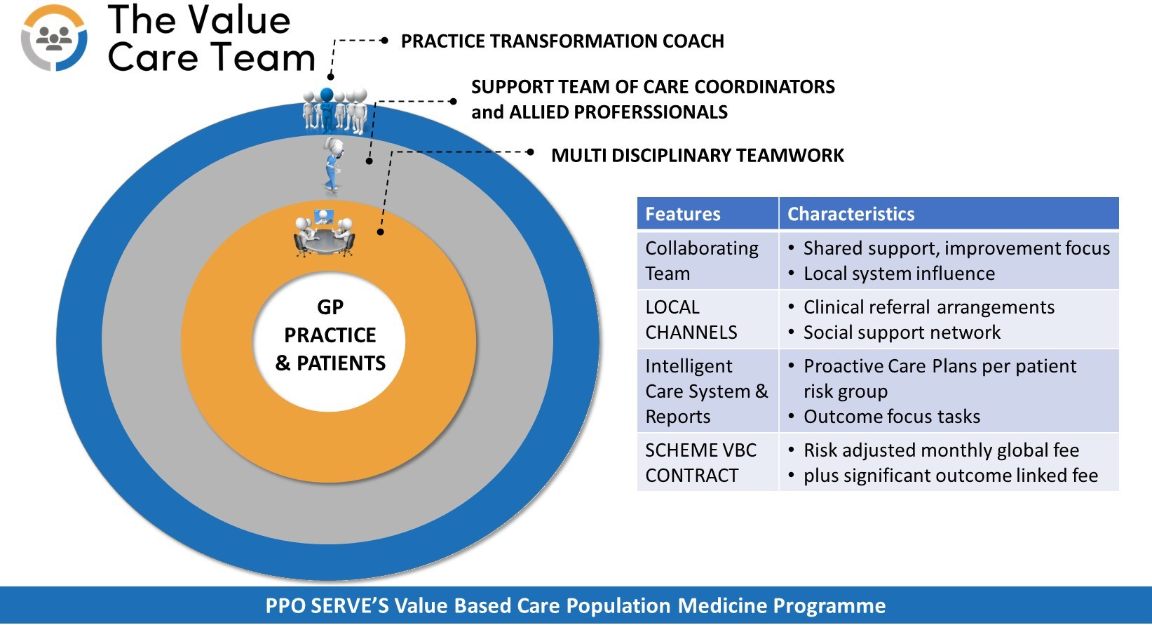
The Multidisciplinary TeamDelivery Model
The Government Employees Medical Scheme (GEMS) is an authorised Financial Services Provider (FSP No 52861)

Slide 11
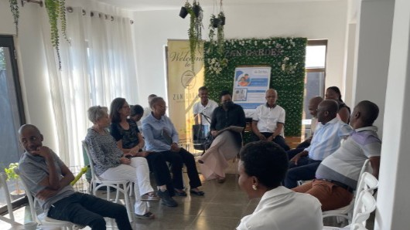
The Multi-Disciplinary Team meeting
The Government Employees Medical Scheme (GEMS) is an authorised Financial Services Provider (FSP No 52861)

Slide 12

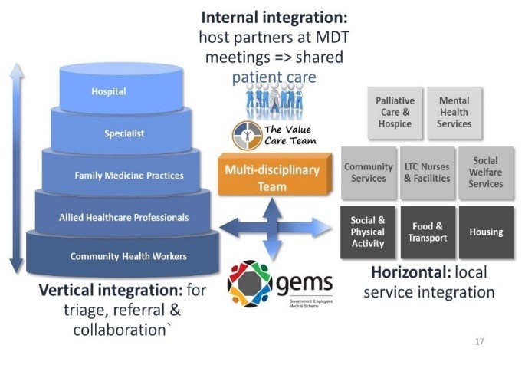

External Integration
– Vertical and Horizontal

Slide 13
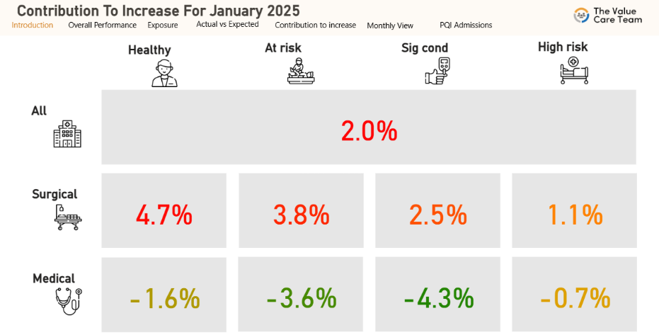
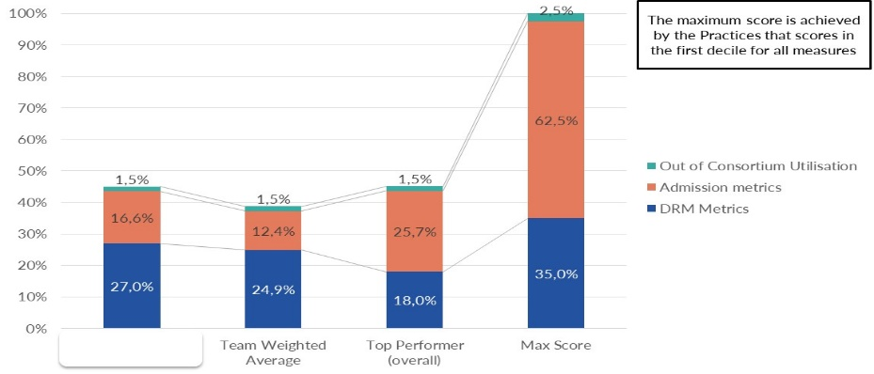
Team Coordination and Support
The TVCT Coach per Hub:
Liaison: PPO Serve and GP practices
Manage TVCT support team – support the Practices
Manage referral arrangements – quality, effective care
Authorisations: scheme ‘in lieu of’ benefits
Train Practice to use the TVCT tools:
  Intelligent Care System (ICS): clinical IT solution for Value-Based Care success
  Practice outcome reports = craft solutions to improve outcome scores
Remuneration: process for Practices, Allieds etc.
Practice

Slide 14
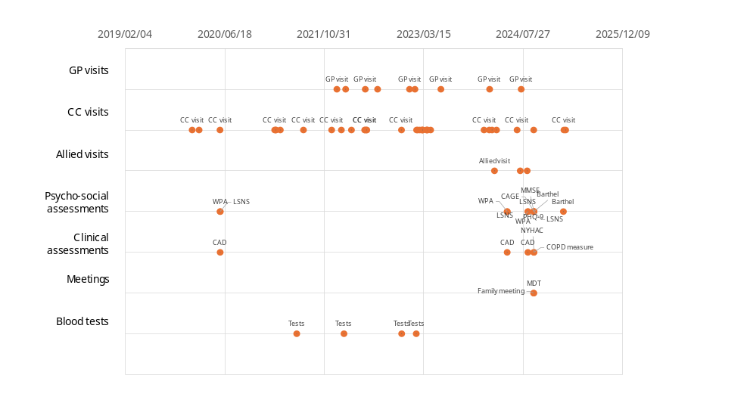
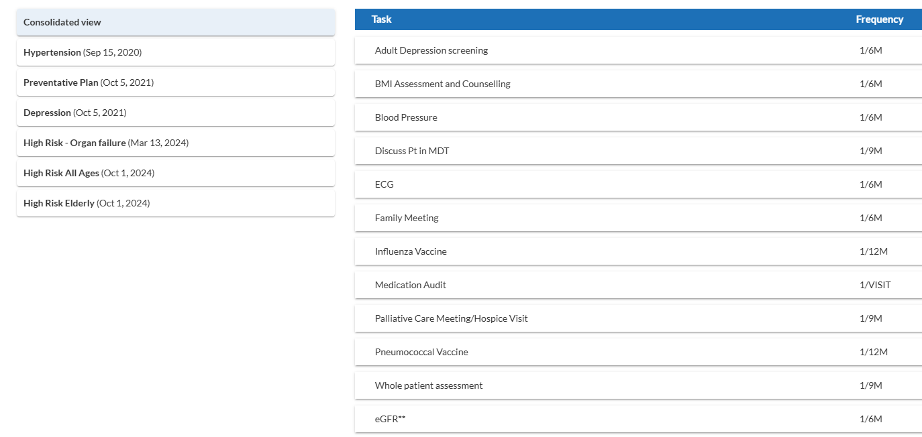
Team Coordination and Support
Care Coordinator (CC) - the Practice’s primary patient population outreach agent:
Works with Practice - optimise patient care, reduce crises/admissions
Trust relationship: patient/ family; complex ‘high needs’ patients, with “at-home” care
Patient information (clinical & psycho-social) + care plan tasks (on ICS)
Link patient to relevant Team medical, allied and support services
Chronic Illness care & compliance support + access to team programmes
Referrals to specialists & support agencies
Case study
Team activity for a patient over time

Slide 15
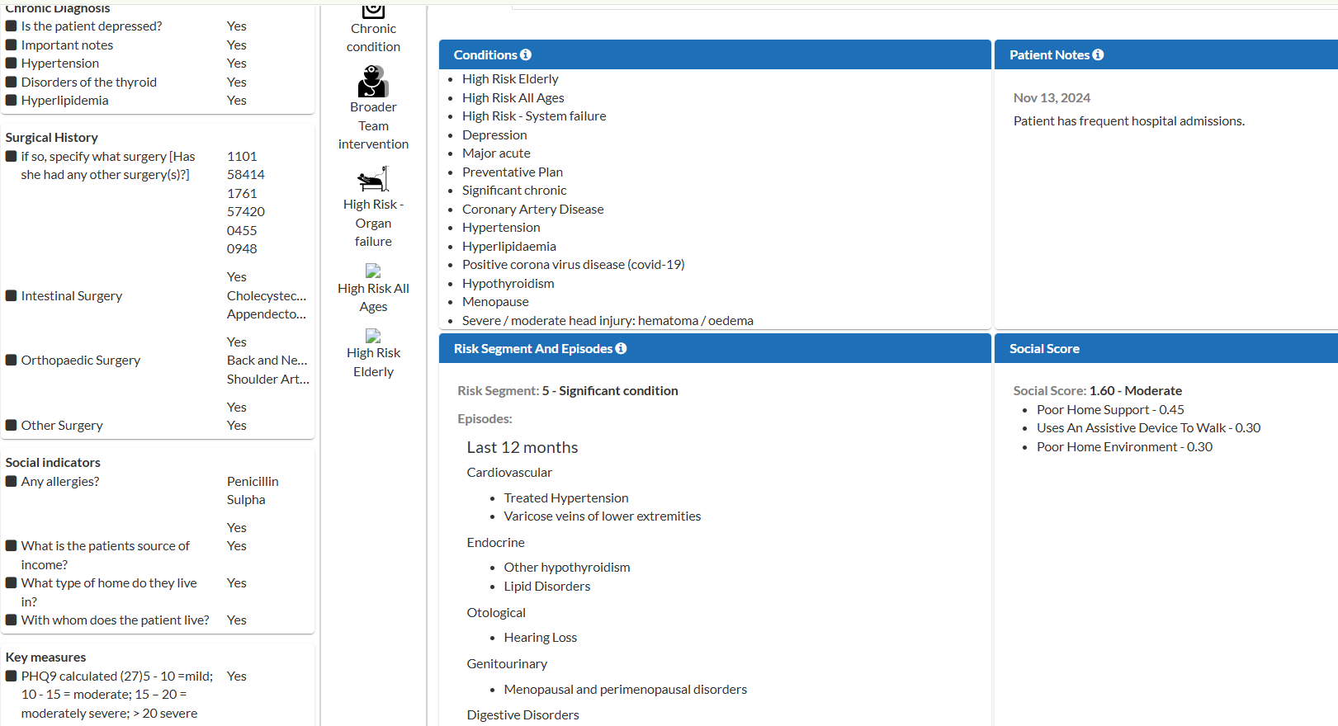
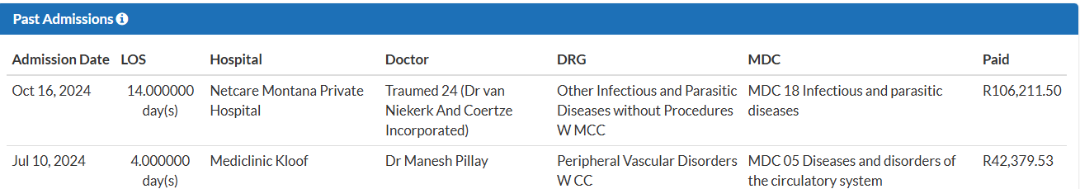
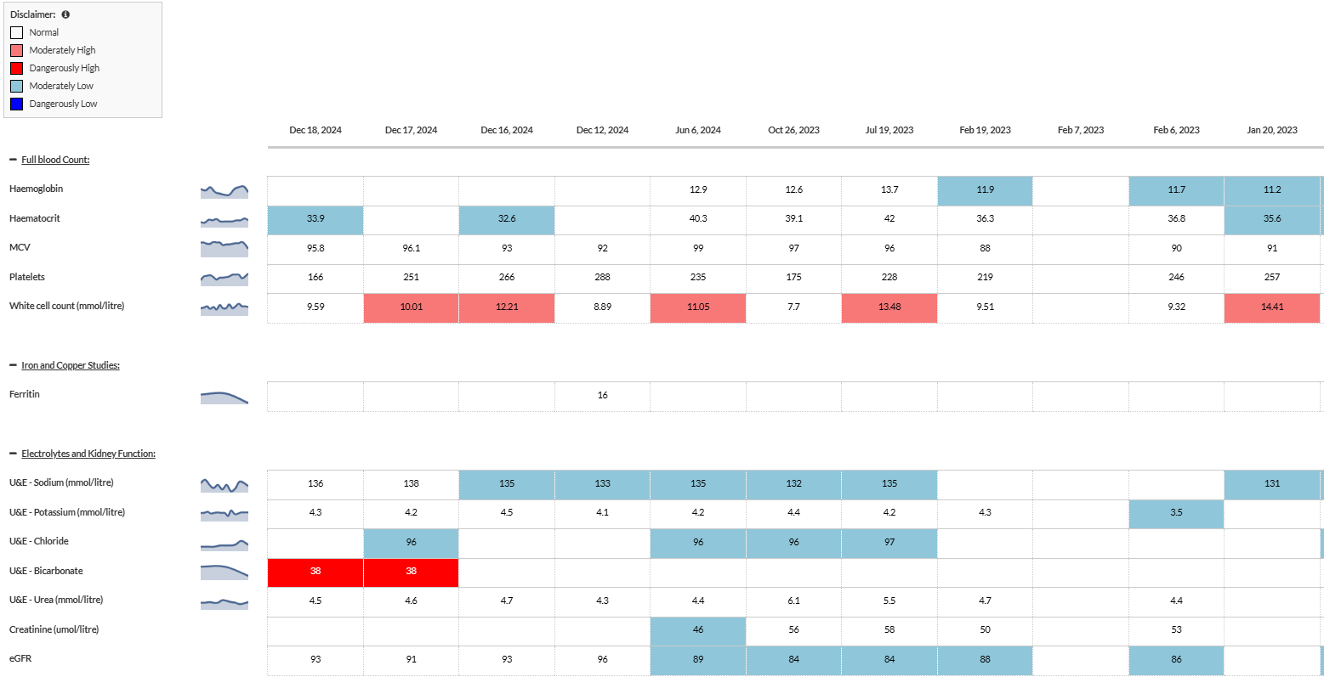

TVCT Benefits for the GP Practice
Better Quality of Life – with supported Teamwork
Consistent, higher revenue – rewards accountability
Clinical Practice IT support
Simple Practice Admin
Data-driven performance support
PPO Serve manages the Scheme contract

Slide 16

TVCT Benefits for the Patients
Out-of-hospital PHC scheme benefits – don't run out
Broad-based care from their GP practice MDT
Care Coordinators support: educate, discuss preferences, guide through the system
Well-managed benefits result in affordable, sustainable premiums

Slide 17

Conclusions
Population Medicine Programme
GP Practices reclaim their central PHC role in the healthcare system and `get rewards their good performance
Patient benefits from the improved outcomes
Scheme’s are affordable to more patients

Slide 18
THE VALUE CARE CONTRACT
Everyone wins

