Slide 1

Advances in Cervical Cancer
Screening and HPV Management
Dr Siva Pillay
25.6.2025
Notes:
Introduce the topic. Emphasize importance of updating practice based on latest WHO and national guidelines.

Slide 2
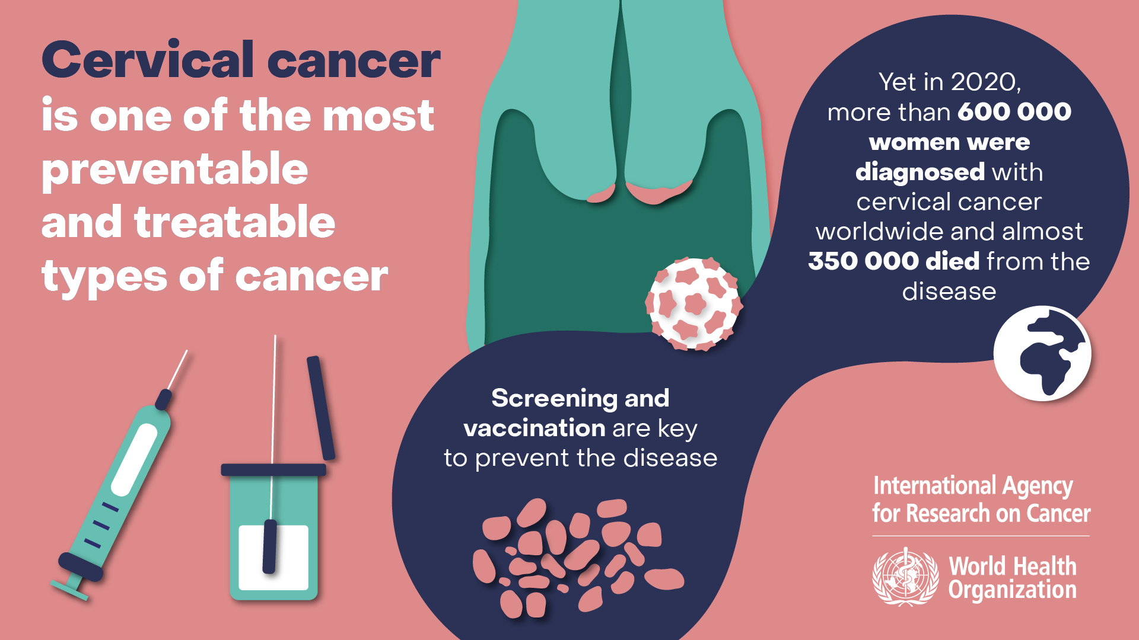

Slide 3
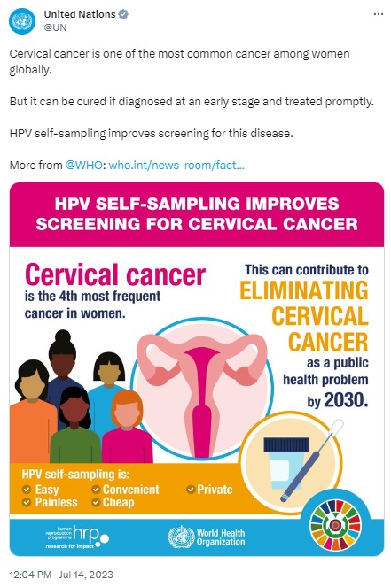
Global & Local Burden of Cervical Cancer
2nd most common cancer in women globally
90% of deaths in LMICs – poor screening
High burden in South Africa due to HIV co-infection
Preventable through screening & early vaccination - extended program beyond 9 year old girls
Notes:
Highlight disparities and need for focused interventions in LMICs like South Africa.

Slide 4
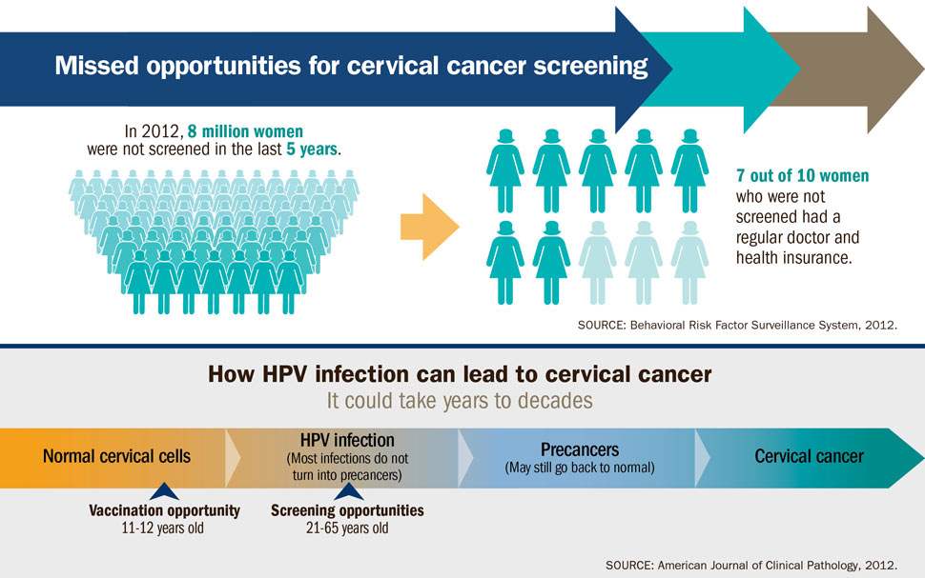
Missed Opportunity for a Preventable condition!

Slide 5
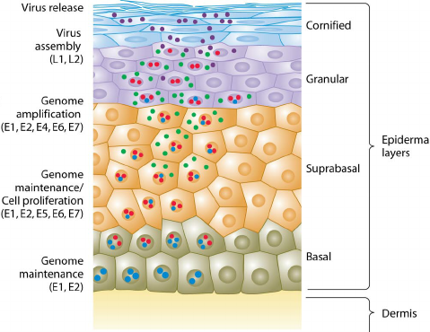
Why HPV before Pap !
99% of Cervical Cancer are caused by persistent HPV infections
HPV 16 & 18 cause ~90% of cervical cancers
Sexually transmitted – but also by skin contact
Most infections resolve- but the persistent infections cause cancer
Notes:
Explain the natural history of HPV and its link to cervical cancer.

Slide 6
Screening Guidelines – General Population
99% of Cervical Cancer are caused by persistent HPV infection
HPV DNA testing preferred from age 25
HPV test every 5 years for non-HIV patients
HPV test every 3 years for WLWH
WHO recommends HPV screening be PHC based
Only do Pap Smear if HPV + (Done at same time but request Pap only if HPV+)
Notes:
Emphasize shift to HPV testing for greater accuracy and longer screening intervals.

Slide 7
Screening in Women Living with HIV
Start at age 25
HPV DNA every 3 years if HPV negative
If HPV + then high risk of persistent infections which is cause of cancers
If HPV + & CIN2+ lesions – treat early
Notes:
Stress earlier, more frequent screening and tailored management for HIV-positive women.

Slide 8
If HPV +
HPV(+) with & VIA (+) - treat or refer
HPV(+) & VIA (-) – then repeat in 1 year
Treatment: Triage & Manage of HPV+ depends on:
  HIV status (because of increased risk and persistence of HPV)
  Type of screening used (HPV DNA, VIA, or cytology)
  Availability of follow-up services (colposcopy, treatment)
Notes:
Describe practical approaches to triage and treatment of screen-positive women.

Slide 9
If HPV + & HIV +
  Start screening earlier (age 25)
  Screen more frequently (every 3 years)
  More likely to have persistent infection
  Lower threshold for referral/treatment
  HPV 16/18 regardless of VIA Refer for Colposcopy
  HPV Other HR+ Treat or refer
  HPV other HR+ & VIA - Repeat HPV annually
  Any abnormal cytology (ASC-US+) Refer or treat
Notes:
Describe practical approaches to triage and treatment of screen-positive women.

Slide 10
If HPV + & HIV -
  HPV 16/18 Colposcopy
  HPV other HR+ Triage with VIA or cytology
  HPV other HR+ & VIA - Repeat HPV annually
  VIA+ & ASC-US+ Refer or treat
  Treatment:
  (1) Thermal ablation or Cryotherapy if lesion is visible with no suspicion of cancer and TZ visible
  (2)LEEP / Leitz or Excision Biopsy if lesion is extensive or if high index of suspicion
  All patients who are treated must be followed up annually if Thermal ablation or Cryotherapy
  If (2) further Management depends on biopsy findings
Notes:
Describe practical approaches to triage and treatment of screen-positive women.

Slide 11
HPV Vaccination Protocols
Target: girls aged 9–14
Bivalent, Quadrivalent, Nona-valent vaccines
1-dose effective (WHO 2022)
2-dose or 3-dose based on age and /or immunocompetence
Should also be given to all HPV – female who are >14 years
Ideally should be given to all girls & boys
Notes:
Present simplified, effective schedules especially useful in resource-limited settings.

Slide 12
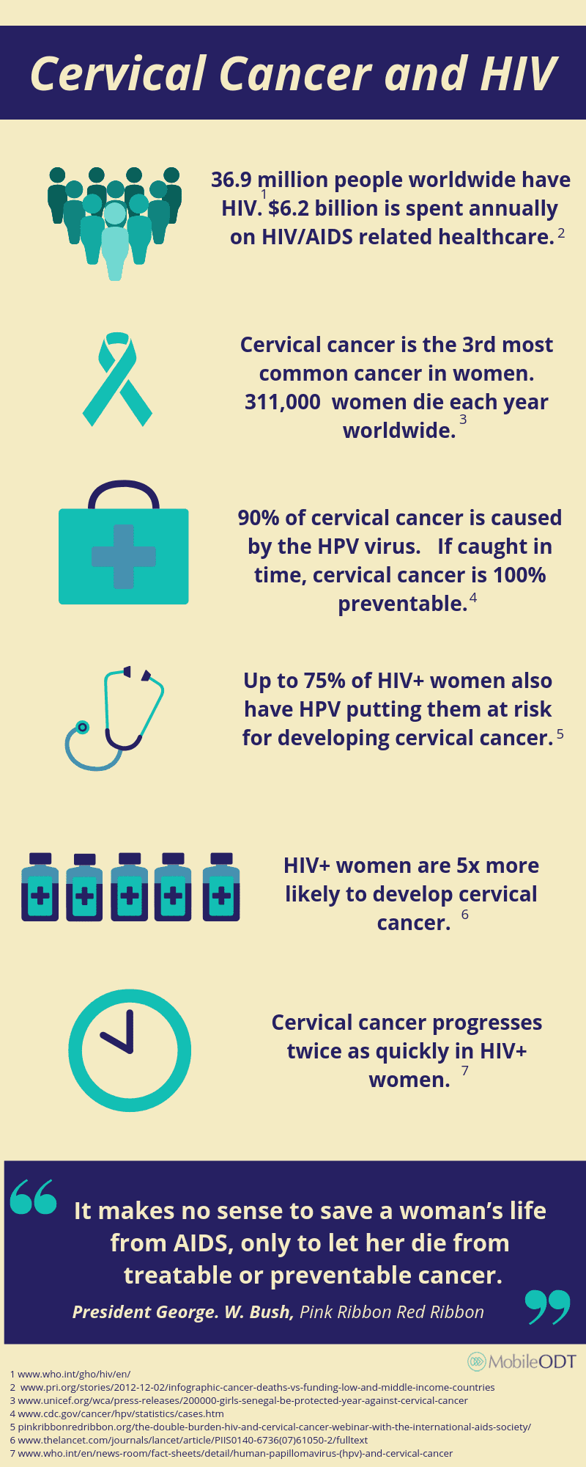
HPV Vaccination in People Living with HIV
3 doses recommended: 0, 1–2, 6 months
Safe & immunogenic
Still need screening post-vaccination
Notes:
Underscore the importance of completing all 3 doses in immunocompromised populations.

Slide 13
Integrating Services for Impact
Integrate HPV, HIV care, family planning
Task-shifting, GPs, clinics, mobile units
Self-sampling with collection points for scale-up
Track data & follow-up
Notes:
Explain systems approach to increasing access and improving outcomes.

Slide 14
Conclusion & Call to Action
Cervical cancer is preventable and can be made obsolete
Screen with HPV, vaccinate early
Prioritize HIV+ women
Support elimination goals (90-70-90)
https://youtu.be/KOz-bNhEHhQ
Notes:
End with a strong appeal for collaborative action and sustained effort.

Slide 15
Resources – 7 Webinars
https://youtu.be/vBkPsQZZqqE
https://youtu.be/c0almr2_XEk
https://youtu.be/I5eTCO1IEyE
https://youtu.be/rvfAvBZ10JQ
https://youtu.be/TbXLFCDczdQ
https://youtu.be/K2LPj0qAuvw
https://youtu.be/-J6PgkIrgyc

Slide 16
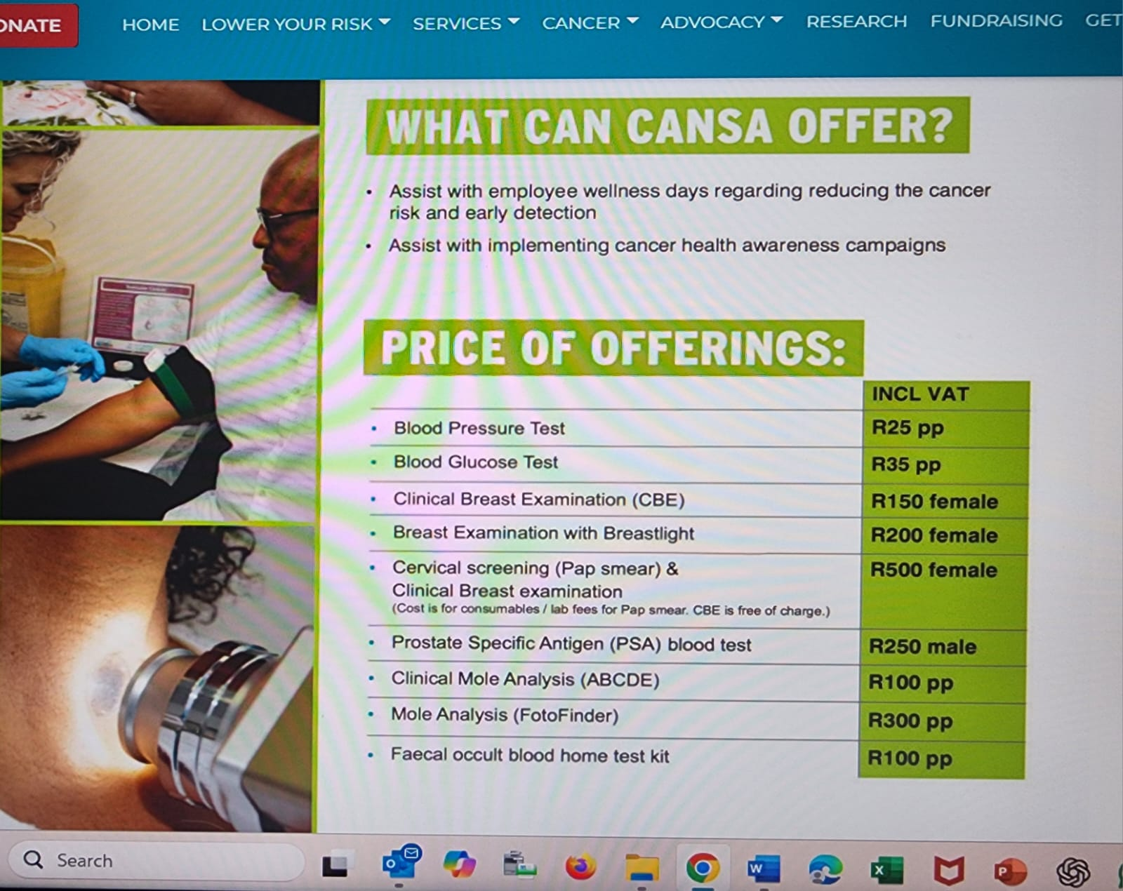

Slide 17
The New Approach to Medicine
The new approach will adhere to the teachings of Hippocrates – in that we will learn from the past, research the present and predict the future
and ..
The pronouncements of Galileo, that the language of God is mathematics and that we should measure everything that is measurable and make measurable everything that is not measurable

Slide 18


