Slide 1

Prevention of
Early-Onset Pre-eclampsia (PE) 25.6.2025
Dr Siva Pillay
Maternal Fetal Medicine

Slide 2
Disclaimer
  No declarations to make
  Not affiliated to parties with Financial Interests
  No conflict of Interest

Slide 3
Prevalence of Early-Onset PET
Occurs in 0.5% to 1% of pregnancies worldwide
More common in women with risk factors (e.g., prior PET, chronic hypertension, diabetes)
Higher incidence in LMICs due to limited screening and antenatal care access
Higher incidence in Black African population and WLWH

Slide 4
Complications of Early-Onset PET
Severe hypertension and proteinuria after 20 weeks gestation
Fetal growth restriction and preterm birth
Increased risk of placental abruption, HELLP syndrome, and maternal organ failure
Higher perinatal and maternal mortality rates
Long term cardiac sequalae for PE

Slide 5
Screening for PET in the 1st Trimester
Performed between 11–13+6 weeks gestation
Includes maternal history, mean arterial pressure (MAP), uterine artery Doppler, and PlGF
Risk calculation using combined algorithm (e.g., FMF algorithm)
Identifies high-risk women for early intervention

Slide 6
Aspirin Prevents Early-Onset PET
Low-dose aspirin (usually 150 mg at night) started early before 16 weeks (2 x Ecotrin)
Improves placental perfusion by inhibiting thromboxane and enhancing prostacyclin
Reduces incidence of early-onset PET by up to 95% in high-risk women
Safe and cost-effective intervention

Slide 7
Guidelines for Aspirin Use
Start between 11–14 weeks in high-risk pregnancies
Continue until 36 weeks or if PET sets in before delivery
Recommended by FIGO, NICE, and ACOG for women at high risk
Monitor adherence and side effects
Stop 72h before any planned surgery

Slide 8
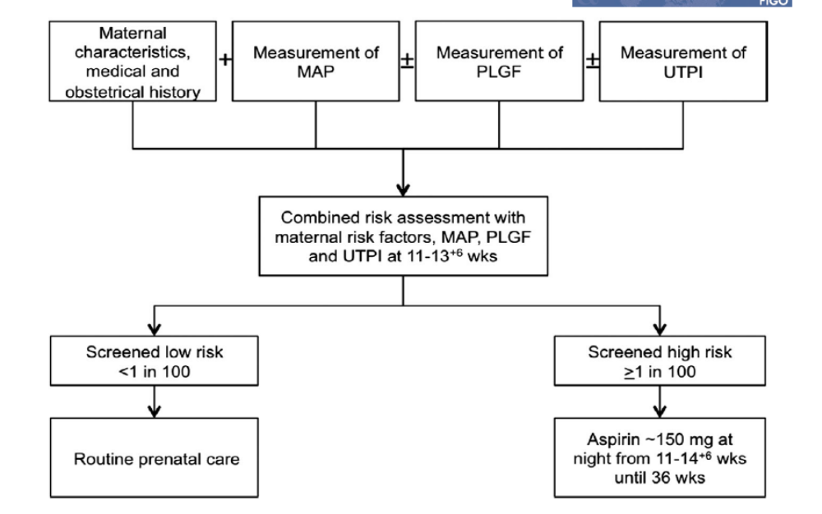
Gold Standard in PET Prophylaxis
(91% effective – early onset PET)

Slide 9
Primary PET Prophylaxis (Risk Score)
High Risk (3) Pre-gestational DM Chronic Hpt Thrombocytopenia Chr. Renal Disease Auto-immune Diseases (SLE; APLAS; RA) Assisted Reproduction (OD or Surrogacy) | Moderate Risk (2) Hypothyroidism F/h/o PET Gestational DM BMI >= 35 Multiple pregnancy Previous PET | Low risk (1) Age >35 Age <19 Anaemia <10g% BMI >= 30 Primigravida Mother SGA F/h/o Cardiac disease PCOS Preg interval > 7 years IVF / ICSI Assisted preg MAP >= 85mmHg Dyslipidaemias Weight gain in preg
If score is >/= 3
Start PET Prophylaxis
Aspirin 150mg/d (Ecotrin 2 nocte)
+
Calcium 1g -1.5g/d

Slide 10
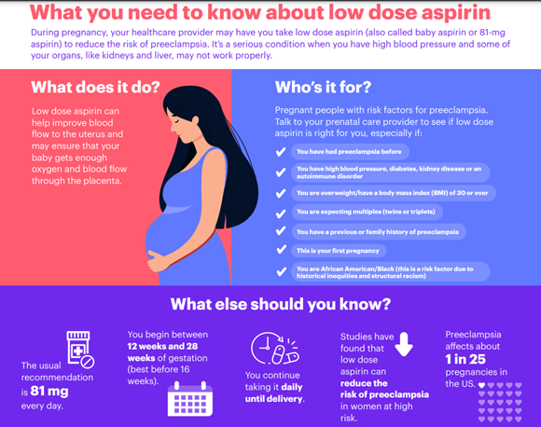

Slide 11
FMF Recommendation / Conclusion:
Preeclampsia is a severe pregnancy complication, with high long-term morbidity for mother and child, and has a high incidence of about 2-5% in South Africa
Prediction & prevention of most early-onset PE is possible today
PE screening should be offered to all pregnant women.
The most efficient method of prediction (screening) is the combined 1st trimester screening algorithm for PE developed by the FMF.
With such screening 75% of all pregnant women at increased risk for preeclampsia can be identified & preterm PE can be prevented in about 2/3 of these women.
Aspirin can help 91% of PE mothers

Slide 12
Take home message
PET Prophylaxis post Screening
with
Aspirin 150mg/d (Ecotrin 2 nocte)
+
Calcium 1g/d
91% effective to prevent and help with
Early onset PET

Slide 13
References
FIGO (2019). 'FIGO Initiative on Pre-eclampsia'
NICE Guideline NG133 (2019). Hypertension in pregnancy
Rolnik DL et al. (2017). N Engl J Med, 377:613–622
• ACOG Practice Bulletin No. 222 (2020)
FMF – which put out the first algorithm

