Slide 1



Diphtheria overview
Dr Jocelyn Moyes
Dr Arifa Parker
Centre for Respiratory Disease and Meningitis (CRDM)
National Institute for Communicable Diseases (NICD)
jocelynm@nicd.ac.za/jossmoyes@gmail.com
0828832044

Slide 2
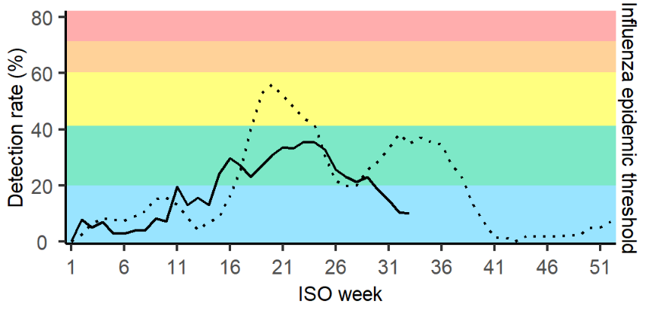
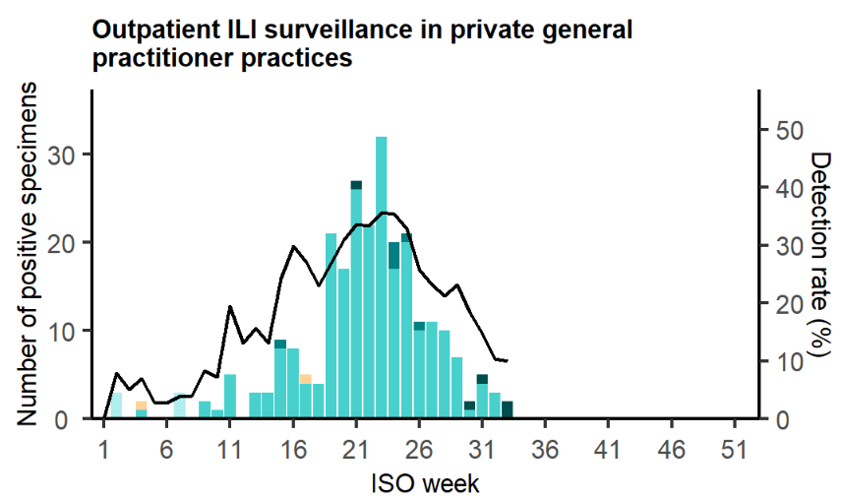
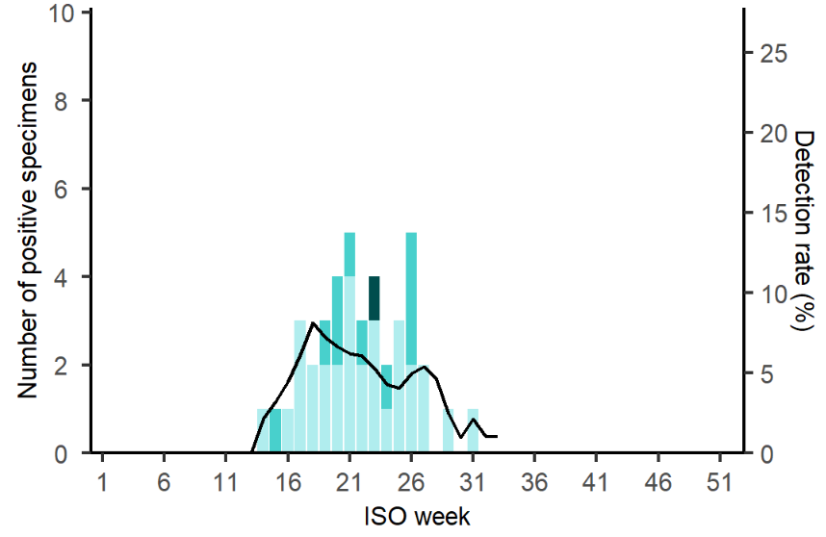
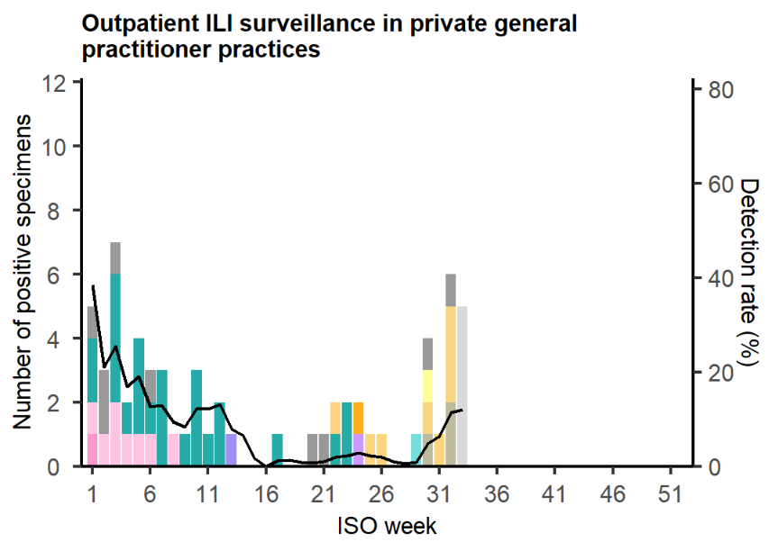
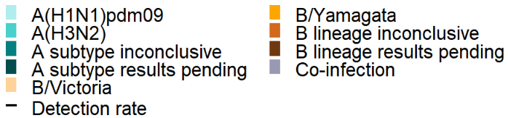
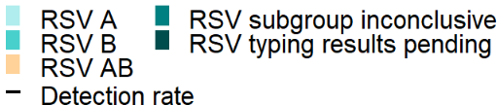
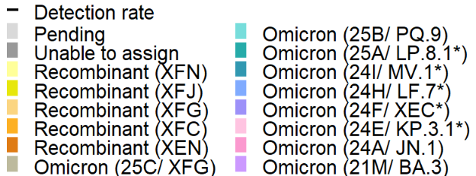
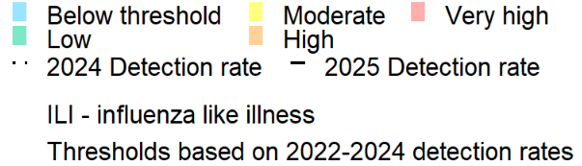
Viral Watch needs enthusiastic GPs
GP based surveillance programme for influenza (est. 1984)
Help us to:
  Define start & intensity of influenza season
  Determine the type and distribution of circulating influenza viruses
  Estimate influenza vaccine effectiveness
  Provide viral isolates that assist with annual vaccine formulation (WHO National influenza centre)
Influenza surveillance epidemic threshold, Viral Watch, South Africa, 30 December 2024 to 17 August 2025
Number of laboratory-confirmed cases and detection rate, Viral Watch, South Africa, 30 December 2024 to 17 August 2025
Influenza
RSV
SARS-CoV-2

Slide 3
Viral Watch needs enthusiastic GPs
What we need from you:
  Enrol patients with symptoms of fever and cough (only verbal consent required)
  Take a nasal swab (kits provided free of charge)
  Complete a short form (online)
  Swabs are transported to NICD via the usual private lab or NHLS transport
Benefits:
  No cost
  Results (influenza, RSV and SARS-CoV-2) within 24 hours of receiving at NICD
  Receive updates on respiratory pathogens (influenza, RSV, SARS-CoV-2) surveillance
  Invitation to annual respiratory virus symposium (CPD points)
  CPD points for programme participation (if you submit 10 or more swabs a year)
WhatsApp 0828832044 to get the registration link.

Slide 4
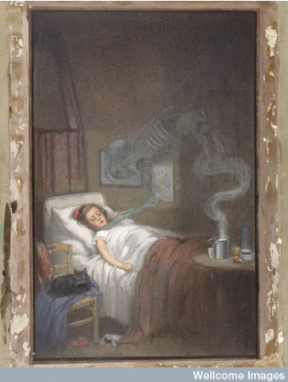
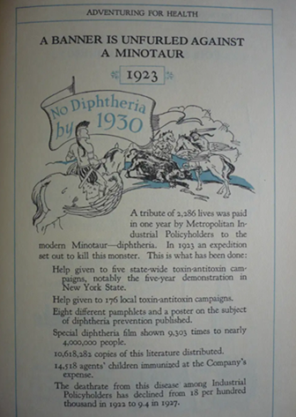
Diphtheria
Highly contagious and vaccine-preventable
Vaccine is toxoid: [protects against the effects of the toxin
  Vaccine at 6, 12 and 14 weeks with booster at 6 and 12 years
Respiratory diphtheria illness
  Caused by toxin producing strains of Corynebacterium diphtheriae
    rarely C. ulcerans or C. pseudotuberculosis
  Toxin is responsible for pathogenesis and clinical presentation (and deaths) of diphtheria
Toxin-producing strains can cause skin lesions and may be a reservoir of infection

Slide 5
Number of individuals testing positive for toxigenic C. diphtheriae (respiratory diphtheria cases and asymptomatic carriers), South Africa, 1 January 2024 to 21 August 2025.
70 confirmed cases of respiratory diphtheria
58 contacts tested positive
Median age among respiratory diphtheria cases is 31 years (range 2-52 years)
Deaths 14/70 (20%)

Slide 6
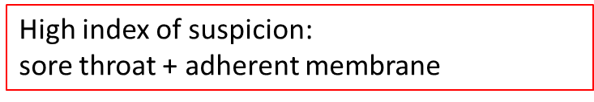
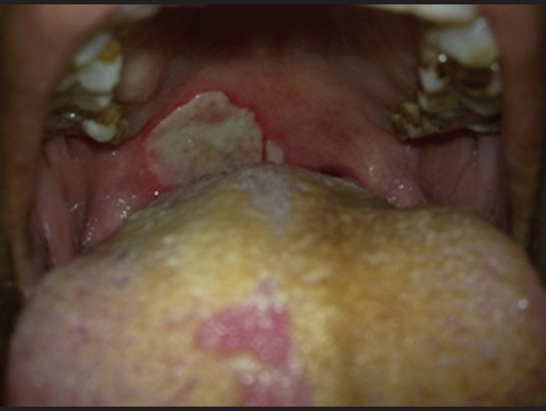
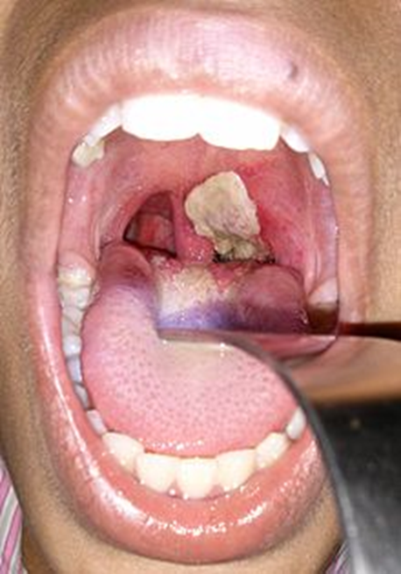
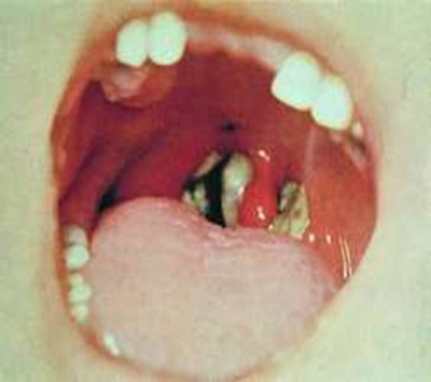
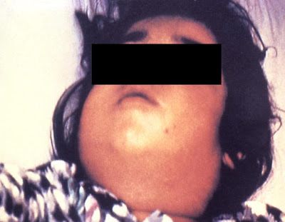
Respiratory diphtheria
Low grade fever
Sore throat
Pseudomembrane
    Local toxin production
    Anywhere from nose to tracheobronchial tree
    Dense, adherent
    Airway obstruction
Cervical LAD – ‘Bull’ neck
Notes:
On tonsils –extend to tonsillar pillars uvula , soft palate , oropharynx
membrane –evolves

Slide 7
Systemic effects of the toxin, causes disease
Airway obstruction by membrane (management essential and early)
Cardiac (monitor ECG)
  Myocarditis - Up to 60%, 7-14 days after respiratory symptoms
  Heart block
Renal failure (Input/output and monitor)
Neurological related to the severity of the respiratory infection)
  3-6 weeks - Cranial nerve deficits including oculomotor, ciliary paralysis, facial, and pharyngeal, or laryngeal nervous dysfunction
  Occasionally, a stocking and glove peripheral sensory neuropathy .
  8 weeks - Peripheral neuritis develops 10 days to 3 months after the onset of pharyngeal disease.
    initially as a motor defect of the proximal muscle groups in the extremities extending distally.
Invasive disease may manifest in multiple organ system disease, though this is rare (non- toxigenic)
DAT saves lives

Slide 8
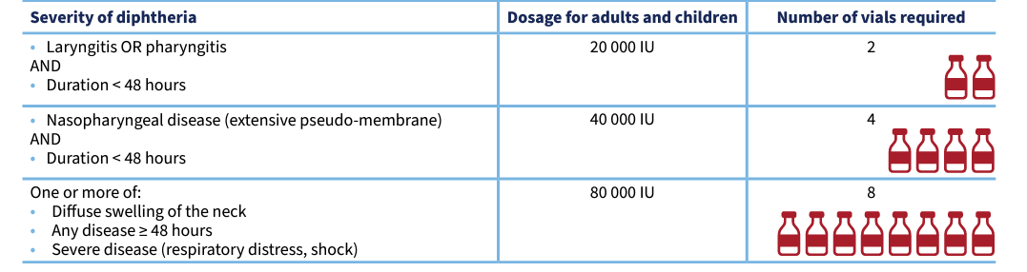
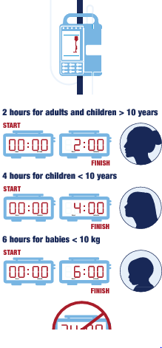
Antibiotics and Diphtheria antitoxin (DAT)
Do not delay DAT! Do not wait for lab confirmation
  Establish DAT supply chains, today
  Make use of ID specialists who have experience in using DAT
  Read guidelines for dosing
  Call NICD hotline 0800 029 999
  Swab to lab for culture and PCR at NICD
First line option (Give alongside DAT (antitoxin)
  Azithromycin 10mg/kg/d (max 500mg/d) IV if difficulty swallowing, then switch to oral
  14 days (can this be shortened ?10d)
Prompt initiation of antibiotics clears the infection between 4 to 6 days
  De-isolation at Day 7 of antibiotic treatment is a reasonable, safe and effective approach (vs 14d).
  Follow up cultures D3/4 and Day5/6 vs Day 14? If follow up cultures positive review antibiotic dose, adherence, drug interactions & prolong course
Alternatives = Penicillin or erythromycin, but need more frequent dosing, emerging penicillin resistance
Resistance is being monitored by NICD
Antibiotics:
  Kills the organism and prevents further toxin production
  Slows the spread of local infection
  Reduces transmission
Notes:
Prevents further bacterial growth and toxin production & reduces duration of infectiousness
Prompt initiation of appropriate antibiotics will clear the infection between 4 to 6 days of therapy
Therefore de-isolation at Day 7 of antibiotic treatment is a safe and effective approach.

Slide 9
Public health response: contact tracing
Urgent response, category 1 notifiable condition
Notify and complete CIF in detail for patient (please give details of vaccine history)
All household contacts
Other contacts:
  More than 15 minutes with 2 metres of patient (and no PPE)
Take swabs Nasopharyngeal (wear PPE)
Post-exposure prophylaxis 7-day course Azithromycin (? 3 Days)
Vaccinate (encourage vaccination of children), frontline staff, adult vaccine not policy (can do privately)
Self-monitor for development of symptoms – may need DAT
Isolate at home, avoid contact until swab result
Positive Contact
  Trace contacts
  Reassess for symptoms
  Consider 14 days of Azithromycin
Do not wait for lab confirmation

Slide 10
Take home messages
High index of suspicion
CFR highest in the first case
Link to experts who have managed cases
Don’t delay DAT
Treat while waiting for lab confirmation
Public health response
  NICD hotline 0800 029 999
https://www.nicd.ac.za/diseases-a-z-index/diphtheria/
https://www.gov.uk/government/publications/diphtheria-public-health-control-and-management-in-england-and-wales, accessed Dec 2024.
https://www.who.int/publications/i/item/WHO-DIPH-Clinical-2024.1

