Slide 1
APPROPRIATE IMAGING
Sharon de kock
Radiologist
bayradiology

Slide 2
Importance of right test for right pt
Risks of inappropriate imaging:
unnecessary radiation exposure
incidentalomas and further workup
increase cost of healthcare
delayed dx if wrong test chosen
Benefits of appropriate imaging:
accurate timely dx
improve pt outcomes
efficient use of healthcare resources

Slide 3
Strong clinical question vital
Specific signs and symptoms
Relevant hx: surgical, conditions
Significant phys ex findings, lab values, etc.
Example weak- Abdominal pain
strong- 23yr old, acute onset RLQ pain, ass with fever, nausea, local tendern
weak- SOB
strong- 65yr old female, known CCF, 3/7 worsening SOB, now lower limb edema

Slide 4
Different Modalities
Radiographs
Ultrasounds
Mammogram
Fluoroscopy
Computer Tomography
Magnetic Resonance
Nuclear Medicine

Slide 5
Appropriate Use Criteria
Most commonly used- American College of Radiology
I Refer Guidelines- Royal College of Medicine
Purpose - promote high quality pt care
- decrease unnecessary imaging
- ensure cost effective care
- to inform referring drs what’s best
Not rigid, integrate with clinical findings, pt specific factors (peads, pregnant, claustrophobic)

Slide 6
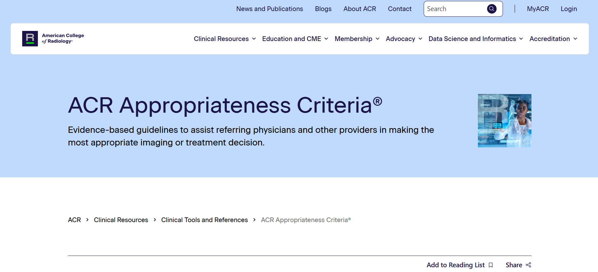

Slide 7
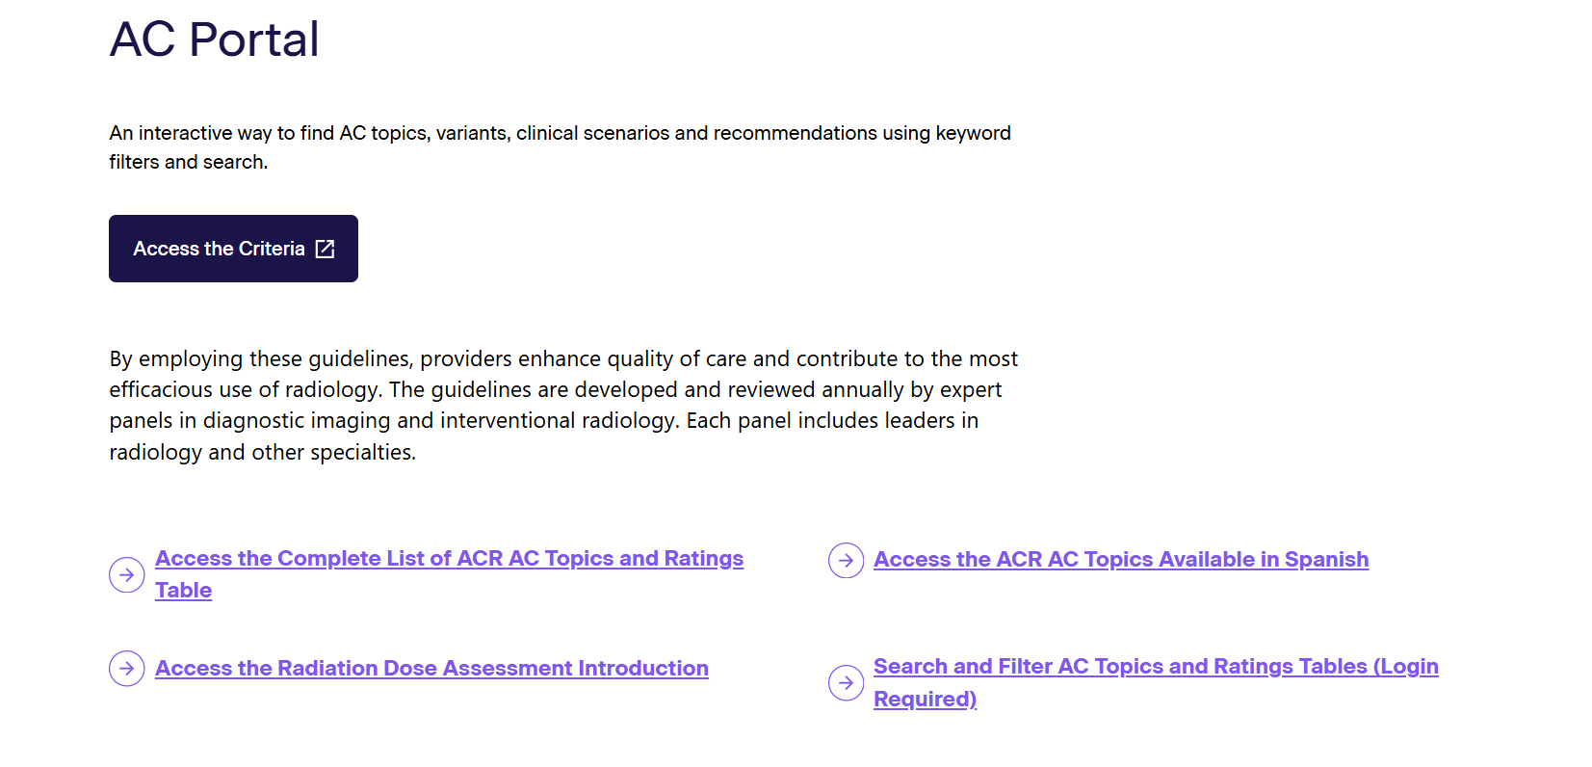

Slide 8
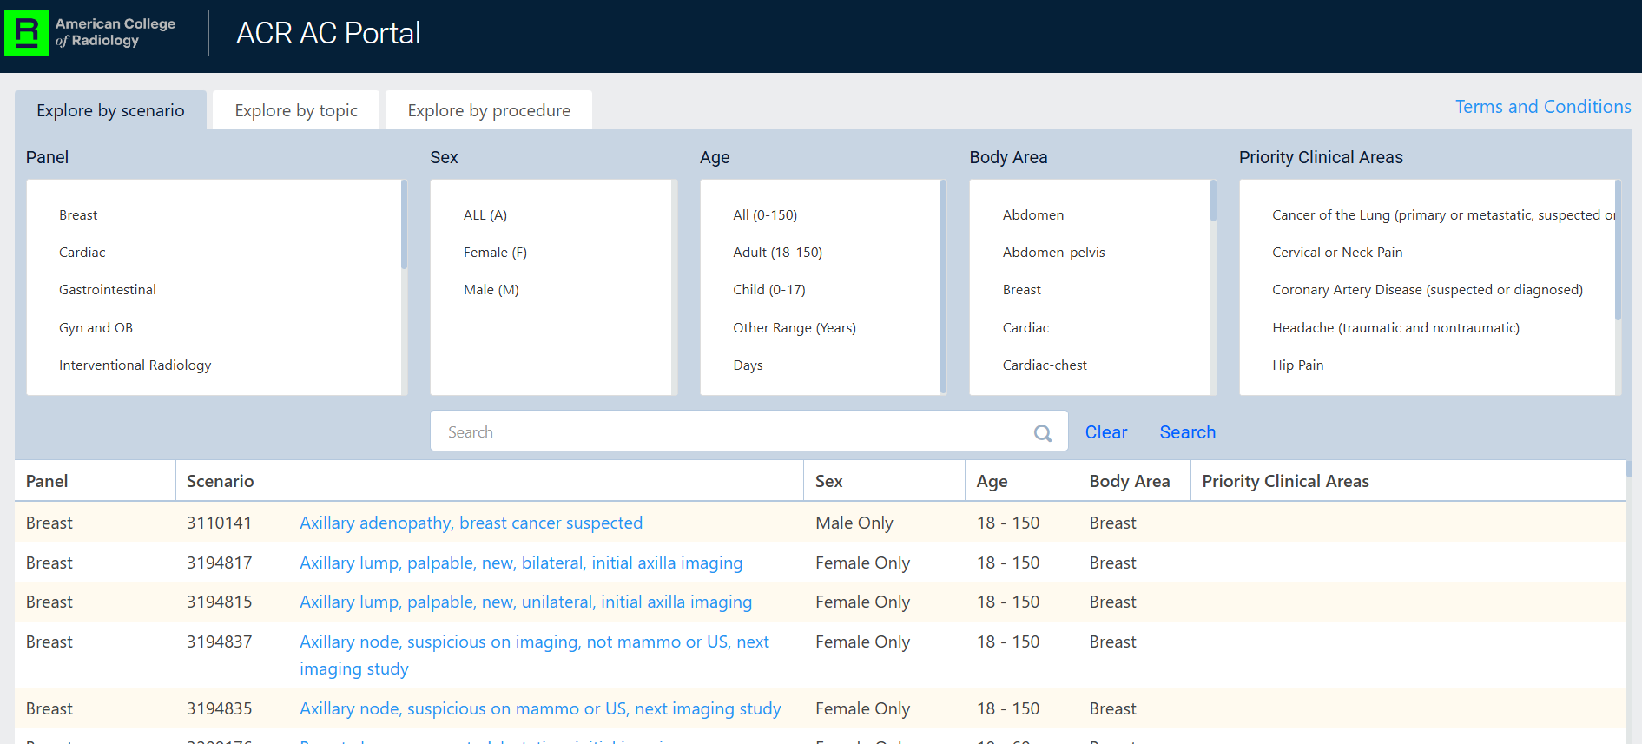

Slide 9
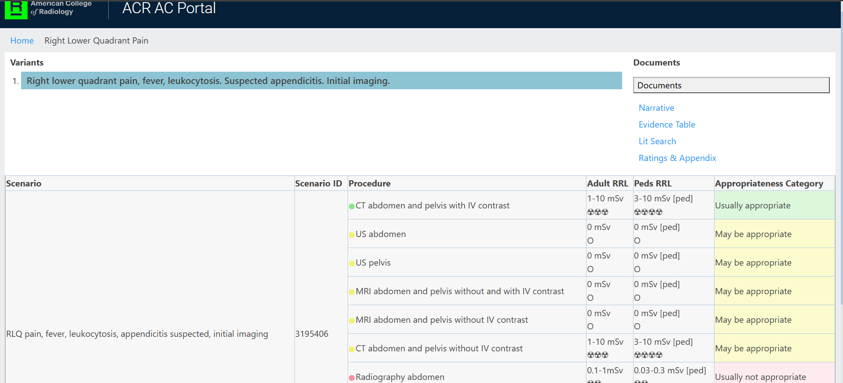

Slide 10
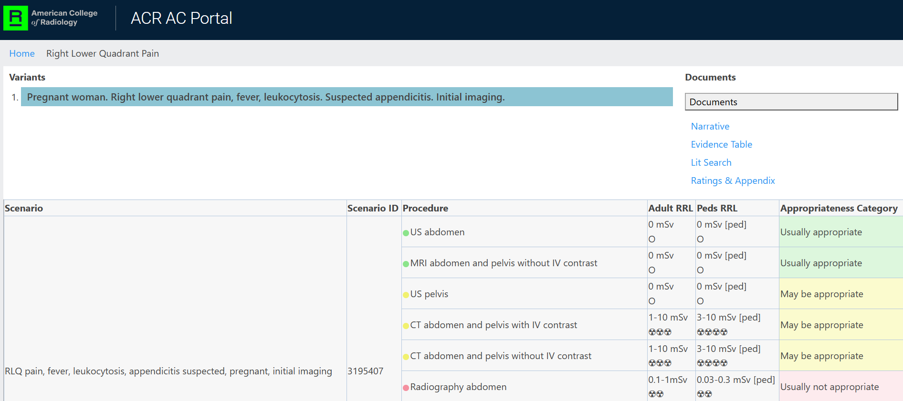

Slide 11
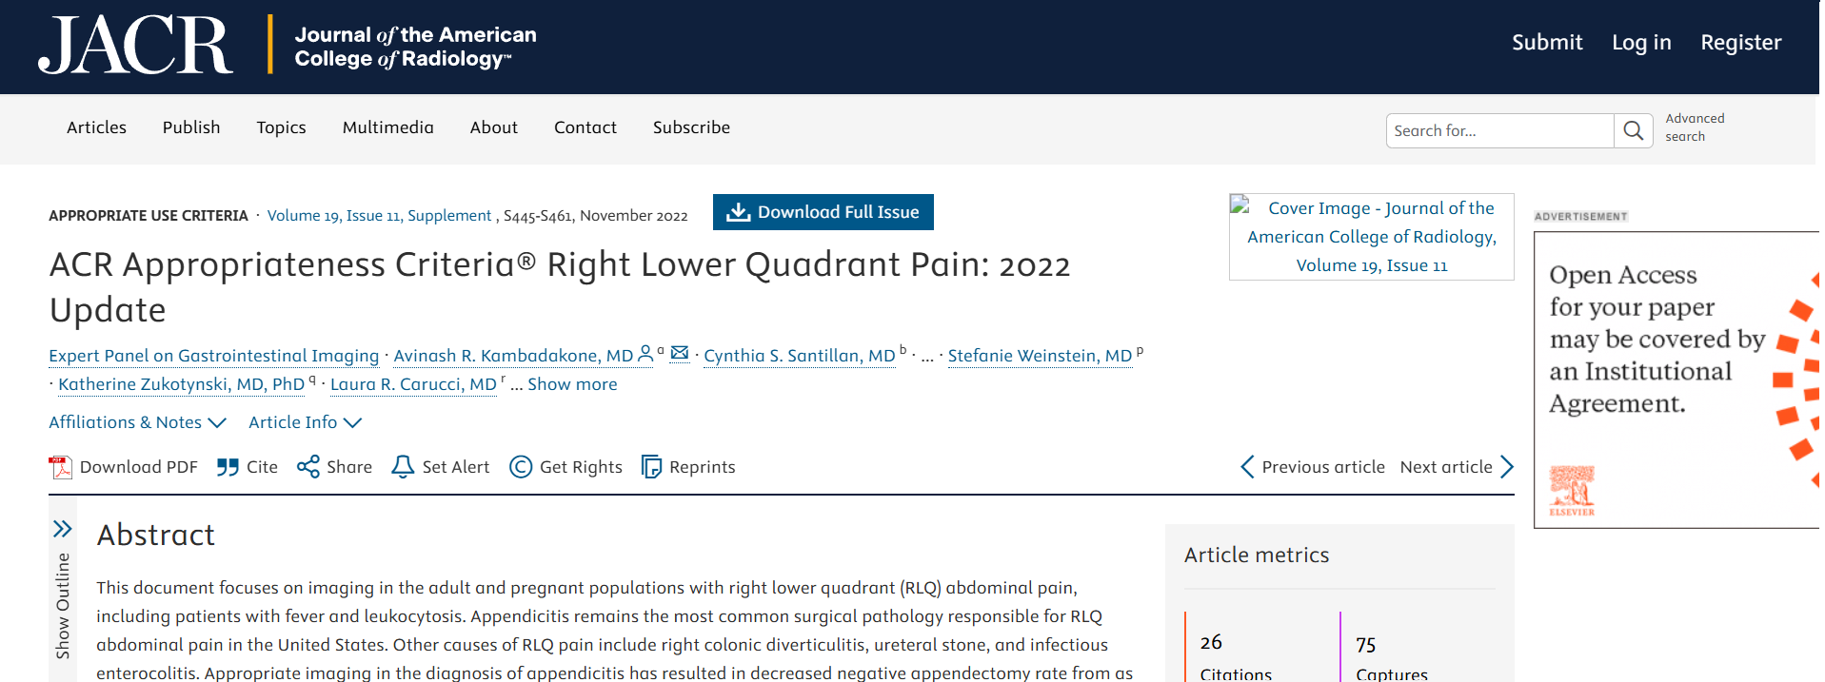

Slide 12
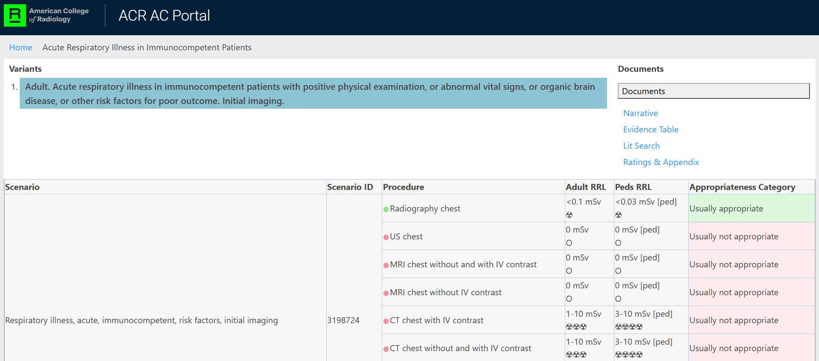

Slide 13
AXR, Supine and Erect
Supine:
bowel gas pattern
organ outline
psoas margins
radiodense calcs
foreign objects
Erect:
only add 2 things-
air-fluid levels
free air sub-diaphragmatic
Recommendation:
?extra-luminal air, do erect CXR
@ fraction of dose, AXR- 1mSV
CXR approx. eff dose- 0,02mSV

Slide 14
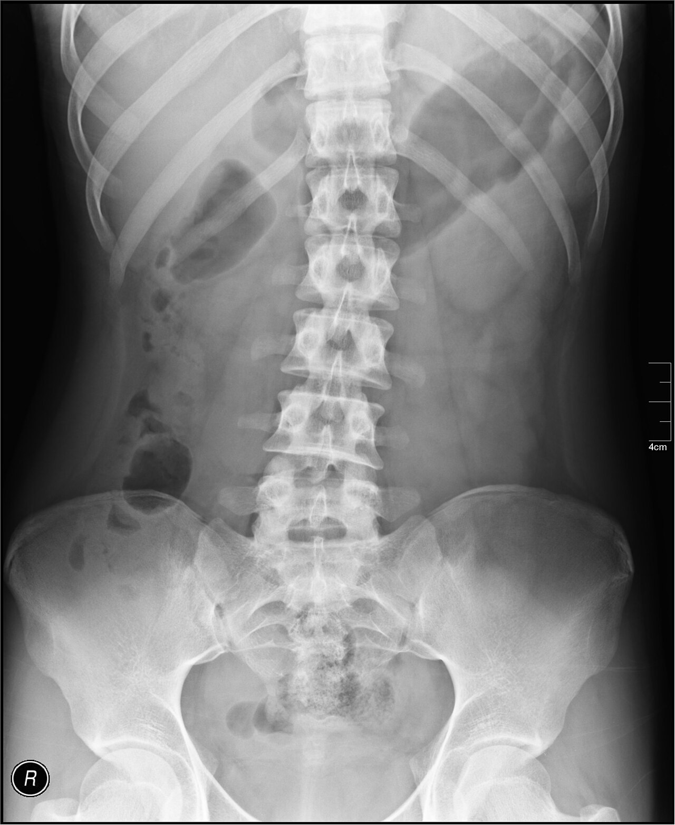
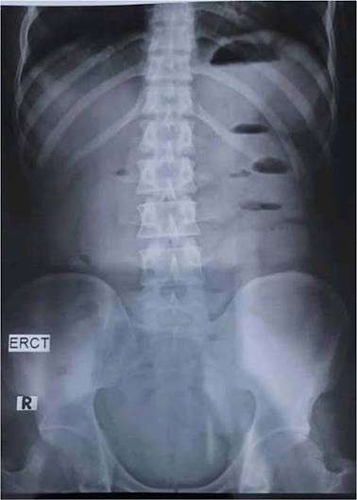

Slide 15
Follow Up CXR
Can take up to 6 weeks for radiological pneumonia to clear, longer with COPD background.
Clinical evaluation better earlier.
If pt improves no need to do earlier.
If persists (on CXR) further imaging should be obtained, esp if pt >50, smoking hx, etc.
To exclude sinister pathology.

Slide 16
Follow up extremities XRs
Fractures take 6-8 wks to show significant healing.
Full recovery can take months depending on the bone and severity of fracture.
Stages of # healing:
Inflammation 1-7 days
Soft callus 2-3 wks
Hard callus 4-12 wks
Remodelling months-years

Slide 17
F/U XRs Extremities
If ordering XRs:
1-2wks if worried about alignment
4-6wks to evaluate early healing
8-12wks ?solid union
3-6mnths to final confirm healing

Slide 18
F/U XRs Extremities
Upper Extremities
Metacarpals 4-6wks
Distal radius 4-6wks
Humerus 6-8wks
Lower Extremities
Metatarsals 6+wks
Tibia 10wks
Femur neck & shaft up to 12wks

Slide 19
Complications
Delayed union: 2x as long as expected
Non-union: no healing after 6-9months
Mal-union: healing in non-anatomical position
Refracturing

Slide 20
Control XRs Peads
Growing immature skeleton
Can be confusing
If uncertain- take a single view of other limb
If clear cut- not necessary

Slide 21
ALARA
As Low As Reasonable Achievable
Pillars-
Justification of XRs, Fluoro, CTs, only when true clinical need.
Optimalization- technical settings.
Limitation & Protection
Gatekeepers of Radiation & Protection

Slide 22
Mammography
Annual/ biennial from 40yrs
See a lot of young pts with breast CA
Baseline MMG 35yrs
Younger pts always 1st start with ultrasound- radiation, density, etc.
If sending pt for diagnostic and not screening MMG- appropriate hx important!
Pts older than 35/40/older- for routine screening- ultrasound cannot pick up microcalcifications, cannot only get an ultrasound.
We do ultrasound with MMG for problem-solving. No need if BiRads1 breasts.

Slide 23
Ultrasounds
PROPER Hx VITAL! ?Appendix if previous appendectomy.
Abdo U/S NPO to better evaluate GB, biliary tree, to minimize bowel gas artefact
Pts can drink water, fill bladder for pelvic u/s
?Appendix- children start with u/s, if indicated continue with pre contrast CT
Testis torsion, window period 4-6hrs from onset onset of symptoms
DVT- duplex doppler, why bilateral?
Thyroid & superficial soft tissue
1st need imaging before thinking of bx

Slide 24


Slide 25
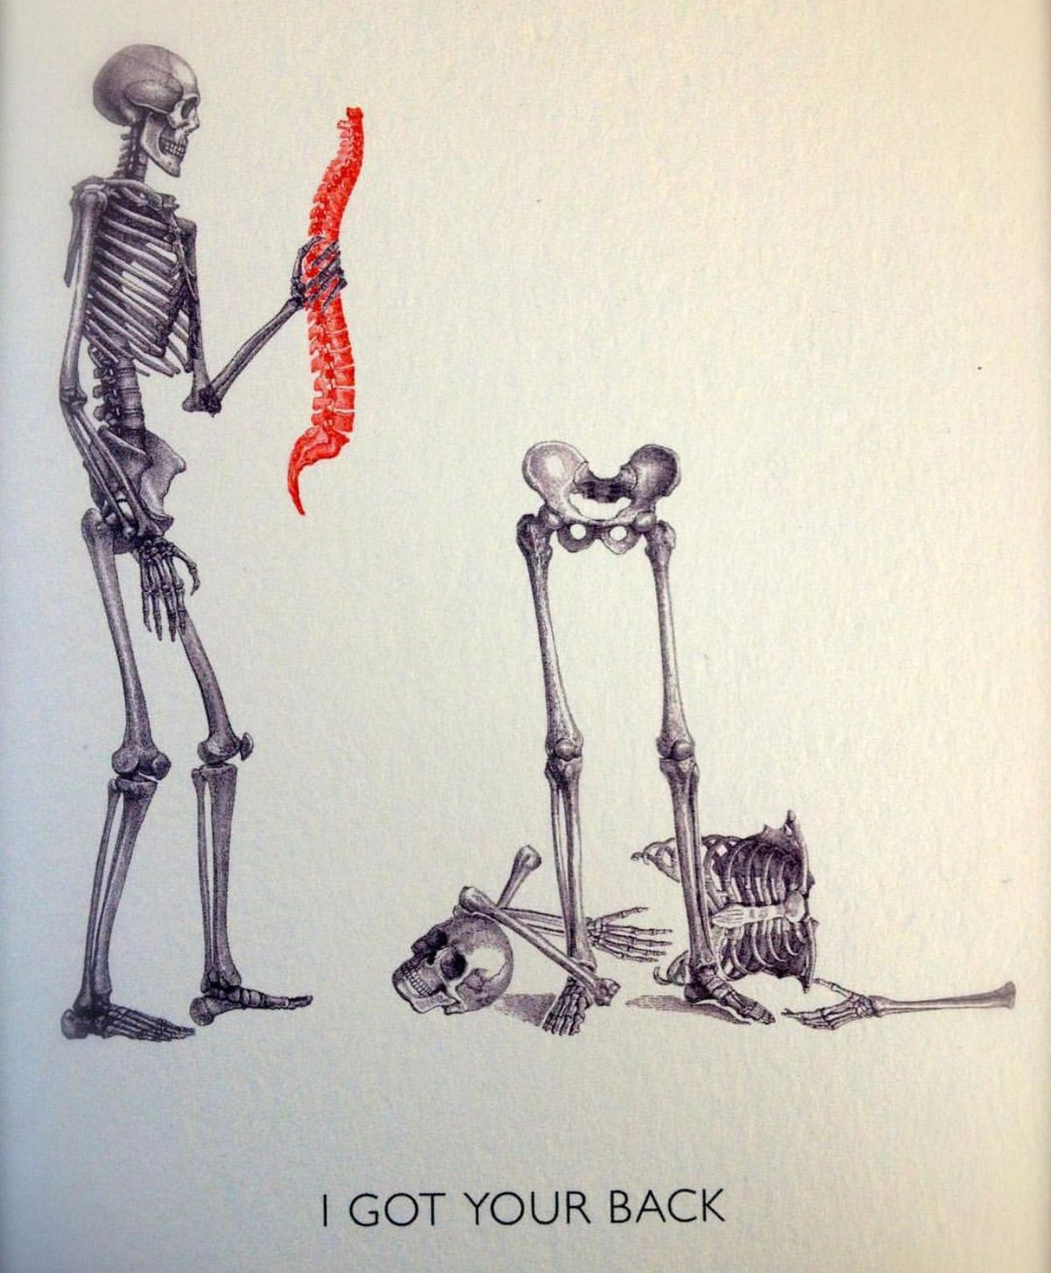

Slide 26
Thank you

