Slide 1


Critical Role of The Microbiology Laboratory In the
Fight Against AMR
Dr Yogandree Ramsamy
MBChB, FCPath(Microbiology), MMed(Microbiology)
Dip. One Health AMR
PhD
Pathologist – Medical Microbiology
JDJ Diagnostic Laboratories
University of KwaZulu-Natal

Slide 2
Burden of Deaths and Costs due to AMR
“……arguably the greatest risk to human health comes in the form of antibiotic-resistant bacteria.
AMR is the next great global challenge - we must act now…”
http://reports.weforum.org/global-risks-2013/
700,000
10 million
$100 trillion
Cumulative costs between now and 2050 that AMR will generate if it is not contained
Current estimated number of deaths from AMR each year
Estimated annual number of deaths from AMR by 2050 if not contained
Hoffman SJ et al. 2015. An international legal framework to address antimicrobial resistance. Bull World Health Organ 93:66 | doi: http://dx.doi.org/10.2471/BLT.15.152710 Estimated annual number of deaths from AMR by 2050 if not contained Review on Antimicrobial Resistance. 2015. Tackling a Global Health Crisis: Initial Steps. http://amrreview.org/sites/default/files/Report-52.15.pdf
Notes:
AMR – a threat to public health and global well being. The burden of Deaths and costs due to AMR is far reaching.

Slide 3
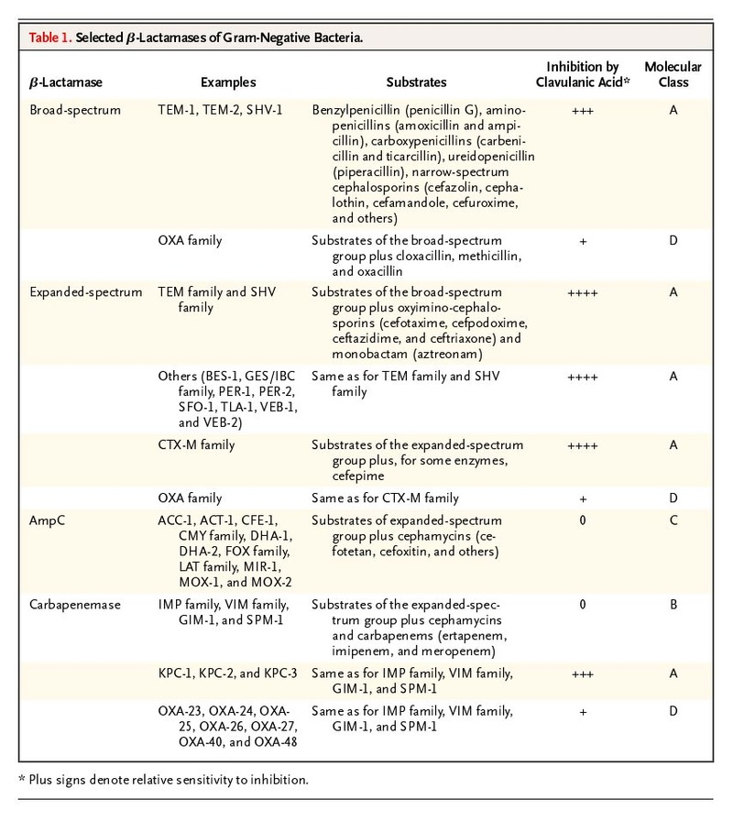
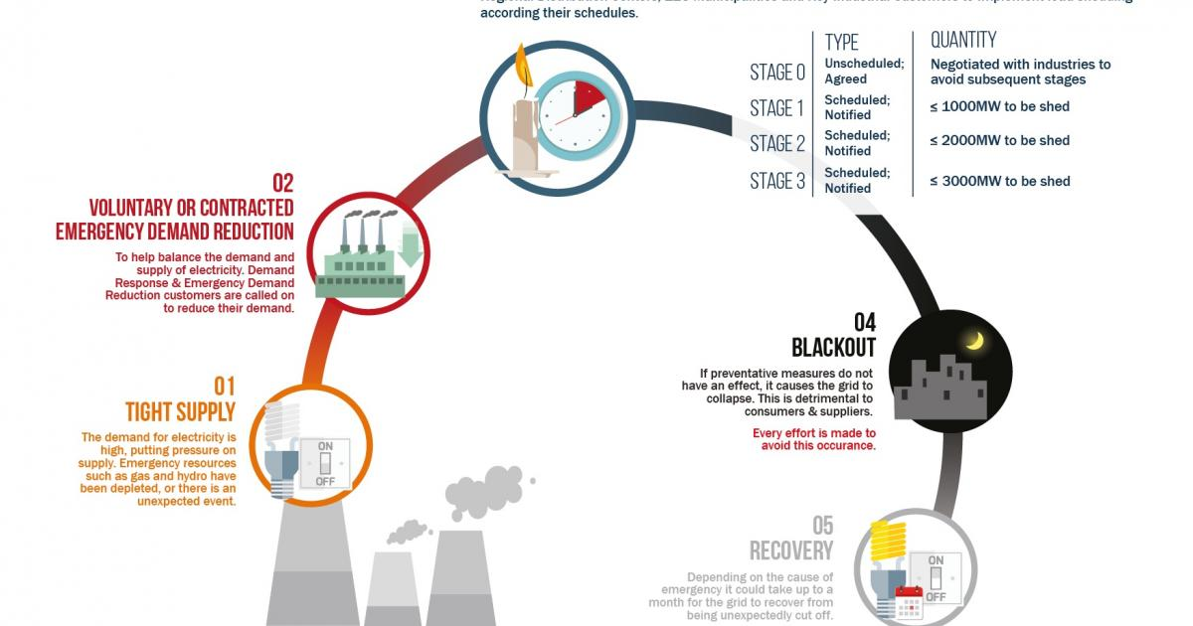




Loadshedding and AMR -
An African Experience
Notes:
Drawing an analogy with AMR and Load Shedding. For many years, as South Africans have had the luxury of endless power supply …. Limitless energy to fuel our everyday needs …. Until recently …… when we literally became powerless succumbing to the concept of load shedding ----- stage by stage reduction in the availability and utilization of energy in South Africa…… similar to this ---- AMR ---- man has for many decades enjoyed what nature offered us, an abundance of antimicrobials – modified and engineered into various classes to treat an array of infectious disease. Alas, slowly but surely in a similar way that we have experienced load shedding… stage 1 we were introduced to beta lactamases … simple beta lactamases targeting penicillin and narrow spectrum cephalosporins, with Stage 2 we saw the entrance of ESBLs which limited our use of antimicrobial agents even further , Stage 3 … feature the Amp C type Beta lactamases which then prompted the use of Carbapenems … now we have reached stage 4 …. Where carbapenemases run rampant globally, limiting the use of what we know as the last resort antimicrobial agents. With very few newer agents in the pipeline …. our very existence is threatened …into a dark abyss.

Slide 4
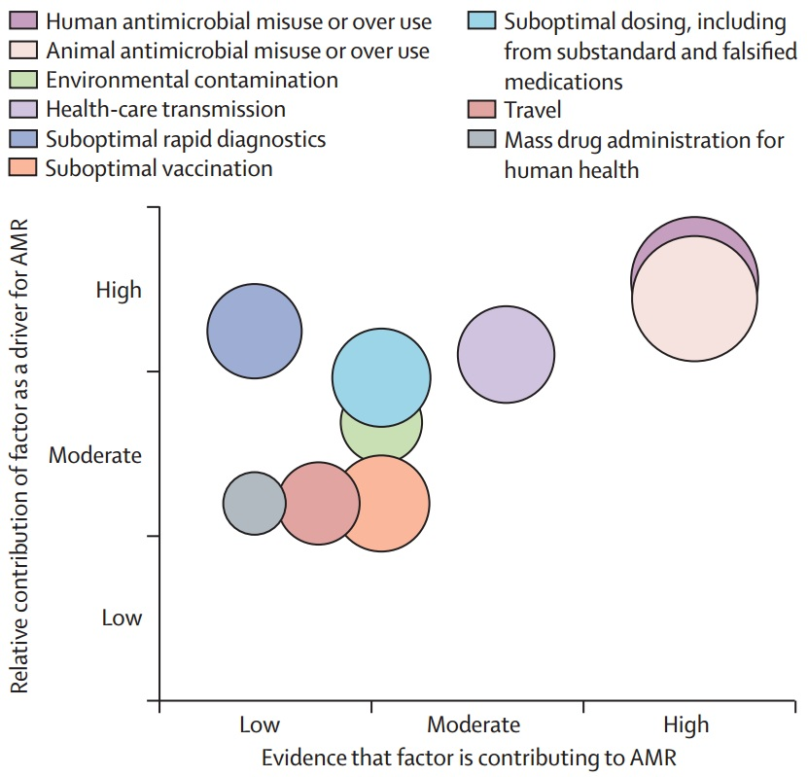
Drivers of AMR
Understanding the mechanisms and drivers of antimicrobial resistance
Holmes, Alison H et al.
The Lancet, Volume 387, Issue 10014, 176 - 187
Notes:
Legend: A hypothetical info-graphic from a Lancet publication by Holmes et al. to illustrate the potential contribution of each factor as a driver for AMR, the supporting evidence for each, and potential population affected (diameter of bubble). Created from a two round Delphi method of contributing authors The GRADE approach was used to identify the quality of the evidence (English language scientific publications (1990-2014) identified from search of “factor” AND “antimicrobial resistanc. Factors were identified from review of the national and international AMR policy documents.e”; where multiple articles on the same topic were identified, the study with the highest GRADE estimate was cited) supporting each driver as being contributory to the rise in antimicrobial resistance (Supplementary Table 2). Relative contribution and potentially affected population based upon consensus expert opinion

Slide 5
Drivers of AMR
Understanding the mechanisms and drivers of antimicrobial resistance
Holmes, Alison H et al.
The Lancet, Volume 387, Issue 10014, 176 - 187
Notes:
The biggest drivers of AMR can be somewhat overcome thro modification of human behavior.

Slide 6




AMR
The dying of the light and time is running out
Light, Life and Hope

Slide 7
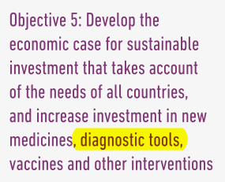
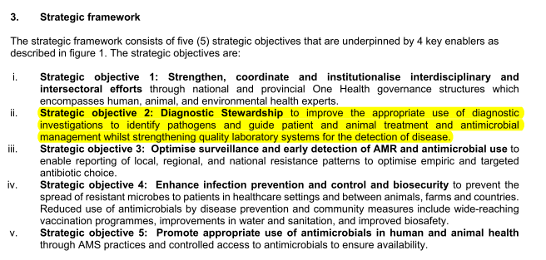
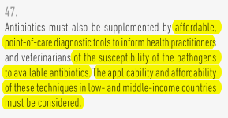
WHO and SA DoH Strategic objectives to combat AMR
WHO – Global Action plan on AMR
South African Antimicrobial Resistance National Strategy Framework; a One Health Approach
2018 – 2024
Notes:
This slide is an excerpt from the AMR National Strategy Framework for 2014-2024 in accordance with the WHO Global Action plan on AMR - highlighting the strategic objectives which is Surveillance, IPC and AMS and more importantly the strategic enablers required to achieve our goals and objectives in our fight against AMR. We see from Strategic objective 2 – ways to improve the APPROPRIATE use of diagnostic investigations to identify pathogens and guide patient and animal treatment and antimicrobial management whilst strengthening quality laboratory systems for the detection of disease.

Slide 8

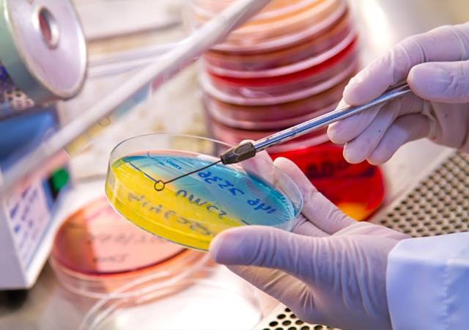
The diagnosis of infections performed by the laboratory has three important functions
1. Diagnosis of infection in individual patient for everyday management of infection
  Classical bacteriological methods used In Africa
2. Advice on appropriate selection of empiric and directed therapy
3. Support for infection prevention and control in ascertaining source and route of transmission of HAI
    Direct smear
    Culture
    Antigen detection
  Antimicrobial susceptibility testing
  Antibody detection
  Molecular detection methods

Slide 9
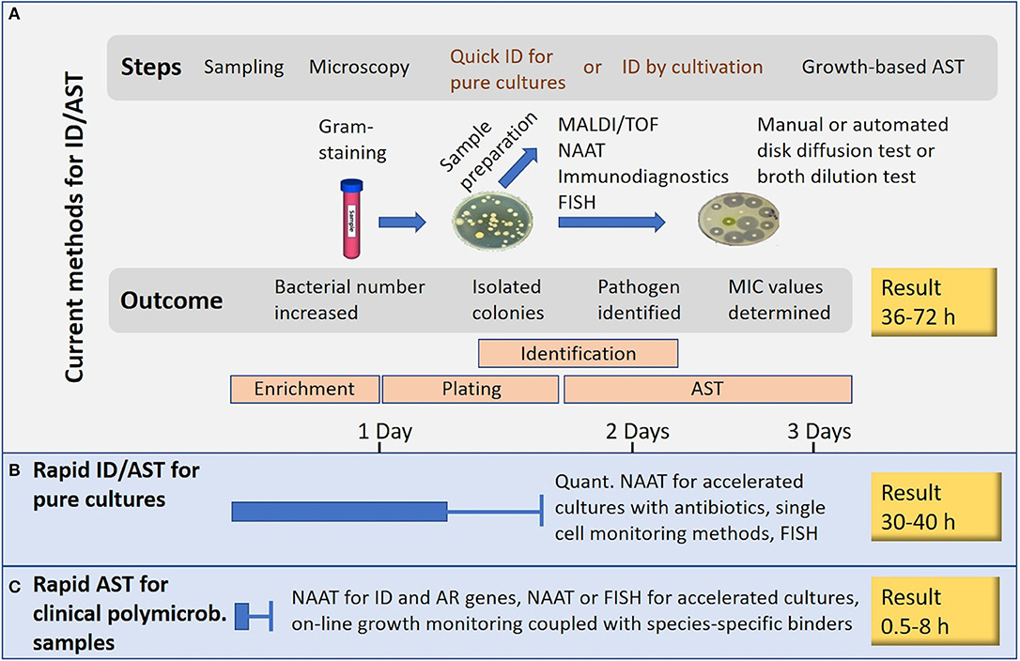

Diagnostics at our disposal
“….. at the beginning of the 21st century, a high proportion of diagnostic tests are still performed according to methodologies pioneered by Pasteur at the end of the 19th century, i.e. methods based on culture….”
Bissonnette L et al. Clin Microbiol Infect
2010; 16: 1044–1053
Vasala A, Hytönen VP and Laitinen OH (2020) Modern Tools for Rapid Diagnostics of Antimicrobial Resistance. Front. Cell.. Infect Microbiol. 10:308. doi: 10.3389/fcimb.2020.00308

Slide 10
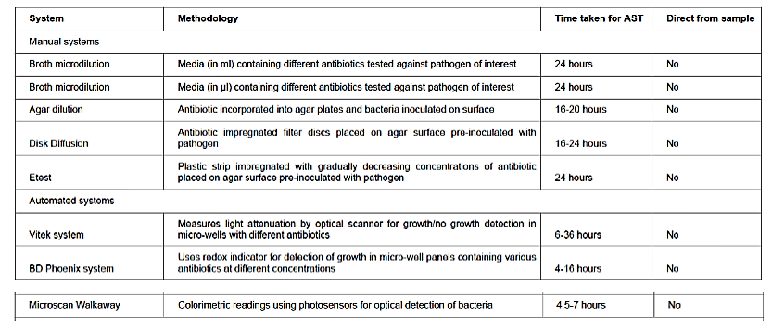
Diagnostic Technologies available to the majority in the South African Healthcare System
Puttaswamy S, Gupta SK, Regunath H, Smith LP, Sengupta S (2018) A Comprehensive Review of the Present and Future Antibiotic
Susceptibility Testing (AST) Systems. Arch Clin Microbiol Vol No:9 Iss No:3:83

Slide 11
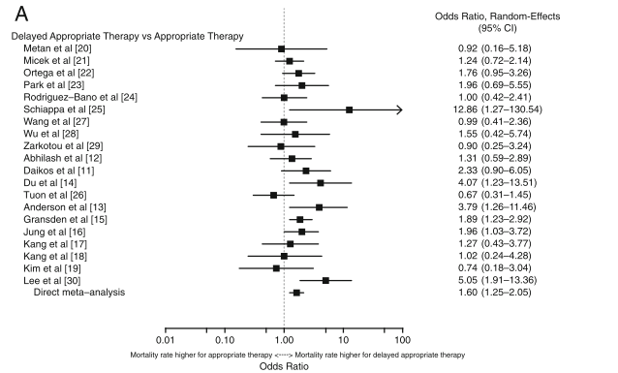
Prompt initiation of antibiotics to treat infections reduces morbidity and save lives, for example, in cases of sepsis …
Rhodes A, Evans LE, Alhazzani W, Levy MM, Antonelli M, Ferrer R, et al. Surviving Sepsis Campaign: International Guidelines for Management of Sepsis and Septic Shock: 2016. Intensive care medicine. 2017 Mar;43(3):304-77.
A systematic review of the association between delayed appropriate therapy and mortality among patients hospitalised with infections due to Klebsiella pneumoniae or Escherichia coli: how long is too long?
Lodise, Thomas P et al. BMC infectious diseases vol. 18,1 625. 5 Dec. 2018,
Notes:
Lodise et al. demonstrated from a systematic review using odds ratio of studies - mortality which was higher for delayed appropriate therapy versus studies which documented mortality rate higher for appropriate therapy. There are more in the delayed appropriate therapy group.

Slide 12
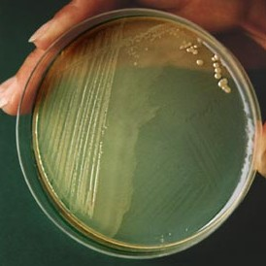


Pivotal Role of the Microbiology Laboratory
Infection
Control
Education
Rapid
Communication
HAI
Surveillance
Antimicrobial
Stewardship
Accurate
Identification of
Pathogen
Resistance
Surveillance
Alert
Microorganisms
Participation in
Outbreak
Management
HAI
Surveillance

Slide 13
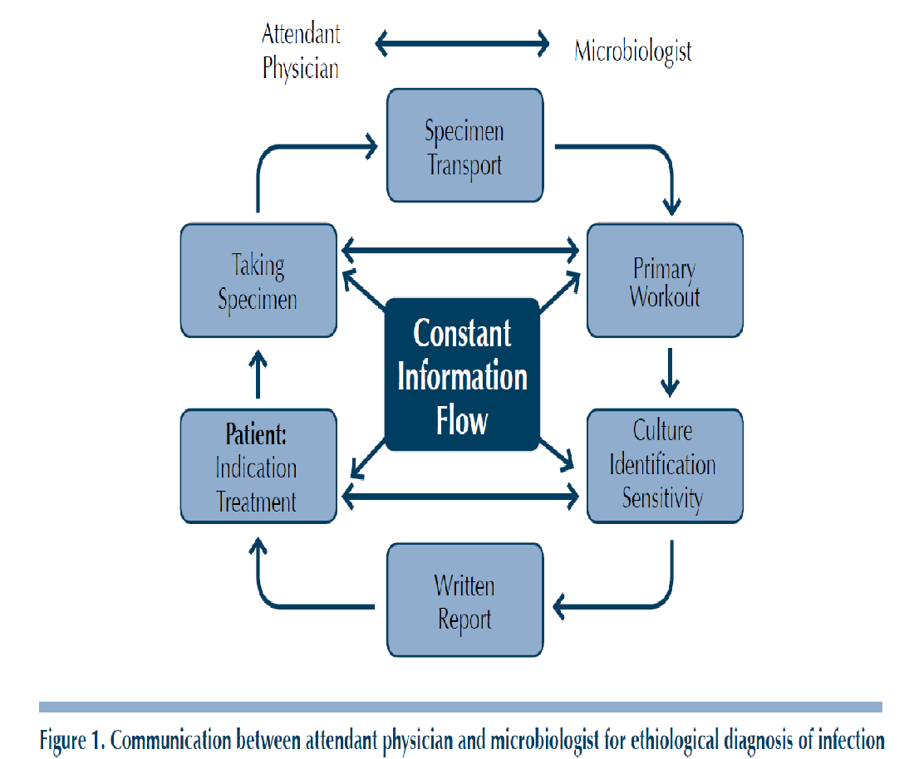

Communication
The Microbiologist and Clinician should not be worlds apart!

Slide 14
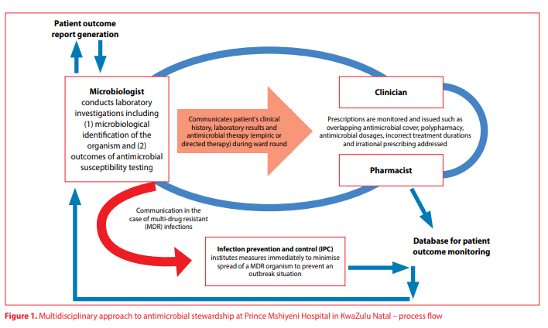


Slide 15
Clinical Microbiologist
Historically
Clinical microbiologists perform laboratory investigations on blood, tissue, and other specimens to locate infectious agents in people, food, or animals. Involved in research focused on fighting and preventing diseases.
Current model
Dynamic
Involved
Knowledgeable
Engaging
Irreplaceable
These attributes enable the current Clinical Microbiologist to be a key player in implementation and maintenance of an ASP at a healthcare institution.
“A behind the scenes personality”
Notes:
The role of a Clinical Microbiologist in an ASP is invaluable especially in an African setting where there is a dearth of ID trained specialists.

Slide 16
Clinical Microbiologist
Rapid and constant communication…… days do matter
Pivotal role confirming and managing outbreaks within the healthcare setting.
Interaction - Clinicians, pharmacists, nurses and allied medical staff.
Empower pharmacists with the clinical aspects of Infectious Diseases management and Microbiology.
Interact with hospital IPC coordinator to limit spread of HAIs.
Notes:
In the vast majority of hospitals in SA and in most parts of Africa, there is a dearth of ID specialists. Clinical Microbiologist as based at the larger referral centers and their services impact positively towards AMS.
Restricted antibiotic reporting / selective reporting
Restriction of antimicrobial use
Regular reporting of changing resistance patterns
Combined ward rounds🡪 meaningful interaction with clinicians, pharmacy team, IPC practitioners and nurses.

Slide 17
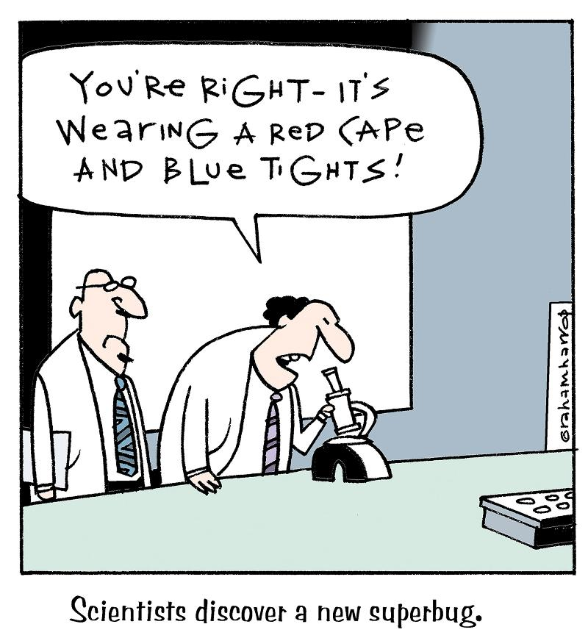
Reporting of Alert Microorganisms
  Methicillin-resistant Staphylococcus aureus (MRSA)
  Vancomycin-intermediate S.aureus (VISA)
  Vancomycin-resistant enterococci (VRE)
  MDR Pseudomonas aeruginosa
  MDR Acinetobacter baumannii
  MDR Mycobacterium tuberculosis
  Carbapenem resistant enterobacteriacae
  Clostridium difficile

Slide 18
The Role of Rapid Diagnostics Tests in AMR
Rapid diagnostic tests are an important tool in the fight against antimicrobial resistance. By enabling faster, more accurate diagnosis and targeted treatment, RDTs can help preserve the effectiveness of existing antibiotics and reduce the burden of AMR on global health.
FilmArray - Biofire
  Pneumonia panel
  GE panels
  Respiratory panel
  Meningitis panel
Xpert - Cepheid
  MRSA
  CPE
  MTB
Important Consideration
RDTs may be prone to misuse and overuse as are antimicrobials without proper interpretation.
Ideally diagnostic guidelines and protocols need to be outlined prior to implementation.
RDTs are likely to be more impactful in 24 hour laboratories in hospitals already involved in AMS with a Clinical Microbiologist .

Slide 19
The Microbiology Laboratory is a
Critical Role Player in the Fight against AMR
“the crisis of antimicrobial resistance and the resultant need to optimize clinical infection management, manifested by the widespread emergence of antimicrobial stewardship programs, and the recent proliferation of innovative rapid diagnostic methods—with their attendant uncertainties with respect to instrument selection, performance characteristics, deployment and work flow, costs, interpretive guidance, and rapid technological turnover—could boost the clinical relevance of clinical microbiologists to levels unseen since the time of Koch and Pasteur”.
Morency-Potvin, Philippe et al. “Antimicrobial Stewardship: How the Microbiology Laboratory Can Right the Ship.” Clinical microbiology reviews vol. 30,1 381-407. 14 Dec. 2016, doi:10.1128/CMR.00066-16

Slide 20



THANK YOU!

