Slide 1

NEW EMERGING PARADIGMS
IN PRIMARY CARE
From infancy to longevity
START
GROW
THRIVE
AGE
A life-course clinical update for
general practitioners
From treating disease to predicting risk, preserving function and extending healthy life
Notes:
[object Object],[object Object]

Slide 2





Meet Nomsa: one life, many windows
Age 0–2
Age 18
Age 35
Age 55
Age 75
Born to a young mother with no pre-conceptual care, late booking, untreated postnatal depression. Early formula and solids; growth centile drifts upward.
Anxious, leaves school early. Becomes sexually active and is never offered prevention choices.
Teenage pregnancy
HIV+
Weight creeping up. Blood pressure “a little high” at each visit - but never followed up.
On HAART
Develops PET & GDM in pregnancy
Diabetes and hypertension discovered only at a hospital admission.
Cardiomyopathy & Angina
Nine medicines, a fall and early frailty.
No one has asked what matters most to her.
Where could primary care have changed her trajectory?
Composite illustration, not a real patient.
Notes:
Timing: 3 min. Tell the story slowly, then ask the room to call out the missed windows. Likely answers: maternal mental health screening, prevention choices in adolescence, absolute-risk follow-up in midlife, structured function and medicine review in older age. Replace the composite with a patient story from your own practice if you prefer. We return to Nomsa at the end.

Slide 3



The lifecourse lens
Critical windows
Cumulative exposure
A unique vantage point
Some periods shape health disproportionately: the first 1 000 days, adolescence, the menopausal transition, and the move into frailty.
Risk accumulates quietly: adversity in childhood, diet, tobacco, blood pressure, glucose, loneliness. Early gains compound for decades.
Primary care is the one part of the system that can follow a person across the whole arc, and act at each window.
The question for every consultation: what does this person need now, and what risk factors can be modified to increase health-span?
Notes:
Timing: 2 min. Keep this conceptual and short. Three ideas: critical windows, cumulative exposure, and the longitudinal vantage point of primary care. The banner question is the one to repeat throughout the talk.

Slide 4
THE LOCAL CONTEXT
South Africa: two demographic realities at once
Age 0–14
26.2%
~63 million
Age ≥60
10.5%
A young population…
…that is also ageing
maternal • child • adolescent • infectious disease
NCDs • multimorbidity • frailty • cognitive decline
Primary care must manage both — simultaneously.
Statistics South Africa. Mid-year population estimates 2025 (P0302). statssa.gov.za/publications/P0302/P03022025.pdf
Notes:
[object Object],[object Object]

Slide 5
WHY PRIMARY CARE IS CHANGING
1. The patient has changed
Longer survival — with more years lived with chronic disease
Multimorbidity and polypharmacy are becoming routine, not exceptional
Obesity, diabetes, CKD and cardiovascular disease increasingly overlap
HIV is increasingly managed as a chronic disease across the life course
Mental health, cancer survivorship and ageing now sit squarely in primary care
Patients generate data outside the consulting room — and expect preventive answers
THE NEW QUESTION NOW IS??
“Doctor, what can I do now to prevent what may happen to me in 20 years?”
Notes:
[object Object],[object Object]

Slide 6
2. The central paradigm shift
TRADITIONAL
EMERGING
Disease
Risk
Reactive
Anticipatory
Episodic
Longitudinal
Single disease
Multimorbidity
Population average
Personalised risk
Clinic measurement
Continuous data
Life-span
Health-span
Notes:
[object Object]

Slide 7
Six paradigms that organise the talk
LIFE-COURSE
PREDICTIVE & PROMOTIVE
CARDIO-RENAL-METABOLIC
Critical periods & trajectories
Risk before disease
Integrated biology
PERSONALISED
DIGITAL + AI
LONGEVITY
Right intervention, right patient
Data beyond the clinic
Function and healthspan
Notes:
[object Object]

Slide 8
01
Life-course medicine
Health is a trajectory shaped by:
  critical periods
  cumulative exposures
  intergenerational influences.
WHO. Framework to implement a life course approach in practice. 2025. who.int/publications/i/item/9789240112575
Notes:
[object Object]

Slide 9
LIFE-COURSE MEDICINE
Health is a trajectory
Fetal life
Childhood
Adolescence
Adulthood
Midlife
Older age
GENETICS • NUTRITION • ENVIRONMENT • SOCIAL DETERMINANTS • INFECTION • STRESS • HEALTHCARE
Critical periods + cumulative exposures → future resilience or disease
WHO. Framework to implement a life course approach in practice. 2025. who.int/publications/i/item/9789240112575
Notes:
[object Object],[object Object]

Slide 10
DEVELOPMENTAL ORIGINS OF HEALTH AND DISEASE
Prevention may begin before birth
Maternal obesity
Diabetes
Hypertension
Smoking / alcohol
Nutrition
Placental dysfunction
Prematurity / FGR
ALTERED DEVELOPMENTAL TRAJECTORY
Cardiometabolic • renal • neurodevelopmental risk
The first cardiovascular prevention consultation may occur before the patient is born.
WHO. Framework to implement a life course approach in practice. 2025. who.int/publications/i/item/9789240112575
Notes:
[object Object]

Slide 11
Preconception becomes primary care
Reproductive intention and timing
BMI, nutrition and metabolic health
Blood pressure and diabetes optimisation
Medication teratogenicity / suitability
Smoking, alcohol and substance exposure
Folate and vaccination status
Family history / genetic risk where relevant
Mental health and social context
PRECONCEPTION
IS NOT A NICHE
It is the first opportunity to optimise the health trajectory of two generations.
Notes:
[object Object]

Slide 12
Pregnancy is a cardiometabolic stress test
Pre-eclampsia
Gestational diabetes
Preterm birth
Fetal growth restriction
A FUTURE PRIMARY-CARE RISK SIGNAL
BP • weight • glycaemia • lipids • renal risk • lifestyle • subsequent pregnancy planning
The obstetric history should not disappear after the postnatal visit.
ACOG. Cardiovascular risk after adverse pregnancy outcomes; postpartum and interpregnancy care guidance.
Notes:
[object Object],[object Object]

Slide 13
Childhood: building biological reserve
GROWTH
DEVELOPMENT
IMMUNITY
NUTRITION
MOVEMENT
MENTAL HEALTH
Adult disease prevention — performed decades early
Protect development, metabolic health, immunity and psychological resilience — not merely the absence of childhood disease.
WHO. Framework to implement a life course approach in practice. 2025. who.int/publications/i/item/9789240112575
Notes:
[object Object]

Slide 14
Adolescence: the neglected transition
Mental health
Sexual & reproductive health
Obesity / metabolic risk
Sleep
Substance use & vaping
Physical activity
Digital environment
Risk-taking / safety
Create space for a confidential, developmentally appropriate consultation.
WHO. Child and adolescent mental health resources, 2025.
Notes:
[object Object],[object Object]

Slide 15
02
From diagnosis to prediction
The GP increasingly manages probability
— not simply the presence or absence of disease.
Notes:
[object Object]

Slide 16
Stop just asking: “Does this patient have disease?”
OLD QUESTION
NEW QUESTION
Does my patient have cardiovascular disease?
What is this patient’s future risk — and can I modify it?
Diagnosis → Risk prediction → Risk modification
Notes:
[object Object]

Slide 17
Predictive primary care: more inputs, better decisions?
Age / sex
BP
Smoking
Lipids
Diabetes
eGFR + ACR
Family history
Pregnancy history
Selected imaging
Biomarkers
Genomics?
MORE TESTING ≠ BETTER MEDICINE
A predictive test is useful only if it meaningfully changes management.
Notes:
[object Object],[object Object]

Slide 18
Hypertension: the shift is already visible
Treat the patient’s total cardiovascular risk, not the BP number alone
Use validated home BP monitoring to complement office measurements
Earlier treatment and tighter control in appropriate patients
Simplify regimens — including single-pill combinations where appropriate
Integrate renal, metabolic and cardiovascular risk assessment
INTERNATIONAL DIRECTION
<130/80
mmHg
A common target in the 2025 ACC/AHA guideline — individualise and apply local guidance.
2025 ACC/AHA High Blood Pressure Guideline. professional.heart.org
Notes:
[object Object],[object Object]

Slide 19
03
Cardio–renal–metabolic integration
The silos are dissolving: heart, kidney, diabetes and obesity increasingly share mechanisms, risk and therapies.
Notes:
[object Object]

Slide 20
The artificial silos are disappearing
One Patient
Diabetes
Obesity
Kidneys
Heart
Shared biology • shared risk • shared therapeutic opportunities
Notes:
[object Object]

Slide 21
CKD: creatinine is not enough
eGFR
+
Urine ACR
= better CKD risk classification
Identify albuminuria — it changes risk
Optimise BP and renin–angiotensin system blockade, where indicated
Use SGLT2 inhibitors in appropriate CKD populations
Integrate diabetes and cardiovascular protection
KDIGO 2024 Clinical Practice Guideline for Evaluation and Management of CKD. Kidney Int. 2024.
Notes:
[object Object]

Slide 22
Obesity: from behaviour to chronic disease
OLD THEME
EMERGING THEME
“Eat less.
Exercise more.”
Chronic • relapsing • biologically regulated
Assess adiposity + complications + function
Visceral adiposity • T2D • MASLD • OSA • CVD risk • Mobility • Psychological burden
ADA Professional Practice Committee. Standards of Care in Diabetes—2025. Diabetes Care 2025;48(Suppl 1).
Notes:
[object Object],[object Object]

Slide 23
Spotlight: obesity treatment in flux
What changed in 2026
What it means in practice
Semaglutide’s patent has expired in South Africa, and SAHPRA approved the first generic (Sun Pharma) in July 2026.
Twelve more generic applications were under review in July, and Novo Nordisk announced a lower-cost authorised version of Ozempic.
SAHPRA and the Pharmacy Council have recalled and seized compounded and unregistered GLP-1 products.
Obesity is not a prescribed minimum benefit, so scheme cover remains limited.
Treat obesity as a chronic disease with a long-term plan (SAMMSS guidelines, Nov 2025).
Prescribe registered products only, and warn patients about compounded or online supply.
Agree duration and exit up front: weight regain after stopping is common.
Protect muscle and nutrition with protein, resistance exercise and monitoring.
Expect prices to fall, but to stay above traditional treatments for some years.
.
Notes:
Timing: 2.5 min. This market is moving fast, so confirm the latest SAHPRA approvals and prices just before presenting. Key messages: generics are arriving, compounded and unregistered supply is a safety issue, and obesity treatment is a long-term commitment, not a course. Mention that coverage by medical schemes is limited because obesity is not a prescribed minimum benefit condition.

Slide 24
The incretin era changes primary care
GLP-1 RA
DUAL GIP/GLP-1
LIFESTYLE + LONGITUDINAL CARE
Weight
Glycaemia
CV risk
Renal risk
MASLD/MASH
Benefits and indications vary by agent and population.
Medication is an important tool — not a complete obesity strategy.
ADA Professional Practice Committee. Standards of Care in Diabetes—2025. Diabetes Care 2025;48(Suppl 1).
Notes:
[object Object],[object Object]

Slide 25
CARDIOMETABOLIC HEALTH
Weight loss is not the endpoint — preserve functional reserve
DESIRABLE
CONCERN
↓ FAT + preserved muscle
↓ FAT + ↓ MUSCLE
Maintained strength • mobility • metabolic reserve
Sarcopenia • frailty • reduced physiological reserve
FUNCTIONAL RESERVE
Muscle • bone • cardiorespiratory fitness • cognition • mobility • sensory function
A “normal” HbA1c and LDL do not compensate for loss of independence.
WHO ICOPE 2nd ed. 2025 • WHO Guidelines on physical activity and sedentary behavior • Clinical principle: preserve capacity, not biomarkers alone.
Notes:
Transition from metabolic medicine to healthspan. Weight loss is clinically useful only if we preserve the capacity that allows the patient to live independently. In older adults especially, loss of lean mass can worsen frailty even when weight, HbA1c or blood pressure look better. Ask not only ‘how much weight was lost?’ but ‘what happened to strength, mobility and function?’ This concept—functional reserve—will return in the final healthspan section. [~60 seconds]

Slide 26
04
Digital & AI-augmented primary care
The consultation is escaping the consulting room
— and the GP becomes an interpreter of continuous data.
Notes:
[object Object]

Slide 27
The consultation is escaping the consulting room
CGM
Home BP
Wearable ECG
Activity
Sleep
Symptoms
Lab / imaging
GP + DECISION SUPPORT
More data does not automatically mean more knowledge.
Notes:
[object Object]

Slide 28
The quantified patient: signal or noise?
Improves diagnostic certainty
Reveals patterns missed in clinic
Changes treatment safely
Improves adherence or self-management
Reduces burden or risk
USEFUL WHEN IT…
PROBLEMATIC WHEN IT…
Creates false positives
Drives anxiety or compulsive checking
Generates non-actionable alerts
Uses unvalidated consumer metrics
Adds workload without benefit
Clinical utility > data volume
Notes:
[object Object]

Slide 29
AI enters the consultation
NOW
EMERGING
RISKS
Documentation
Summarisation
Administrative support
Literature synthesis
Risk prediction
Decision support
ECG / imaging assistance
Personalised monitoring
Hallucination
Automation bias
Privacy
Accountability
AI should augment clinical judgement — not substitute for it.
Notes:
[object Object],[object Object]

Slide 30
AI will not replace the GP — but it will change the GP Mx
AI can scale
The GP contributes
Information retrieval
Pattern recognition
Documentation
Routine monitoring
Clinical context
Physical examination
Probability & uncertainty
Patient values
Ethics & accountability
The likely future is not AI vs doctor — it is AI-enabled clinical practice!
Notes:
[object Object]

Slide 31
05
South African essentials
Emerging medicine must not distract from high-burden, high-impact primary care – SA quadruple burden of disease.
Notes:
[object Object]

Slide 32
Innovation without implementation is not progress
HIV
TB
MATERNAL HEALTH
VACCINATION
HYPERTENSION
DIABETES
CANCER SCREENING
MENTAL HEALTH
The future of primary care is advanced technology
+ reliable delivery of proven basics.
WHO. Global Tuberculosis Report 2025.
Notes:
[object Object],[object Object]

Slide 33
Vaccination becomes lifelong medicine
Birth
Childhood
Adolescence
Pregnancy
Adult
Older adult
At every life stage ask: “Is this patient appropriately immunised for age, pregnancy and risk?”
Childhood schedule • HPV • maternal vaccination • influenza / risk-based adult vaccines
• older-age vaccination
WHO. Immunization Agenda 2030 / life-course immunization resources.
Notes:
[object Object]

Slide 34
Multimorbidity: the patient guidelines forgot
MRS M — 74
Type 2 diabetes
Hypertension
CKD stage 3
Atrial fibrillation
Osteoarthritis
Mild cognitive impairment
11 medications
Lives alone
Which guideline are you treating?
None.
You are treating Mrs M.
Disease targets must be reconciled with function, treatment burden and patient goals.
Notes:
[object Object]

Slide 35
Deprescribing is a therapeutic intervention
PRESCRIBE
REVIEW
STILL INDICATED?
BENEFIT > HARM?
CONTINUE / REDUCE / STOP
Anticholinergic / sedative burden
Hypotension and falls
Hypoglycaemia
Renal function
Duplicate therapy
Life expectancy and time-to-benefit
Patient goals and treatment burden
Notes:
[object Object]

Slide 36
6. Longevity :What determines Life-span to Health-span?
HEALTH SPAN
Function • Independence • Purpose
METABOLIC
HEALTH OPTIMIZATION DISEASE PREVENTION
ATTITUIDE
HAPPINESS CONTENTMENT
PURPOSE
MEANING
BELONGING COMMUNITY
SPIRITUALITY
STRESS AND RESILIANCE
RESTORATIVE
SLEEP
MOVEMENT
EXERCISE
NUTRITION & DIET
ENVIRONMENT
HEALTHSPAN
function • independence • purpose
These are all now becoming specialised fields of medicine
Notes:
This is the healthspan framework I want the audience to remember. Healthspan is not produced by one biomarker or one drug. It emerges from interacting medical, behavioural, psychological and social domains. Prevention and metabolic health matter, but so do nutrition, movement, sleep, chronic stress, relationships, safety, belonging, purpose and meaning. Across every domain we should reduce harmful exposures—especially tobacco, excess alcohol and unnecessary medication—and preserve functional reserve. The GP cannot personally deliver every intervention, but can identify which domain is limiting this patient’s future health. [~75 seconds]

Slide 37
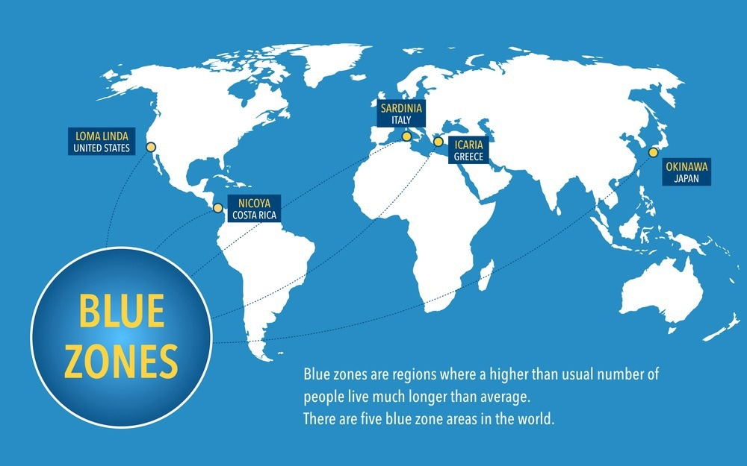
Blue Zones

Slide 38
The GP can make health-span practical
ASSESS
→
PRIORITISE
→
PRESCRIBE
→
CONNECT
→
MONITOR
ANNUAL HEALTHSPAN REVIEW
MOST USEFUL QUESTION
MEDICAL
CAPACITY
LIFE CONTEXT
“What do you want to remain capable of doing at 70, 80 or 90?”
• BP • lipids • glucose • kidney risk medicines • vaccines • screening
• activity • strength • balance • falls
• vision • hearing • cognition
• nutrition • sleep • mood/stress
• relationships • safety • purpose
Then align prevention, treatment and referrals with what matters to that patient.
Choose 2–3 achievable priorities — not 12 simultaneous instructions.
Navi Pillay @ 85 years is our living example of what is achievable!
WHO ICOPE, 2nd ed. 2025 • Practical synthesis for longitudinal primary care; individualise screening and targets to age, risk and context.
Notes:
The GP’s role is not to become the patient’s dietitian, trainer, psychologist and social worker. It is to assess, prioritise, prescribe, connect and monitor. I suggest reframing the routine annual check-up as an annual healthspan review: medical risk plus physical capacity plus life context. Then choose only two or three priorities. Lifestyle advice should be prescribed with the same specificity as medication—what exercise, how often, what sleep problem are we treating, what dietary pattern? Connect the patient to dietetics, physiotherapy or biokinetics, psychology, audiology, dentistry or community resources when appropriate. The question ‘What do you want to remain capable of doing at 70, 80 or 90?’ converts abstract longevity into a patient-centred goal. [~90 seconds]

Slide 39
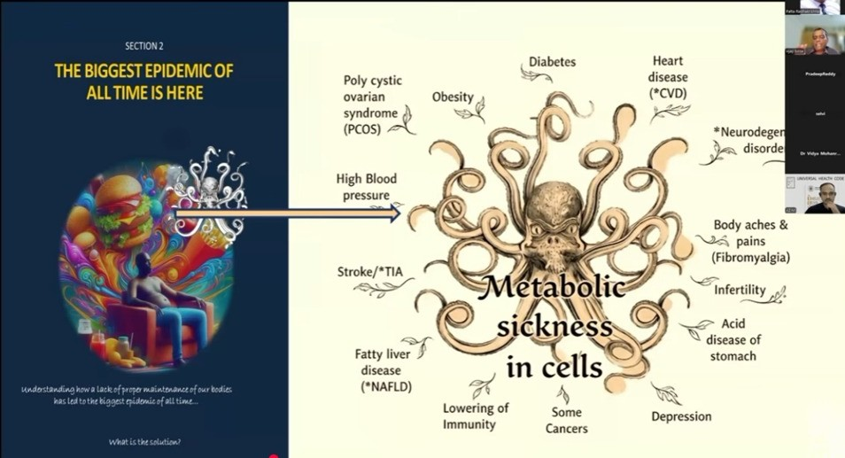
The Human Code
Understanding how the lack of proper maintenance of our bodies is leading the largest epidemic
Where is the solution?

Slide 40
TAKE-HOME MESSAGE
The GP becomes the custodian of the health trajectory
PREDICT
PREVENT
PERSONALISE
COORDINATE
PRESERVE FUNCTION
“Our task is increasingly not simply to treat today’s disease — but to influence tomorrow’s health.”
SELECTED KEY REFERENCES
1. WHO. Framework to implement a life course approach in practice. 2025. who.int/publications/i/item/9789240112575
2. WHO. Integrated care for older people (ICOPE), 2nd ed. 2025. who.int/publications/i/item/9789240103726
3. Statistics South Africa. Mid-year population estimates 2025 (P0302). statssa.gov.za/publications/P0302/P03022025.pdf
4. ADA Professional Practice Committee. Standards of Care in Diabetes—2025. Diabetes Care 2025;48(Suppl 1).
5. KDIGO 2024 Clinical Practice Guideline for Evaluation and Management of CKD. Kidney Int. 2024.
6. 2025 ACC/AHA High Blood Pressure Guideline. professional.heart.org
Notes:
[object Object],[object Object],[object Object]

Slide 41
Caution: Established, emerging, speculative
Established: act now
Emerging: pilot and watch
Speculative: be sceptical
Absolute-risk cardiovascular prevention
Integrated chronic care
Deprescribing in older adults
Oral and long-acting PrEP (SAHPRA-registered)
Registered GLP-1 products, per guidelines
Ambient AI scribes
HPV-based cervical screening
Generic GLP-1 access and pricing
Home and wearable monitoring
Cardio-kidney-metabolic risk tools
Increased screening
Longevity supplements and anti-ageing protocols
Epigenetic age tests outside research
Unvalidated whole-body scans sold direct to consumers
Hormone or peptide regimens sold for optimisation
Notes:
Timing: 1.5 min. The credibility slide. Re-state that every claim in the talk belongs in one of these three columns. For the speculative column, be factual rather than dismissive: the problem is marketing ahead of evidence, not curiosity. Adjust the lists to the claims you actually made.

Slide 42
Monday morning: five actions
1
Ask one lifecourse question at every contact
Feeding and development, mood and prevention, absolute risk, or function: whichever fits the patient.
2
Offer HIV & HPV prevention choices
Know your nearest lenacapavir site and refer eligible patients.
3
Calculate absolute risk, then check kidneys and liver
Do this for every adult with hypertension or diabetes.
4
Prescribe only registered GLP-1 products – Check waist-to-height ratio (WHtR)
Agree a long-term plan, including how treatment will be reviewed or stopped.
5
Run a 10-minute function and medicine review for over-65s
Walking, memory, mood, weight, senses and falls, then ask what matters most.
Notes:
Timing: 3 min. This is the slide people photograph, so leave it up during discussion. Invite each person to pick one action and commit to it. Adapt the list to the messages you chose to emphasise.

Slide 43
Back to Nomsa – what would you have done??
Age 0–2
Age 18
Age 35
Age 55
Age 75
Born to a young mother with no pre-conceptual care, late booking, untreated postnatal depression. Early formula and solids; growth centile drifts upward.
Anxious, leaves school early. Becomes sexually active and is never offered prevention choices.
Teenage pregnancy
HIV+
Weight creeping up. Blood pressure “a little high” at each visit - but never followed up.
On HAART
Develops PET & GDM in pregnancy
Diabetes and hypertension discovered only at a hospital admission.
Cardiomyopathy & Angina
Nine medicines, a fall and early frailty. No one has asked what matters most to her.
Where could primary care have changed her trajectory?
Composite illustration, not a real patient.
Notes:
Timing: 3 min. Tell the story slowly, then ask the room to call out the missed windows. Likely answers: maternal mental health screening, prevention choices in adolescence, absolute-risk follow-up in midlife, structured function and medicine review in older age. Replace the composite with a patient story from your own practice if you prefer. We return to Nomsa at the end.

Slide 44
Take home message
Primary care is where the whole lifecourse becomes visible, and where it can still be changed.
1
Think in decades, not visits.
2
Match each new tool to the evidence and to our system.
3
Make one change on Monday.
Thank You
Notes:
Timing: 1.5 min, then questions. Return to Nomsa: with a lifecourse approach, each window was a chance for a short, practical intervention. Close with the three takeaways and open the floor.

Slide 45
Evidence Base for the Healthspan Prescription
Universal Health Code : https://youtu.be/ojd3RTs_o_0?si=KKFuCRq5kWY9iD2d
6 Pillars of Lifestyle medicine: https://youtu.be/TruVwfSwN5o?si=cmAQz9KNNZBe9zbX
High-authority references for practical GP counselling
DIET
EXERCISE
SLEEP
WHO
Guidelines on Physical Activity & Sedentary Behaviour (2020)
US HHS
Physical Activity Guidelines for Americans, 2nd ed. (2018)
AASM / Sleep Research Society
Adult Sleep Duration Consensus (2015)
AHA
Life’s Essential 8 (2022)
WHO & FAO
What are healthy diets? (2024)
WHO
Healthy Diet Fact Sheet (2026)
HEALTHY LIFESTYLE
SOCIAL CONNECTION
WHO Commission on Social Connection
From Loneliness to Social Connection (2025)
WHO Commission on Social Connection
Report & resources (2025)
AHA
Life’s Essential 8 (2022)
WHO
Life-Course Approach Framework (2025)
Health-span = metabolic health + physical capacity + restorative sleep + psychological well-being + social connection + purpose
Support : https://heala.org/

Slide 46
ICD10 Codes
Overall wellness/health-risk assessment | Z00.0 | General medical examination
Diabetes screening | Z13.1 | Screening for diabetes in someone without established diabetes
Metabolic assessment, including lipid disorders | Z13.8 | Screening for specified metabolic disorders
Endocrine assessment, including thyroid disorders | Z13.8 | Screening for specified endocrine disorders; excludes diabetes
Nutrition and deficiency screening | Z13.2 | Screening for nutritional disorders
Cardiovascular risk assessment | Z13.6 | Screening for cardiovascular disorders
Blood disorders/anaemia and certain immune disorders | Z13.0 | Screening for blood and specified immune disorders
Mental health assessment | Z13.3 | Screening for mental and behavioural disorders
Vision and hearing screening | Z13.5 | Screening for eye and ear disorders
Sleep-disorder screening | Z13.8 | Screening for a specified sleep disorder
Other specified disease screening | Z13.8 | Where no more specific screening category applies
Unspecified screening | Z13.9 | Only when the screening target is unspecified

