Slide 1




Pre & Postnatal Care
The GPs closes the loop
- Lifespan Management
Dr Siva Pillay
Maternal Fetal Medicine

Slide 2
Disclaimer
Except for being an ECIPA member & a practicing doctor involved in maternal-fetal care, I have:
  No declarations to make
  Not affiliated to parties with Financial Interests
  No conflict of Interest

Slide 3
Purpose of Talk
Emerging paradigms in primary care - from infancy to longevity
Create awareness through Pre-conceptual care & encourage Pro-active Mx & Risk Assessment of all pts
Pregnancy is a cardiometabolic stress test for both mother and baby
Pre & Post-natal care & follow-up becomes the GP’s responsibility
Take Home Message - is the Absolute Potential of Risk Assessment & Pro-active Mx of these 2 patients

Slide 4
Consequence of poor Pre-natal & Post-natal care
Adverse pregnancy outcomes -
  12% babies are premature
  3% have LBW
  8% have congenital & other birth complication
  31% have some pregnancy related complications
Many of the above are identified and managed better with Pre-natal , BANC and Post-natal care
We must check and screen for & mitigate against these adverse factors

Slide 5
Pre-Conceptual care:
Change paradigm to
12 not 9!

Slide 6
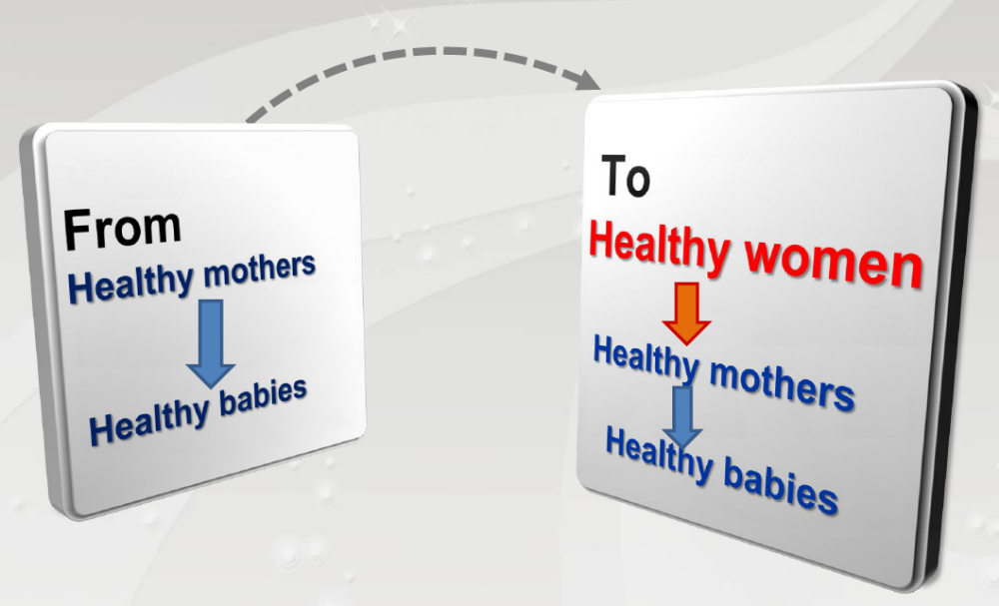
Time for a Paradigm Shift
+ Healthy environment also needed

Slide 7
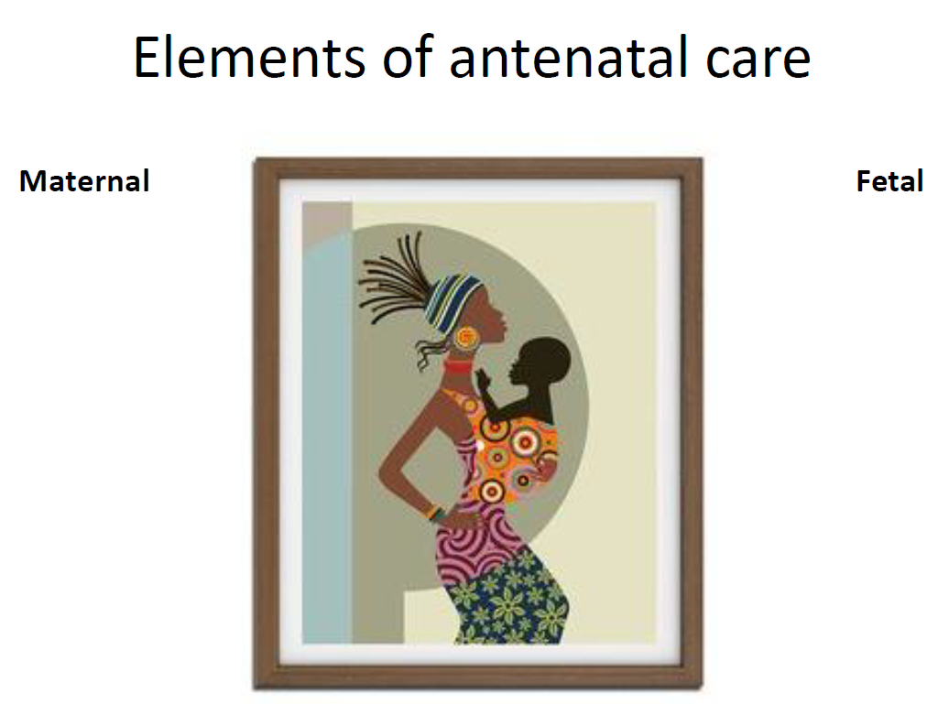
Barker’s Hypothesis
theory of fetal origins of adult disease

Slide 8
Objective of PCC & BANC
To develop a mind-set of Promotive and Preventative management with interventions that aim to identify and modify bio-medical, behavioural and social risks to the women’s & baby’s health – ensure healthy pregnancy
These are in the domain of GP care & have a huge significance on outcomes in both mother & baby
Goals:
Optimise women’s health
Minimise risk to mother & fetus
Improve pregnancy outcome
Give information to make informed choices on reproduction

Slide 9
Why Pre-conceptual care is Vital
Preconception care has a positive effect on a range of health outcomes. Among others, pre-conception care can:
reduce maternal and child mortality
prevent unintended pregnancies
prevent complications during pregnancy and delivery
prevent stillbirths, preterm birth, miscarriages & low-birth weight
prevent birth defects
prevent neonatal infections
prevent underweight and stunting
prevent vertical transmission of HIV/STIs
lower the risk of some forms of childhood cancers
lower the risk of type 2 diabetes, and
Lower risk of some cardiovascular disease esp. PET

Slide 10
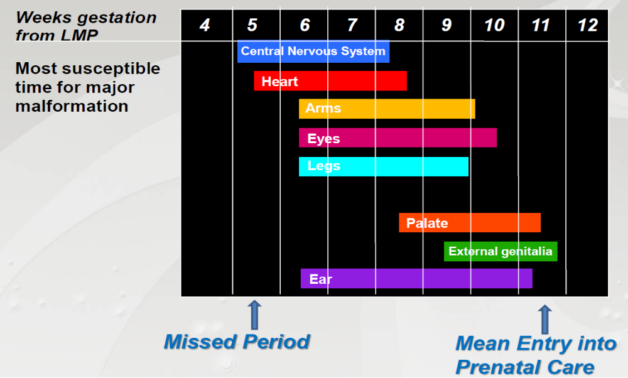
Early ANC is too late!!!
To prevent birth defects
Or to prevent Implantation errors

Slide 11
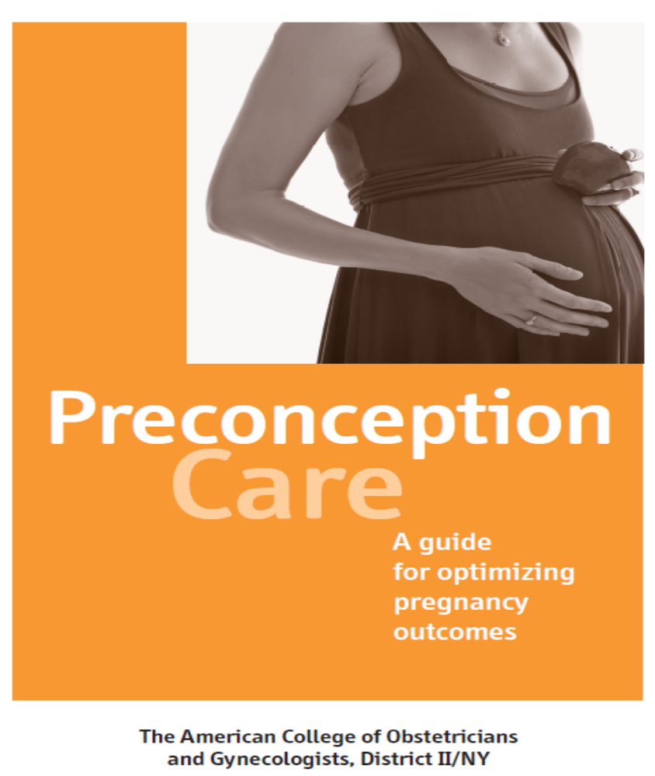
Resource:

Slide 12
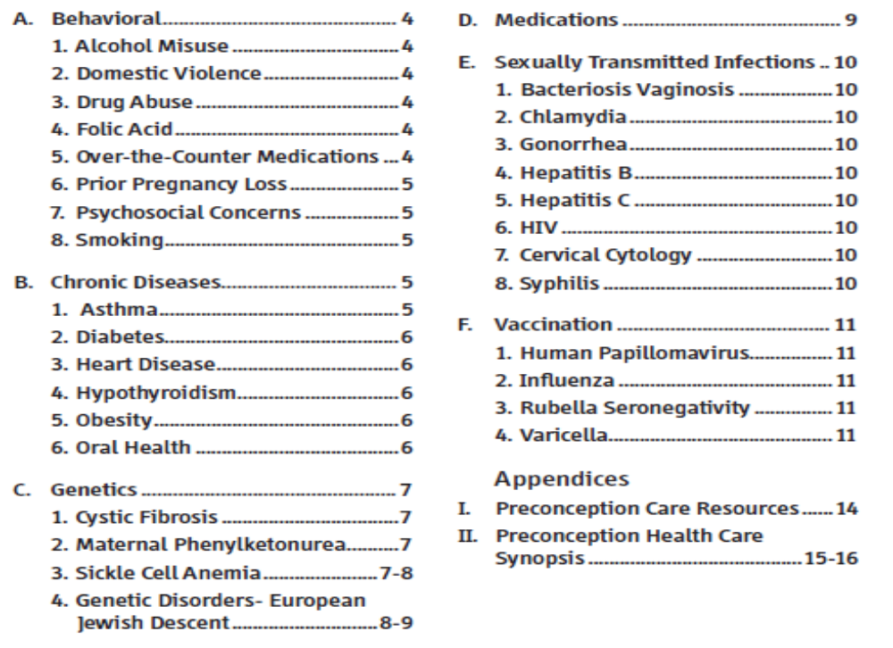
Contents:

Slide 13
As a Family Doctor - History is known to you!!
Maternal conditions:
Hpt
DM
Renal disease
Acute febrile illnesses
Asthma
Epilepsy
Collagen vascular disease
Anti-phospholipid synd
Sickle cell disease
Cervix cone biopsy
Obesity
Smoking & Substance abuse
Incomplete vaccination
HPV & Perineal warts
Chronic Anaemia
Diet fads with Nutritional deficiencies
f/h/o Genetic disorder
Thyroid disorder
Mental illness
Environmental exposure
Teratogenic drugs- Roaccutane
Previous Pregnancy Conditions:
PET
Previous C/S
Isoimmunisation

Slide 14
Cervical Cancer Screening and
HPV Management
Any form of Cervical , Vaginal or Uterine cancer is a C/I for pregnancy and will progress faster if pregnant!
Pre-natal Screening is vital!
Cx Cancer eradication program by Vaccination
No need for initial Pap Smear
Patient can also self test!!
Cervical cancer screening Z12.4
Notes:
Introduce the topic. Emphasize importance of updating practice based on latest WHO and national guidelines.

Slide 15
Screening Guidelines – General Population
99% of Cervical Cancer are caused by persistent HPV infection
HPV DNA testing preferred from age 25
HPV test every 5 years for non-HIV patients
HPV test every 3 years for WLWH
WHO recommends HPV screening be PHC based
Only do Pap Smear if HPV + (Done at same time but request Pap only if HPV+)
Notes:
Emphasize shift to HPV testing for greater accuracy and longer screening intervals.

Slide 16
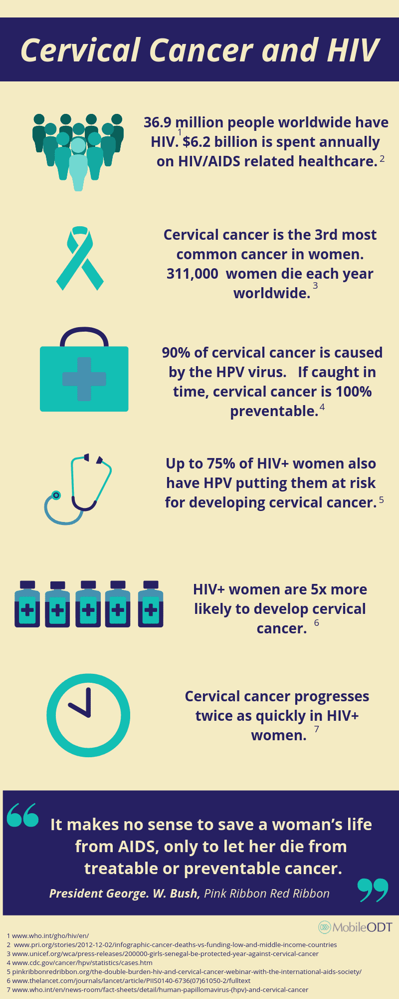
HPV Vaccination
2 doses for adults
0, 1-2 months
3 doses for PLWH
0, 1–2, 6 months
Safe & immunogenic
post-vaccination screening still advised
Notes:
Underscore the importance of completing all 3 doses in immunocompromised populations.

Slide 17
Resources – 7 Webinars
https://youtu.be/vBkPsQZZqqE
https://youtu.be/c0almr2_XEk
https://youtu.be/I5eTCO1IEyE
https://youtu.be/rvfAvBZ10JQ
https://youtu.be/TbXLFCDczdQ
https://youtu.be/K2LPj0qAuvw
https://youtu.be/-J6PgkIrgyc

Slide 18

Tobacco use:
Screening of women at all clinical visits (using 5 ‘A’ method (Ask, Advice, Assess; Assist & Arrange)
Providing brief tobacco cessation advice, pharmacotherapy (including nicotine replacement therapy, if available) and intensive behavioural counselling
Screening of all non-smokers (men &women) and advising about harm of second-hand smoke and harmful effects on pregnant women and unborn children
Smoking-cessation counselling Z71.6

Slide 19
Family Planning & C/I for Preg
Educate on options for Contraception
Avoid unwanted and un-planned pregnancy
Decrease teenage pregnancy
Not to delay 1st pregnancy >35 years.
Encourage planned pregnancies with spacing
Educate about contra-indications to pregnancy
  Severe Nephropathy
  Uncontrolled hypertension with Cardiomyopathy
  Uncontrolled Diabetes & severe Retinopathy
  Active Coronary disease
  Uncontrolled and inadequately treated Hyperthyroidism / Goitre
General contraceptive/family planning counselling and advice Z30.0

Slide 20
Vaccination status
Ensure all pre-pubescent girl immunised for HPV
Check status of all child-bearing age group for
  Measles, Mumps & Rubella Abs (check Rubella Abs & give MMR)
  Varicella Abs
  HPV antibodies (Pap with LBC)
  Hep B
  Tetanus, Diphtheria & Pertussis (give Tdap & it covers all 3)
  Influenza – esp. for HIV, DM and compromised patients
  ?RSV
NB > Infection with Measles; Rubella and Varicella in pregnancy has very high risk for congenital abnormalities
Z71.8 — Vaccination counselling and advice.
Z23–Z27 — When documenting the need for specific immunisations, according to the vaccine.
Z28 — When immunisation is not carried out, with the appropriate subcategory.

Slide 21
Harmful Environment
Smoking
Alcohol
Drugs & substance abuse
Teratogenic drugs
  OTC meds
  Isotretinoin (Roaccutane)
Risky behaviour
STDs & HIV
GBV
Exposure to Environmental hazards:
  Chemical - Toxins and harmful Insecticides
  Physical – GBV ; work environment
  Biological
  Cultural

Slide 22
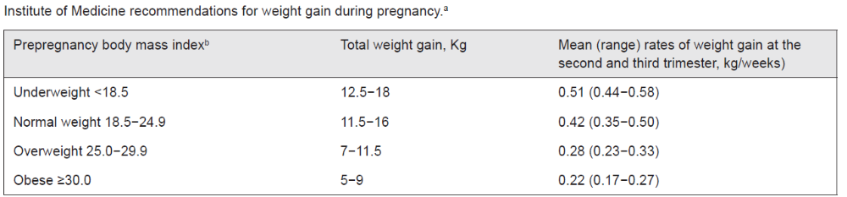
Diet & Nutrition ICD 10 -- Z71.3
Avoid certain foods:
* Under-cooked, Raw & Processed meats * Sugars, Cools drinks, Ice creams etc.
* Raw sprouts * Unhealthy salty snacks * Unwashed fruit & salads (juices)
* Sea-foods high in Mercury * Cheese from un-pasteurized milk (Camembert, Brie)
Alcohol * Caffeine
Raw or undercooked eggs (Salmonella) -
Poached or fried eggs with a runny yolk Lightly scrambled eggs
Salad dressings that contain egg, such as Caesar dressing Tiramisu
Eggnog Hollandaise sauce
Casseroles and other products containing eggs
Restrict Carbs in GDM to 35% of food

Slide 23
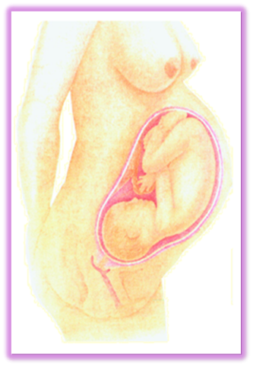
Educate about excessive weight gain in Pregnancy
Baby
Placenta
Amniotic fluid
Uterus
Maternal breast tissue
Maternal blood
Fluids in maternal tissue
Maternal fat and nutrient stores
3.2 – 3.6 kg
0.5 – 0.9 kg
0.9 kg
0.9 kg
0.9 kg
1.8 kg
1.8 kg
3.2 kg
American Pregnancy Association

Slide 24

Encourage Breastfeeding
General Information
Breastfeeding is the GOLD STANDARD for infant feeding
Nutritionally adequate mothers will support the normal growth and development of their infant without any additional foods through the first 4 to 6 months of life
Maternal nutritional requirements are exceedingly high - to support breastfeeding and are among the highest in human development
Nutritional deficiencies may develop during this period and affect both mother and infant

Slide 25

Pre-conceptual care for Men:
Little attention has been given to men’s preconception health and health care
There has been a steady increase in research and programs on men’s health
“ Men as Partners in reproductive health”

Slide 26
Pre-conceptual care for Men: Opportunity
Heath promotion – Family planning – preparing for fatherhood
Disease prevention
Review medical & surgical history that may influence Reproductive health e.g. DM, varicocele, STDs
Genetic assessment based on age & ethnicity e.g. Cystic fibrosis, Klinefelter syndrome, Kartagener syndrome, polycystic kidney disease, etc
Review about social history, potential occupational exposures e.g. metals, solvents, endocrine disruptors, any chemical exposure, pesticides
Behavior modification – alcohol, tobacco. GBV, obesity
Address sexual health problems & infertility

Slide 27
Prevention of
Early-Onset Pre-eclampsia (PE)

Slide 28
Screening for PET in the 1st Trimester
Performed between 11–13+6 weeks gestation
Includes maternal history, mean arterial pressure (MAP), uterine artery Doppler, and PlGF
Risk calculation using combined algorithm (e.g., FMF algorithm)
Identifies high-risk women for early intervention
Ophthalmic Art Doppler

Slide 29
Aspirin Prevents Early-Onset PET
Low-dose aspirin (usually 150 mg at night) started early before 16 weeks (2 x Ecotrin)
Improves placental perfusion by inhibiting thromboxane and enhancing prostacyclin
Reduces incidence of early-onset PET by up to 95% in high-risk women
Safe and cost-effective intervention
Start between 11–14 weeks in high-risk pregnancies
Continue until 36 weeks or if PET sets in before delivery
Recommended by FIGO, NICE, and ACOG for women at high risk
Monitor adherence and side effects
Stop 72h before any planned surgery

Slide 30
Primary PET Prophylaxis (Risk Score)
High Risk (3) Pre-gestational DM Chronic Hpt Thrombocytopenia Chr. Renal Disease Auto-immune Diseases (SLE; APLAS; RA) Assisted Reproduction (OD or Surrogacy) | Moderate Risk (2) Hypothyroidism F/h/o PET Gestational DM BMI >= 35 Multiple pregnancy Previous PET | Low risk (1) Age >35 Age <19 Anaemia <10g% BMI >= 30 Primigravida Mother SGA F/h/o Cardiac disease PCOS Preg interval > 7 years IVF / ICSI Assisted preg MAP >= 85mmHg Dyslipidaemias Weight gain in preg
If score is >/= 3
Start PET Prophylaxis
Aspirin 150mg/d (Ecotrin 2 nocte)

Slide 31
FMF Recommendation / Conclusion:
Preeclampsia is a severe pregnancy complication, with high long-term morbidity for mother and child, and has a high incidence of about 2-5% in South Africa
Prediction & prevention of most early-onset PE is possible today
PE screening should be offered to all pregnant women.
The most efficient method of prediction (screening) is the combined 1st trimester screening algorithm for PE developed by the FMF.
With such screening 75% of all pregnant women at increased risk for preeclampsia can be identified & preterm PE can be prevented in about 2/3 of these women.
Aspirin can help 91% of PE mothers

Slide 32
Pre-existing Disease Management

Slide 33
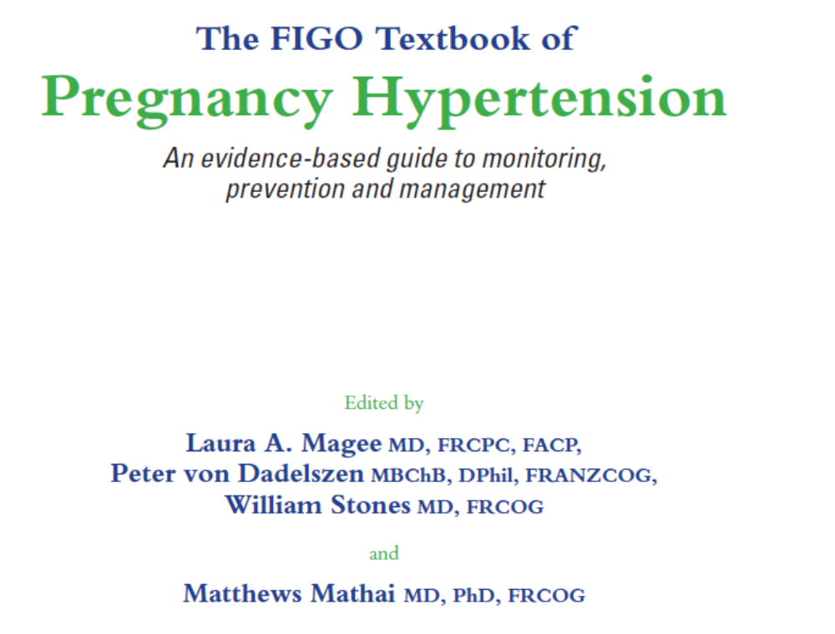
Hypertension
Source:

Slide 34
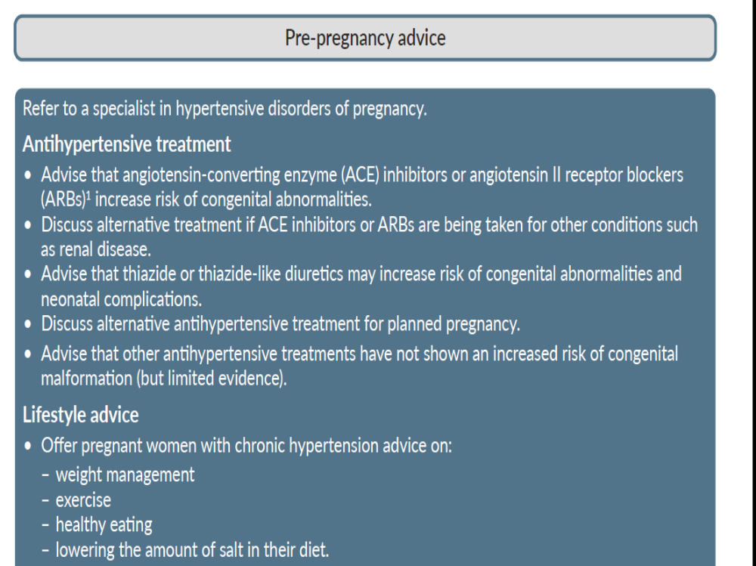

Slide 35
Hpt drugs safe in Pregnancy
Methyldopa
  Most tested 0.5-2g / d in 2-3 divided doses
  Discontinue post partum due to depression
Labetalol
  200-1200 mg/d in 2 divided doses
  Preferred if baseline pulse > 100/mt
  C/I in Asthma, CCF, DM, & Bradycardia
Long acting Nifedipine
  20-120 mg/d of slow release drug in 1-2 divided doses
  S/E Tachycardia, palpitations, headaches, facial flushing
  Never sub-lingual
Hydralazine
  Initial: 10 mg PO q6hr for 2-4 days; may increase gradually
  by 10-25 mg/dose every 2-5 days up to 50 mg PO q6hr
Amlodipine
  5-20 mg/d – Data just out and now also recommended

Slide 36
Drugs C/I in Pregnancy
Ace Inhibitors
  Feto-toxic
  Can be used post-partum - & safe for breast –feeding & Reno-protective
  Risk of miscarriages
ARBs
  Feto-toxic
B-blockers esp. Atenolol
  SGA & IUGR
  Oligo-hydramnios
Diuretics
  SGA & IUGR
  Oligo-hydramnios
  Data now showing that Low Dose HCTZ (<12.5mg/d acceptable)

Slide 37
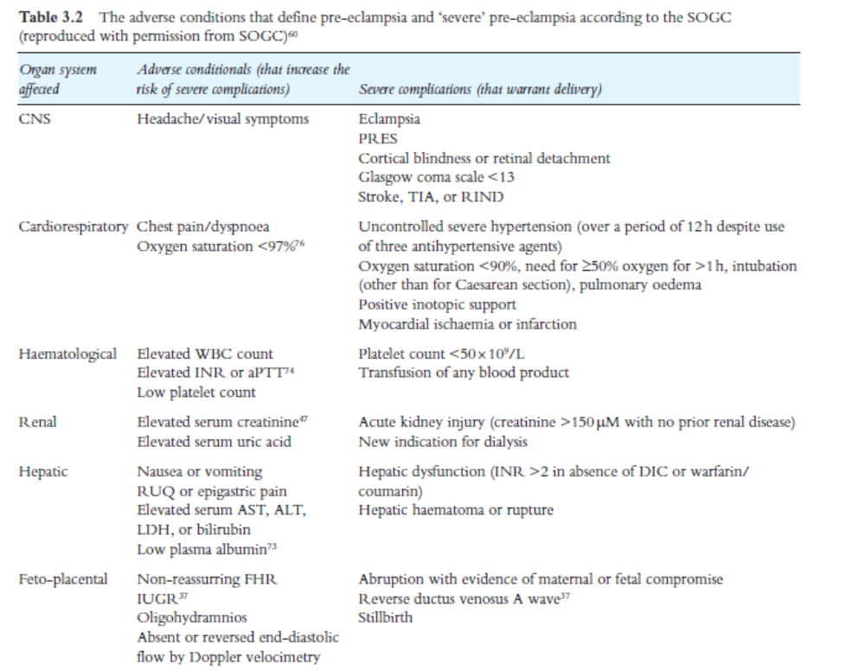
PET & Eclampsia effects:

Slide 38
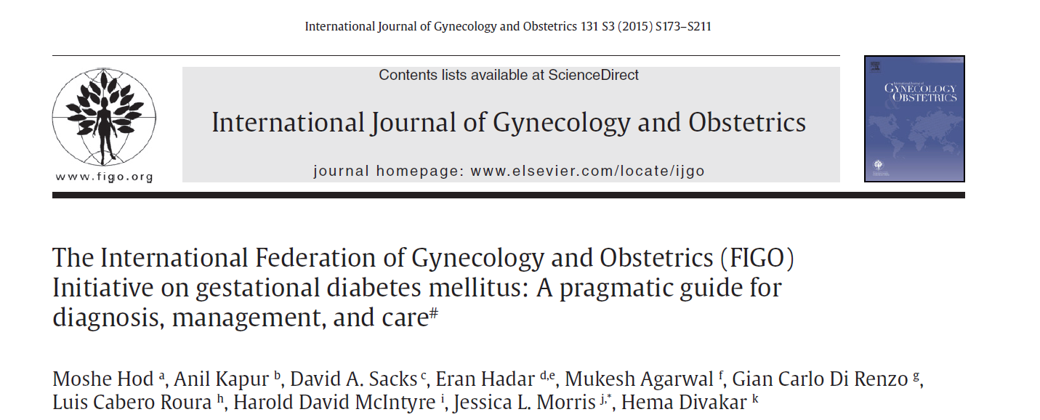
Diabetes:
Resource: FIGO

Slide 39
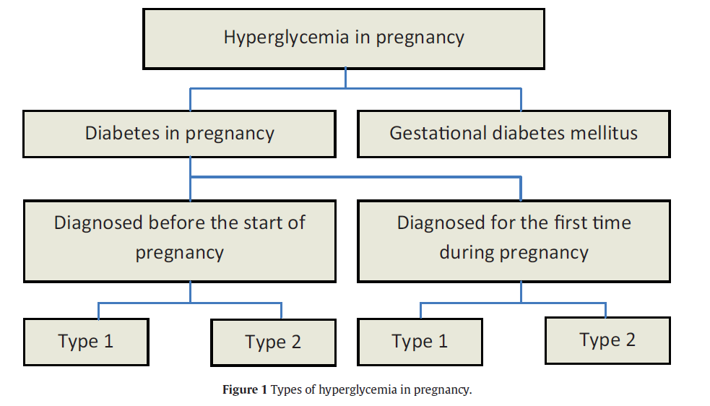
Diabetes:
Increasing prevalence
Need to proactively screen
23% picked up at ANC

Slide 40
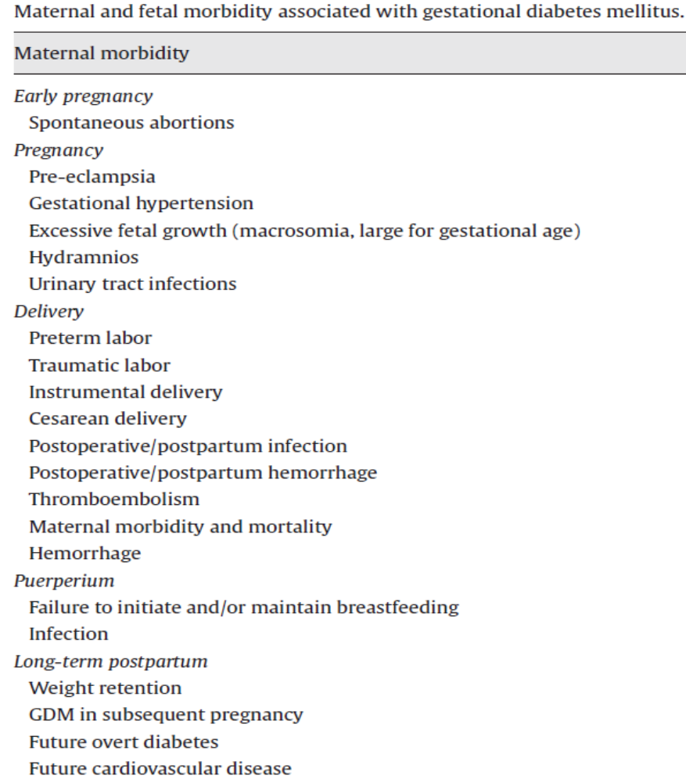
Diabetes Complications : Maternal

Slide 41
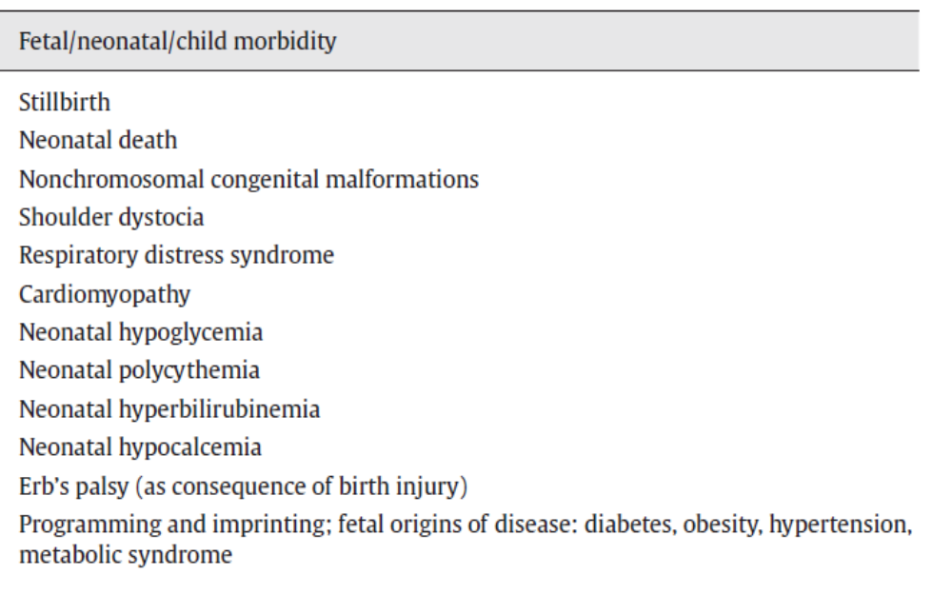
Diabetes – Fetal Complications :

Slide 42
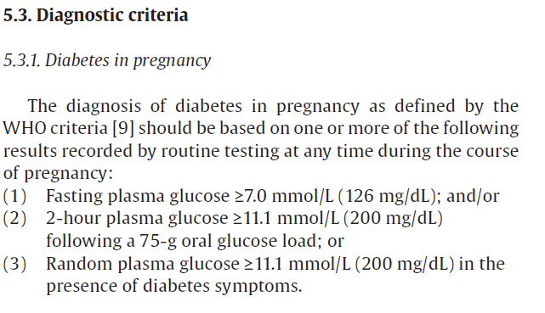
Diabetes :
Screen all mother at 20-22 weeks with 75g glucose and test at 1h and 2h
1h < 7.8 mmol/l
2h < 6.7mmol/l

Slide 43
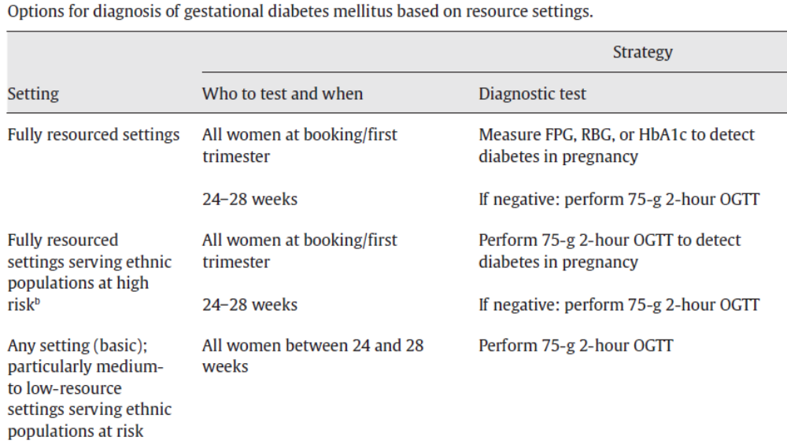
Diabetes Screening :

Slide 44
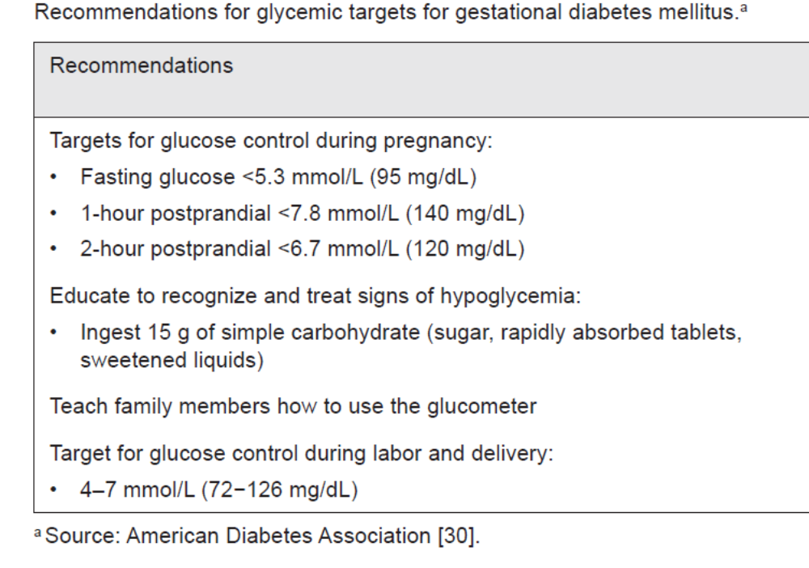
Diabetes :

Slide 45
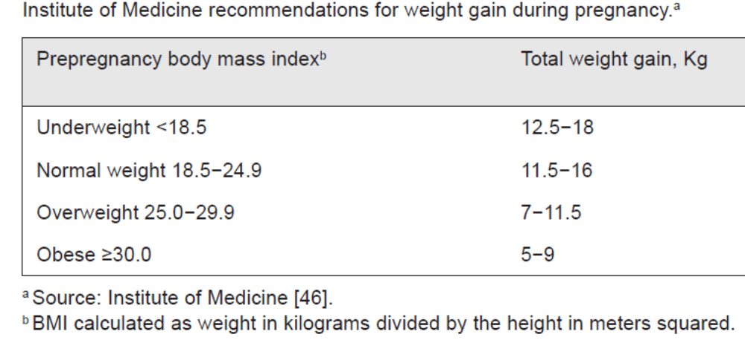
Diabetes :

Slide 46
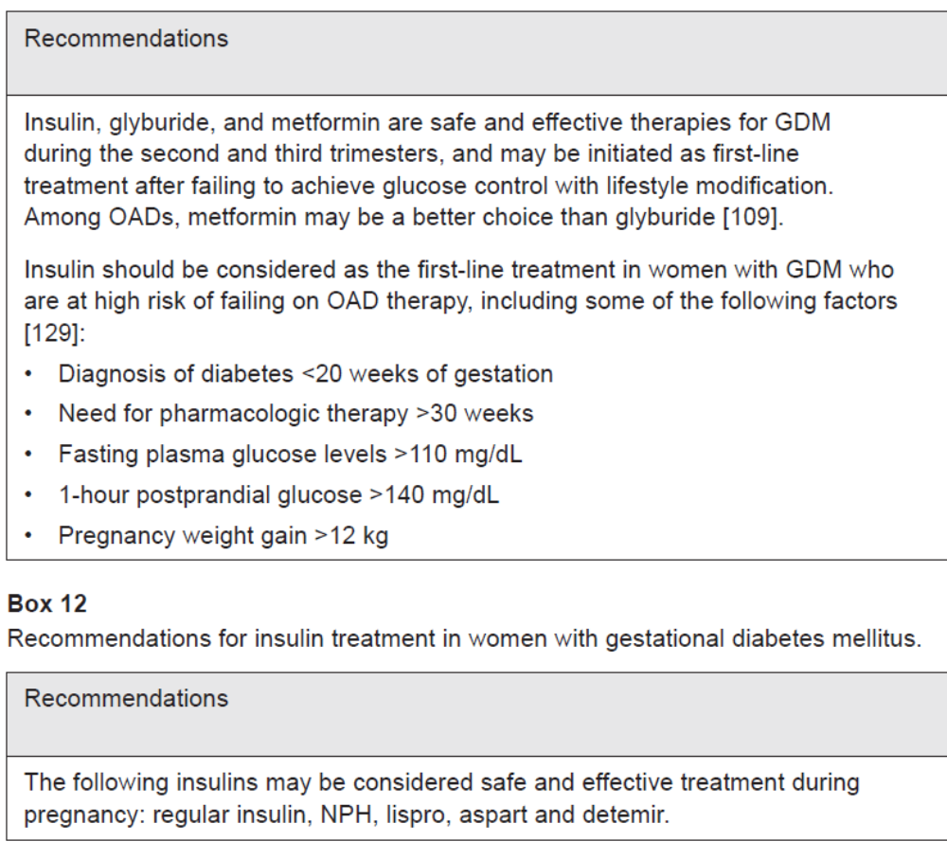
Diabetes: stop all other oral DM Drugs

Slide 47
Anemia Screening & Supplementation
Major problem with >60% pregnant behind on Iron
Start Iron + Folate at least 3/12 before pregnancy
If BMI >30 or Hpt – start Calcium early in pregnancy
Sometimes may need IV Iron booster (Cosmofer)
FBC on all child-bearing women & if <11g% - treat
If alcoholic &/or ↑MCV - Give Vit B12 & Vit BCo
If previous miscarriages / deformities (NTD) – Folate
If DM or Hpt on Diuretics – check electrolytes
If high risk of PET – Start Aspirin 150mg nocte
If Thyroidism – Iodine – even 150ug as routine
Prof Vernon Louw : https://www.youtube.com/watch?v=Ldu-FaOjWSQ

Slide 48
Thyroid screening
All women of child-bearing age should be screened for Thyroid dysfunction
2nd most common endocrine disease
Affects 1% of all women of child-bearing age
Physiological changes during pregnancy
  ↑ BhCG results in ↓ TSH in 1st Trimester – so check T4.
  NB> It returns to normal by 13 weeks
  E2 (from placenta) ↑ Thyroid hormone binding proteins and thus ↑ Thyroid hormone levels (Physiological)
Interaction:
  In 1st 10- 12 wks baby depends on mother for Thyroxine
  After 13 wks – baby produces Thyroxine

Slide 49
Hypo-Thyroidism
Occurs in 2.5% of pregnancies
  Sub-clinical 2-5%
  Most common is Auto-immune in cause – Hashimoto’s
  Negative outcome in pregnancy
In Mother:
  Anemia,
  Myopathy (muscle pains & weakness)
  PET & Placental abnormalities
In Baby:
  Impaired brain development with cognitive & neurological developmental abnormalities
Easily treated with HRT and those on HRT may
need up to 20-30% ↑ in dose
Sub-clinical hypothyroidism is biggest risk for baby & hence, Screening is important

Slide 50
Hyper Thyroidism:
Occur in approximately 0.2% of all pregnancies
• Most common causes
  80~85% : Grave’s disease , 1/1500 pregnant patients
  Transient hyperthyroidism; hyperemesis gravidarum
Maternal and fetal outcome is directly related to the control of hyperthyroidism
Uncontrolled maternal hyperthyroidism
  Fetal tachycardia
  SGA ,Prematurity, stillbirth, Pre-eclampsia
  Possibly congenital malformations
  Extremely high level of TSH - cross the placenta, interact with baby’s thyroid - cause fetal or neonatal hyperthyroidism
Anti-thyroid drug therapy – Methimazole cross the placenta, potentially impair the baby’s thyroid function –
and cause fetal goitre

Slide 51
Hyper Thyroidism:
Treatment of thyroid conditions improves pregnancy outcomes
Overt maternal hyperthyroidism should be treated with antithyroid medication – preferably before pregnancy
Methi / Neomercazole has been associated with fetal developmental abnormalities
  If a women is currently on methimazole, she should be converted to PTU prior to pregnancy
PTU (Propylthiouracil) is the drug of choice in pregnancy
Radioactive iodine treatment:
  Customary to avoid pregnancy for the first 6 months after Rx
  Contraindicated to treat hyperthyroidism during pregnancy
    If given after 12 weeks of GA -Crosses the placenta - Increased risk of fetal thyroid destruction - Permanent hypothyroidism in baby

Slide 52
Asthma Therapeutic Mx
Many bio-physiological changes occur in pregnancy
Baby is dependant on oxygen from mother’s blood
Hence, need to control Asthma carefully & optimally
Fallacy that Inhaled steroids will harm baby and some mother (& doctors) ↓ “Controller” steroids – which are safe in pregnancy – avoids acute oral steroids use
FMF - algorithm that adjusted inhaled corticosteroids (ICS) according to F_{eNO} (Nitric Oxide fraction) and added long-acting β-agonists when symptoms remained uncontrolled resulted in fewer exacerbations, more women on ICS but at lower mean doses, and improved infant respiratory health. It also needed less use of the “reliever”
Avoid oral steroids use
Control the “triggers” more strictly

Slide 53
Drug substitution in Pregnancy
Many drugs are unsafe in pregnancy and need to be substituted or stopped early:
Warfarin to LMW Heparin * Hpt – ACE inhibitors & ARBs
Statins
Arthritis- Immune modulators & NSAIDs
Migraine – Migranal
Endometriosis - Danazol
Methotrexate
NSAIDs & Arthrotec – which has Misoprostol
Isotretinoin / Roaccutane
Tetracyclines and many other antibiotics
Epilepsy – Sod Valproate
Anti-depressants
Sleep medications
OTC drugs with anti-histamines & ephedrine etc

Slide 54
Mental Health Awareness:
Many patients on anti-depressants & sleeping pills – may need substitution or weaning off
Substance abuse & its abrupt cessation in pregnancy needs to be monitored – even smoking – an precipitate acute psychosis
Unless probed for – many psycho-social and mental disorders are over-looked
Post-partum depression is common

Slide 55
DEVELOPMENTAL ORIGINS OF HEALTH AND DISEASE
NB> Prevention may begin before pregnancy
---with GP
Maternal obesity
Diabetes
Hypertension
Smoking / alcohol
Nutrition
Placental dysfunction
Prematurity / FGR
ALTERED DEVELOPMENTAL TRAJECTORY
Cardiometabolic • renal • neurodevelopmental risk
The first cardiovascular prevention consultation may occur before the patient is born
Pregnancy gives an opportunity to manage 2 generations!!!
WHO. Framework to implement a life course approach in practice. 2025. who.int/publications/i/item/9789240112575
Notes:
[object Object]

Slide 56
POSTNATAL CARE: THE PREGNANCY DOES NOT END AT DELIVERY
Pregnancy reveals future risk. The GP must convert obstetric history into lifelong prevention.
PREGNANCY
STRESS TEST
OBSTETRIC
PHENOTYPE
POSTPARTUM
RISK HANDOVER
LIFELONG
PREVENTION
• The discharge summary should record GDM, PET/eclampsia, preterm birth, FGR/SGA, macrosomia, placental disease and major neonatal complications.
• These are not merely historical obstetric diagnoses — these are future cardiometabolic and developmental risk markers.
ACOG: adverse pregnancy outcomes predict later ASCVD; SA NDoH Integrated Maternal & Perinatal Care Guideline, 2024.

Slide 57
THE FIRST 12 WEEKS: POSTPARTUM CARE IS A PROCESS, NOT A SINGLE VISIT
1
2
3
4
5
≤72 h
3–10 d
≤3 wk
4–12 wk
Ongoing
Severe hypertension
or clinical concern
BP review after
hypertensive pregnancy
Early maternal
postpartum contact
Comprehensive review
+ GDM 75-g OGTT
Risk-based primary
care & contraception
At every contact:
bleeding/sepsis/VTE symptoms • BP • wound/perineum • breastfeeding • mood • sleep • medication • contraception • social safety.
ACOG Optimizing Postpartum Care; SA NDoH Integrated Maternal & Perinatal Care Guideline (2024), Chapter 22.

Slide 58
GESTATIONAL DIABETES: DELIVERY IS NOT THE END OF THE DIAGNOSIS
4–12 WEEKS
IF NORMAL
IF PREDIABETES
75-g oral glucose tolerance test using non-pregnancy criteria.
Prefer OGTT to HbA1c in the early postpartum period.
Lifelong screening for prediabetes/type 2 diabetes every 1–3 years.
Reassess weight, BP, lipids, lifestyle and future pregnancy plans.
Intensive lifestyle intervention; consider metformin when appropriate.
Breastfeeding should be supported; discuss contraception and preconception testing before the next pregnancy.
• GP message: every woman with previous GDM remains a metabolic-risk patient even when glucose normalises after delivery.
ADA Standards of Care in Diabetes—2026: postpartum OGTT 4–12 weeks; lifelong screening every 1–3 years.

Slide 59
PET / ECLAMPSIA: A CARDIOVASCULAR RISK MARKER FOR LIFE
WHAT PREGNANCY REVEALED
EARLY POSTPARTUM
LONG-TERM GP PLAN
Hypertensive disorders of pregnancy identify women with increased later cardiometabolic and ASCVD risk.
Risk is especially important after severe or recurrent disease, preterm PET, FGR or associated metabolic disease.
BP surveillance early after discharge.
Review antihypertensive therapy and breastfeeding compatibility.
Check renal recovery/proteinuria when clinically indicated.
Educate about headache, visual symptoms, dyspnoea, chest pain and neurological symptoms.
Do not delete PET/eclampsia from the problem list.
Regular BP and global cardiovascular-risk assessment.
Weight, glucose/HbA1c, lipids, smoking, exercise and renal risk.
Counsel before subsequent pregnancy.
ACOG: pregnancy is a natural cardiovascular ‘stress test’; hypertensive disorders are associated with higher lifetime ASCVD risk.

Slide 60
THE OBSTETRIC HISTORY BECOMES A PRIMARY-CARE RISK STRATIFIER
Pregnancy history
Mother: future surveillance
Child: what the GP should remember
GDM / diabetes
OGTT 4–12 wk; diabetes screen q1–3 y; weight/BP/lipids
Growth trajectory; obesity/metabolic risk; healthy family diet/activity
PET / eclampsia / gestational HTN
BP; ASCVD risk; metabolic/renal risk; recurrence counselling
Prematurity/FGR consequences where present; BP/metabolic risk over life course
Preterm birth
Maternal cardiometabolic risk assessment; recurrence factors
Growth, neurodevelopment, vision/hearing, respiratory and school performance
FGR / SGA / placental disease
BP/metabolic/vascular risk factors; recurrence planning
Catch-up growth without excessive adiposity; development; later cardiometabolic risk
LGA / macrosomia
Screen maternal dysglycaemia/metabolic risk
Monitor growth/BMI trajectory; family metabolic prevention
Perinatal depression / trauma
Mood, suicidality, sleep, bonding, treatment continuity
Attachment, development, family environment and safeguarding
Life-course synthesis for GP practice. Specific surveillance should be individualised to gestation, severity, neonatal course and local guidelines.

Slide 61
THE BABY: POSTNATAL CARE STARTS WITH THE BIRTH STORY
Poor feeding
Lethargy
Fever/hypothermia
Increasing jaundice
Respiratory distress/cyanosis
Seizures/abnormal movements
Dehydration
Failure to gain weight
Caregiver concern
1. KNOW THE EXPOSURES
2. CHECK THE BASICS
3. SAFETY-NET
Gestation at birth
Birthweight & centile
FGR/SGA or LGA
Maternal Risk – Diabetes / PET
Infection / HIV exposure
Drugs / alcohol / tobacco
NICU course & hypoglycaemia
Congenital anomaly / birth trauma
Feeding & breastfeeding
Weight and growth trajectory
Jaundice
Hydration
Cord/skin
Respiratory status
Newborn screening as locally indicated
Immunisation
Maternal–infant bonding
SA NDoH Integrated Maternal & Perinatal Care Guideline (2024): routine and complicated postnatal care.

Slide 62
THE HIGH-RISK BABY: FOLLOW THE DEVELOPMENTAL TRAJECTORY
PRETERM / FGR
growth • nutrition • neurodevelopment
DIABETIC PREGNANCY
growth • adiposity • metabolic trajectory
PET / PLACENTAL DISEASE
growth • prematurity sequelae • later BP risk
NICU / NEONATAL INSULT
hearing • vision • motor • cognition • feeding
The aim is not to label the child as ‘diseased’ — it is to recognise a higher-risk trajectory early enough to modify nutrition, activity, growth and plan & give developmental support.
Developmental Origins of Health and Disease: obstetric and neonatal phenotypes can signal later cardiometabolic and neurodevelopmental vulnerability.

Slide 63
DON'T MISS THE MOTHER WHILE EXAMINING THE BABY
Mental health
Breastfeeding & nutrition
Screen for postnatal depression/anxiety; ask directly about self-harm, psychosis, bonding and support.
Lactation support; anaemia/nutritional recovery; medication compatibility.
Contraception
Pelvic & sexual health
Offer an effective plan before fertility returns; align with future pregnancy intentions.
Perineal/C-section recovery, pain, dyspareunia, incontinence and pelvic-floor dysfunction.
Chronic disease
Social safety
Restart/adjust long-term therapy; BP, diabetes, thyroid, epilepsy, renal disease, asthma.
GBV, substance use, housing/food insecurity, partner/family support and ability to rest.
SA NDoH postnatal guidance includes infant feeding, nutrition, contraception, HIV and postnatal mental health.

Slide 64
A PRACTICAL GP ‘POST-PREGNANCY HEALTH PLAN’
RECORD
Obstetric phenotype
in problem list
REVIEW
Mother + baby
within risk window
RECLASSIFY
Convert GDM/PET/
preterm/FGR into risk
REDUCE RISK
BP • glucose • lipids
weight • smoking • activity
RECALL
Create long-term
screening reminders
• Make the pregnancy history visible in the GP record — not buried in an old obstetric discharge letter.
• At each future preventive visit ask: What did pregnancy reveal about this woman's cardiovascular, metabolic and reproductive risk?
Primary-care implementation framework based on ACOG postpartum/ASCVD guidance, ADA diabetes standards and SA NDoH postnatal guidance.

Slide 65
TAKE-HOME MSG:- PREGNANCY IS A TWO-PATIENT STRESS TEST
THE MOTHER
THE CHILD
GDM → lifelong diabetes risk surveillance
PET/eclampsia → lifelong cardiovascular-risk awareness
Preterm/placental disease → cardiometabolic signal
Postpartum mental, reproductive and chronic-disease care must continue.
Prematurity/FGR/LGA and maternal metabolic disease -
identifyies children who may need closer growth and developmental surveillance.
Promote breastfeeding, healthy nutrition, activity, immunisation, safety and a supportive family environment from the start.
The GP closes the loop:
PRECONCEPTION → PREGNANCY → POSTPARTUM → LIFELONG HEALTH
Core message: adverse pregnancy outcomes are opportunities for prevention, not diagnoses that expire after delivery.

Slide 66
Miscarriages: Prevention & Management
Pre-pregnancy: - Investigate all mothers with h/o miscarriages to try & find cause
  Request POC histopath & karyo-typing
  TORCH screen
  Anti-phospholipid syndrome
  Iso-immunisation
  Infections – e.g. Toxoplasmosis and cats
Educate all child-bearing age women on Risk factors
If mother has h/o miscarriage, spotting, break-through bleeding, precious baby – consider early Progesterone (Cyclogest) -- Refer early (phone & make a plan)
If inevitable or incomplete abortion – do blood Rhesus grouping to prevent Iso-immunisation
If h/o Cone Biopsy – early Cervical encirclage

Slide 67
Reminder!
PET Prophylaxis post Screening
Aspirin 150mg/d (Ecotrin 2 nocte)
91% effective to prevent and help with
Early onset PET
And
Preparing and arranging for a
1st Trimester Screen

Slide 68
Summary & Discussion
Pre & Post-natal care = foundation of continuum
GPs are gatekeepers of maternal health
Recognize normal vs abnormal early symptoms
Act fast on red flags
“Early detection saves two lives.”

Slide 69


Slide 70
ICD10 Codes
Overall wellness/health-risk assessment | Z00.0 | General medical examination
Diabetes screening | Z13.1 | Screening for diabetes in someone without established diabetes
Metabolic assessment, including lipid disorders | Z13.8 | Screening for specified metabolic disorders
Endocrine assessment, including thyroid disorders | Z13.8 | Screening for specified endocrine disorders; excludes diabetes
Nutrition and deficiency screening | Z13.2 | Screening for nutritional disorders
Cardiovascular risk assessment | Z13.6 | Screening for cardiovascular disorders
Blood disorders/anaemia and certain immune disorders | Z13.0 | Screening for blood and specified immune disorders
Mental health assessment | Z13.3 | Screening for mental and behavioural disorders
Vision and hearing screening | Z13.5 | Screening for eye and ear disorders
Sleep-disorder screening | Z13.8 | Screening for a specified sleep disorder
Other specified disease screening | Z13.8 | Where no more specific screening category applies
Unspecified screening | Z13.9 | Only when the screening target is unspecified

